Slide 1
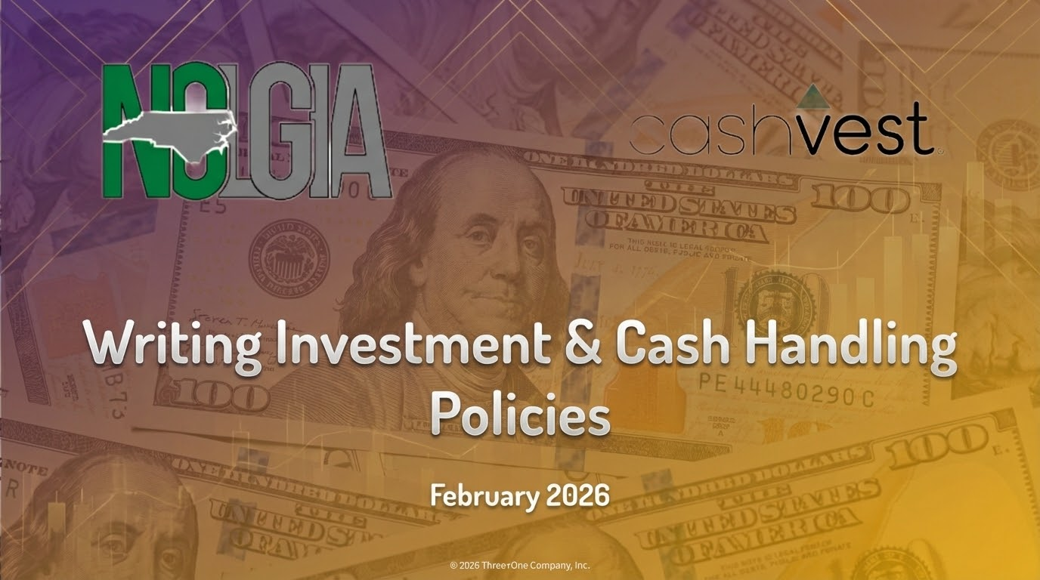

Slide 2


Slide 3


Why are cash handling/investment policies important in practice?
Case Studies
City of Dunkirk, NY
City of Somersworth, NH

Slide 4

What this can mean for your entity
Lean on the LGC
Take advantage of the guidance by the LGC - many states don’t have this kind of resource
“Breaking the Buck”
Florida LGIP Freeze
Use your peers as a resource
Audit Reports posted by the LGC show what auditors look for
Policy = Protection

Slide 5


Slide 6
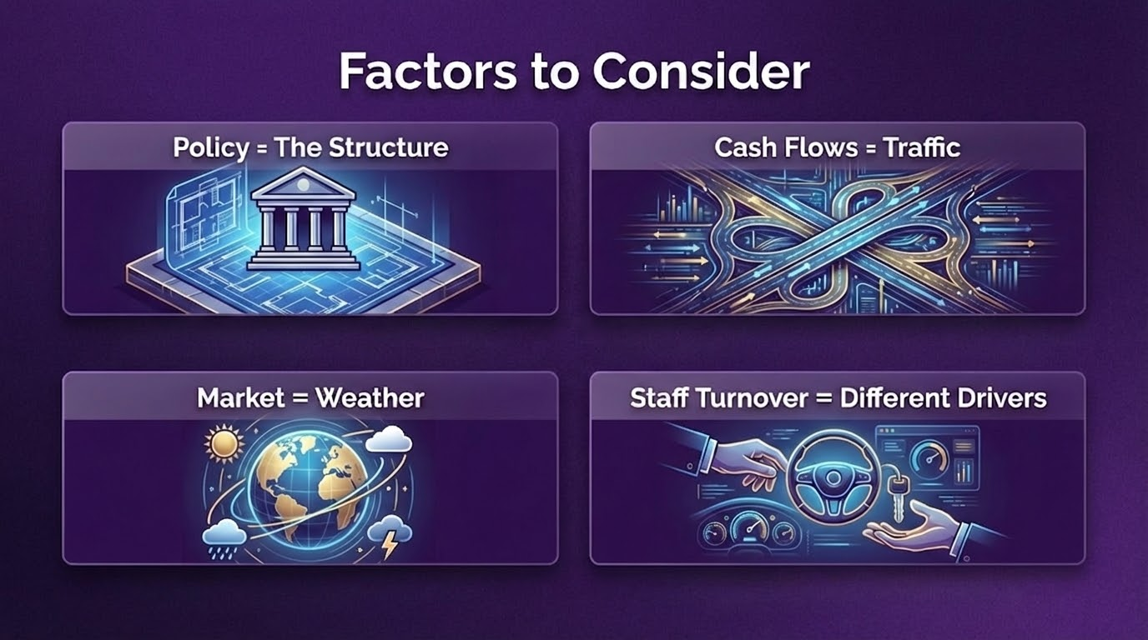

Slide 7
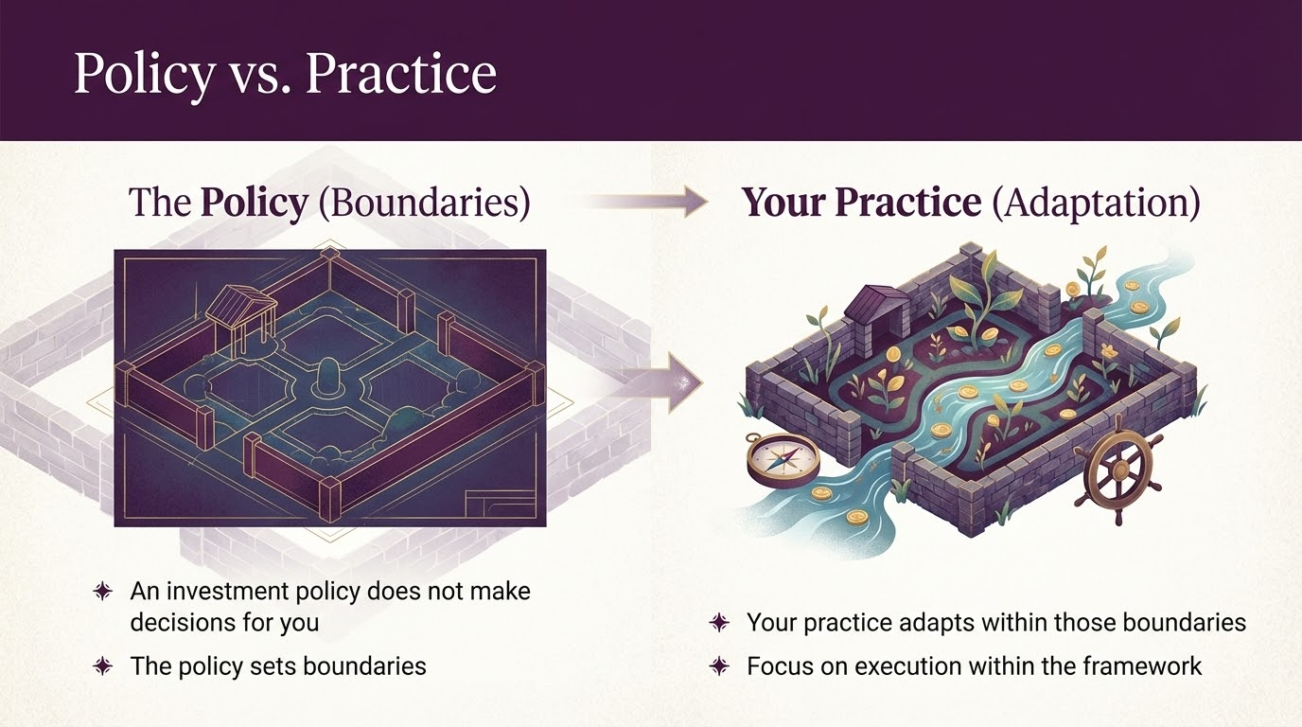

Slide 8
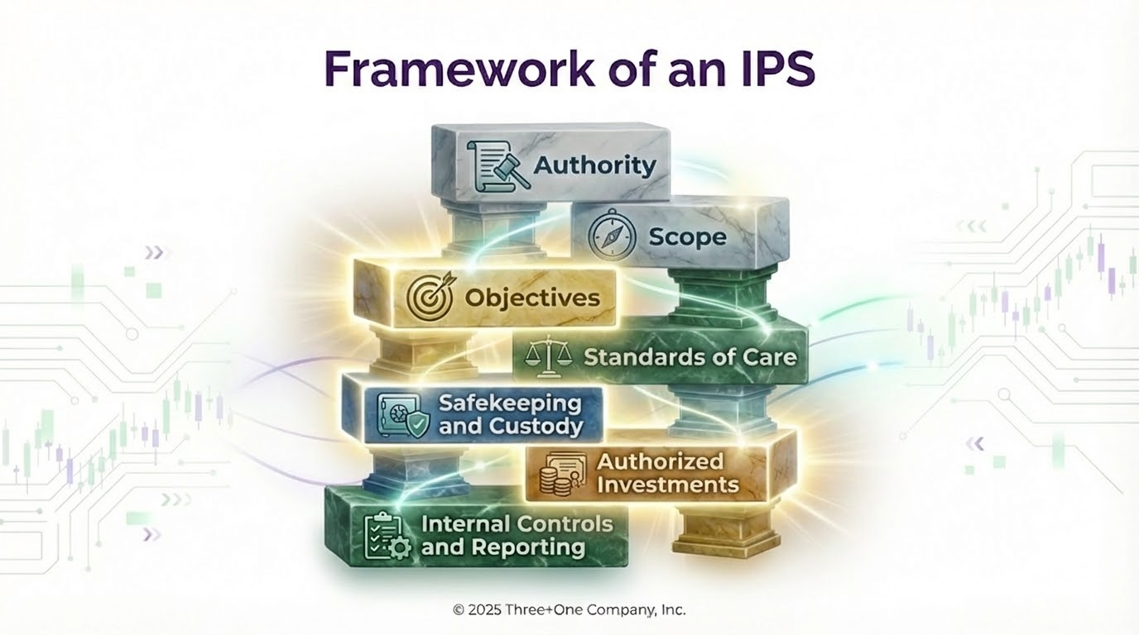

Slide 9


Slide 10
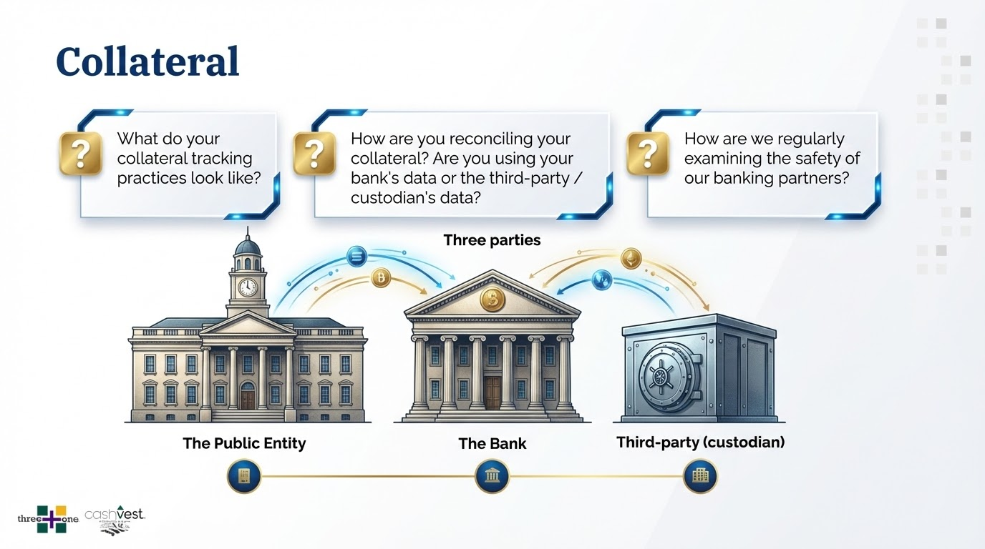

Slide 11
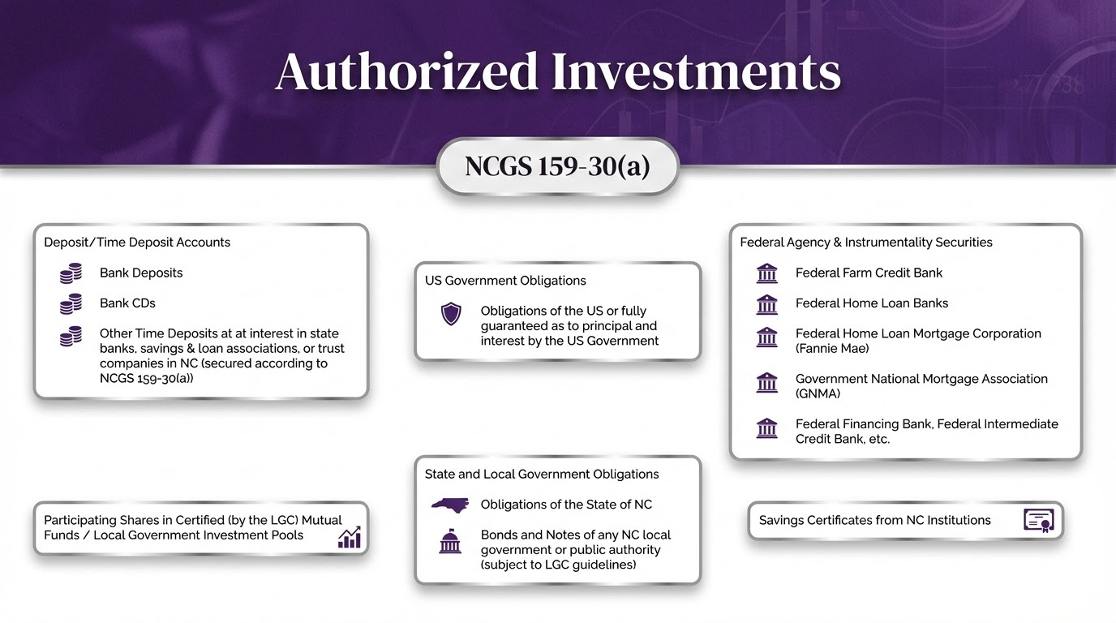

Slide 12
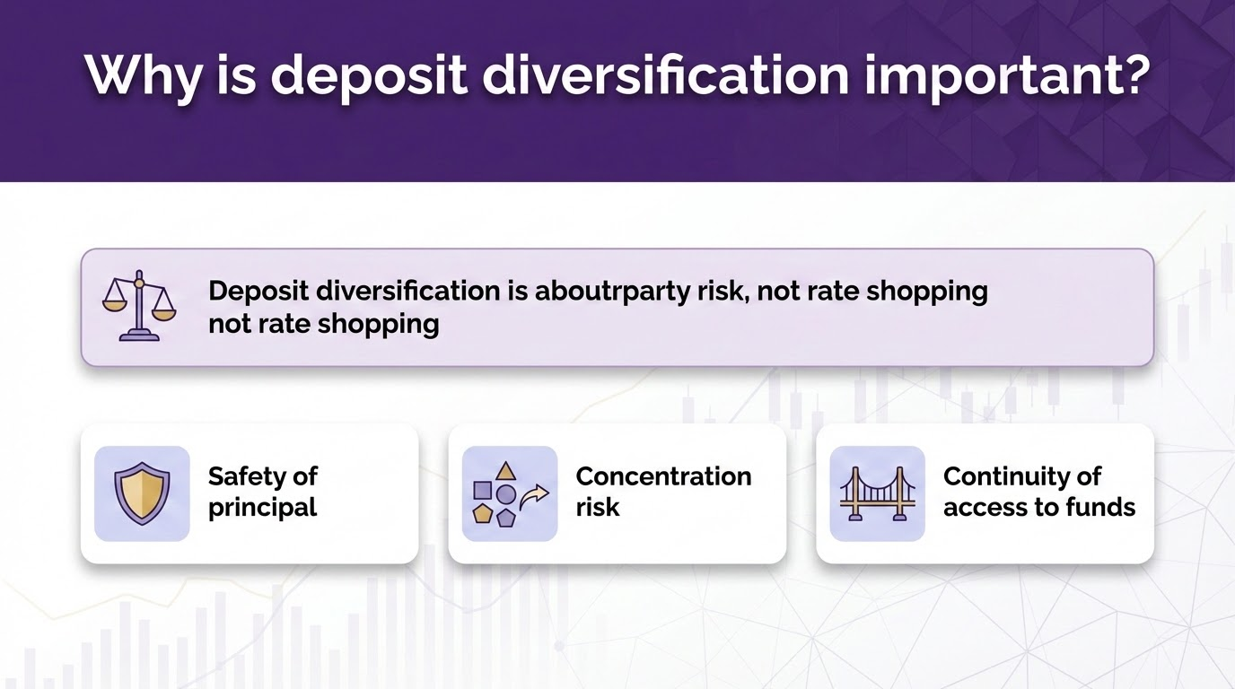

Slide 13
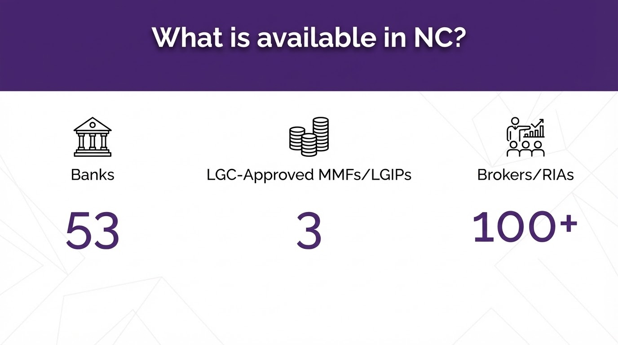

Slide 14
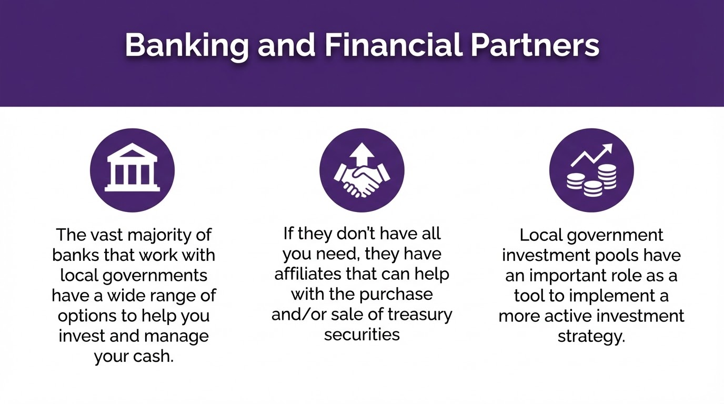

Slide 15
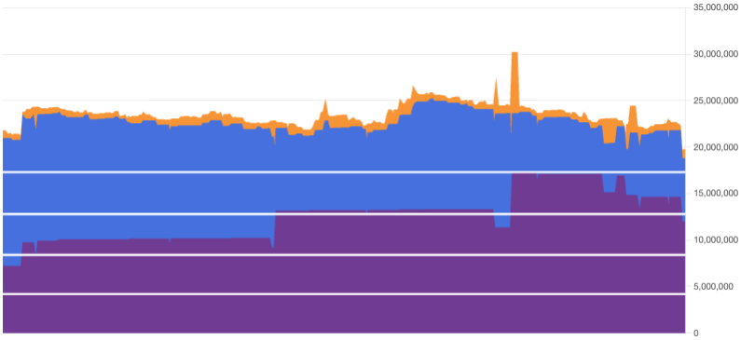
Diversification by investment type

Slide 16
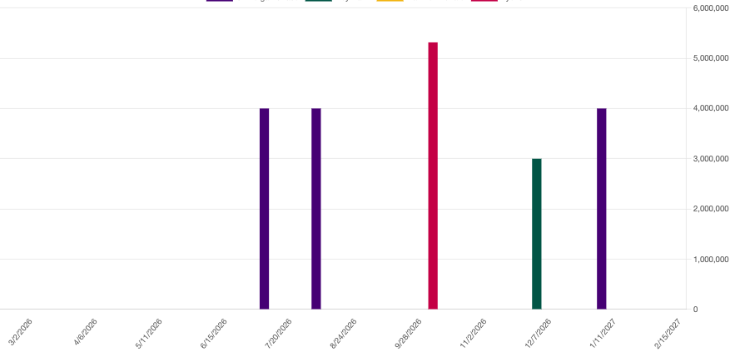
Diversification by maturity

Slide 17
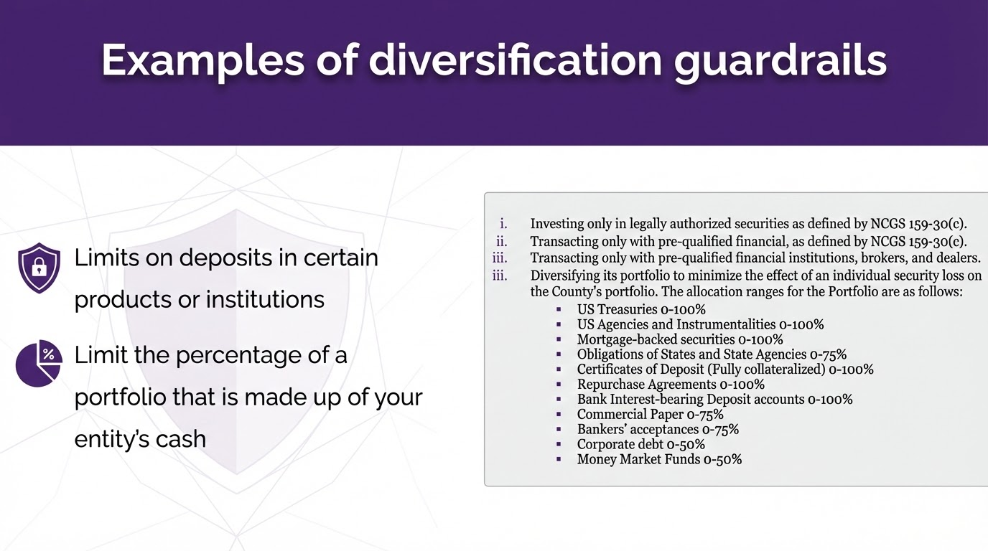

Slide 18
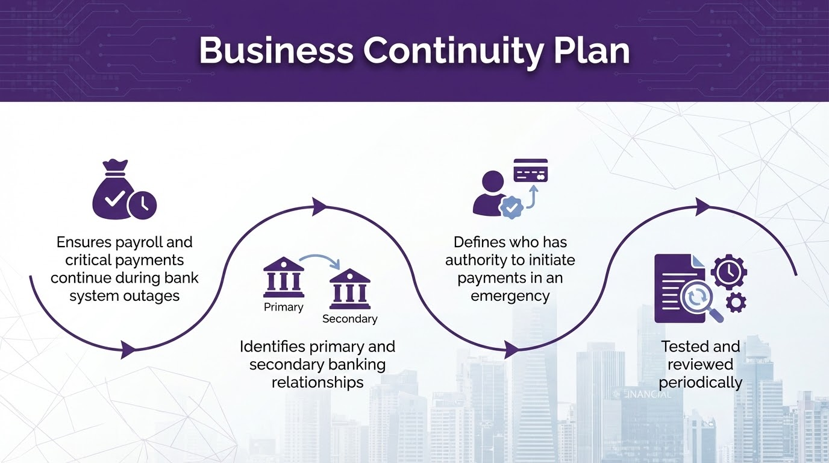

Slide 19

Resources
GFOA Sample Investment Policy
GFOA Investment Policy Guidance
GFOA Cash Handling Best Practices
AFP Resources
UNC School of Government Resources
LGC Resources
Ask Your Peers

Slide 20



Mike Abbott
Relationship Specialist
mja@threeplusone.us
(585) 484-0311 x718

