Slide 1


Updating your Investment Policy
Presented by: Richard G. Long, Jr.

Slide 2

Purpose of an Investment Policy
Ensure compliance with NC General Statute 159-30
Finance officer shall manage subject to restrictions and directions imposed by your governing board
Big picture - address:
  Investment objectives
  Strategies
  Responsibilities
  Authorized investments
  Risk Tolerance
2

Slide 3

GFOA Recommendations
Scope and investment objectives
Roles, responsibilities and standard of care
Suitable and authorized investments
Investment diversification
Safekeeping, custody and internal controls
Authorized financial institutions and broker/dealers
Risk and performance standards
Reporting and disclosure standards

Slide 4
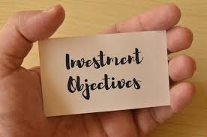
Scope and Investment Objectives
All ACFR Funds
Safety
Liquidity
Yield
“Not for Speculation”

Slide 5

Roles, Responsibilities & Standard of Care
Finance Officer = Investment Officer
  More than one
Investment Committee?
Managing Funds as per Investment Policy
Prudent Person Standard

Slide 6
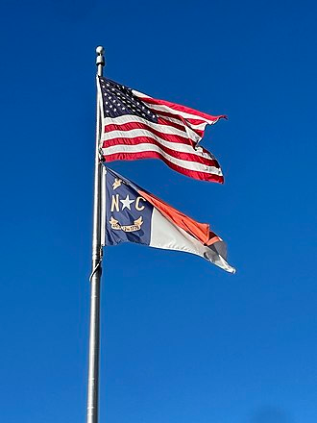
Suitable & Authorized Investments = “Classes of Securities”
Obligations of and guaranteed by US
Agencies and Instrumentalities:
  Federal Financing Bank
  Federal Farm Credit Bank
  Bank for Cooperatives
  Federal Intermediate Credit Bank
  Federal Land Banks
  Federal Home Loan Banks
  Federal Home Loan Mortgage Corporation
  Federal National Mortgage Association
  Government National Mortgage Association
  Federal Housing Administration
  Farmers Home Administration
  United States Postal Service
State of North Carolina

Slide 7
“Classes of Securities” (con’t)
North Carolina local government or public authority
S&L savings certificate (insured or collateralized)
Prime Commercial Paper
Bills of exchange or time drafts
Mutual fund shares (certified by LGC)

Slide 8
“Classes of Securities” (con’t.)
Comingled investment pool – State Treasurer
Comingled investment pool – interlocal agreement
Future interest and principal of US
Repurchase Agreements
Tax-exempt funds:
  Tax-exempt mutual fund
  Taxable mutual fund w/rebate calculation

Slide 9

Investment Diversification
Issuer Risk
Market Value Volatility
Cash Flow Uncertainty
Arbitrage Consequences
Fund-type Strategy

Slide 10
Safekeeping, Custody & Internal Controls
Independent Safekeeping Agent and Collateral Custodian
Delivery Versus Payment (DVP)
Standard Controls
  Clear Delegation of Authority
  Avoidance of Collusion
  Separation of Duties
  Dual Authorization

Slide 11
Authorized Financial Institutions & Broker/Dealers
Financial Institutions = State/LGC Approved
Broker/Dealers
  Establish Criteria
  Competitive Environment
  Approve Firms
  Review Performance

Slide 12

Risk and Performance Standards
Classes of Securities set Issuer Risk
Fund-type Strategies set Market Risk
  Maximum Maturity
  Maximum Weighted Average Maturity
  FYE Fair Valuation (GASB 31 & 72)
Performance Standards
  Total Return
  Weighted Average Yield to Maturity
  Formula Index versus Default Investment Option

Slide 13

Reporting & Disclosure Standards
Report Frequency & Scope
  Internal
  Governing Body
ACFR
Rating Agencies
Arbitrage Calculation Agent
LGC

Slide 14

Useful Websites
www.gfoa.org
www.bigcharts.com
www.ustreasuryyieldcurve.com
https://fred.stlouisfed.org/categories
www.bloomberg.com/markets/rates-bonds/government-bonds/us
www.federalreserve.gov/releases/H15
TMUBMUSD02Y | U.S. 2 Year Treasury Note Historical Prices - WSJ

Slide 15


Questions?
Thank you
Richard G. Long, Jr.
rglong@valleyviewconsultingllc.com

