Slide 1
Local Government Credit Ratings
North Carolina Local Government Investment Association

Slide 2



Rating Agencies
There are three “major” rating agencies:
Moody’s Investors Service
S&P Global Ratings
Fitch Ratings
There are other agencies that have tried to break into the market, but they have not gained much traction in this region.

Slide 3
What is a Rating?
Forward looking of the relative risk of financial obligations
The security is rated ‘through the economic cycle’ or through a long-term focus.
Ratings are assigned to specific securities (General Obligation, Limited Obligation, Water and Sewer, etc.).
The rating reflects the expectation of a default/nonpayment, a concept that incorporates both default probability and the likely financial recovery after default.

Slide 4
Rating Scale

Slide 5
What are the Key Drivers to a Tax- Supported Credit Rating?
1st Economic Base – Foundation of an Entity’s Fiscal Health.
    Incorporation of Local, Regional and National Economic Factors.
    Demographic Characteristics including Population Trends, Employment and Wealth Levels.
    Tax Base – Size, Structure and Diversity.
    Industry Mix and Composition of Employment Base.
    Local and Regional Patterns of Growth.
2nd Financial Performance and Flexibility.
    Revenue and Expenditure Structure and Patterns.
    Annual Operating and Budgetary Performance.
    Financial Leverage and Fund Balance Position.
    Budgeting and Long-term Financial Planning.
    Pension Funding and Insurance Risk.
    3rd Debt Factors.
    Nature of Pledged Security, Debt Structure.
    Balance between Accelerated Debt Issuance and Under-investment in Capital Facilities.
    Debt Burden Measured Against:
      Tax Base; and,
      Total Budget.
    4th Management Factors.
    Range and Growth of Services Provided in Relation to Capacity to Provide Services.
    Financial Forecasting and Management.
    Consistent and Prudent Budgeting Practices.
    Adherence to Long-Range Financial Planning and Financial Policies.
Economy
Finances
Long-Term Liabilities
Management

Slide 6
Credit Quality of North Carolina Local Governments
Moody’s Ratings of Counties
Moody’s Ratings of Cities/Towns

Slide 7
The Benefit of a Higher Credit Rating
Average Spread June 2003 – September 2008: | 0.28%
Average Spread September 2008 – Present: | 0.59%
Current Spread: | 0.44%

Slide 8
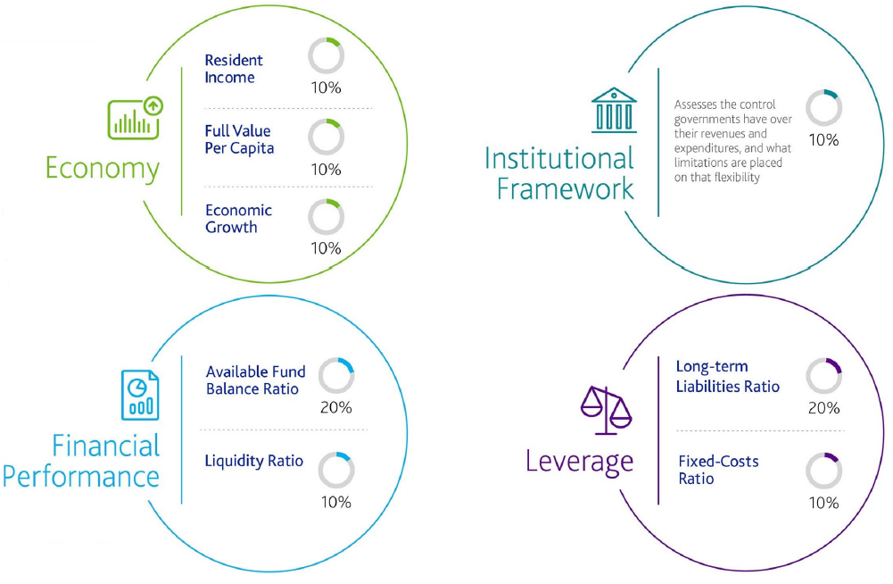
Moody’s US Cities and Counties Methodology
    Moody’s Investor Services adopted their new methodology on November 2, 2022 with the following changes:
    1) Key Scorecard Changes
      Update to scorecard inputs/ratios, particularly for Economy and Debt/Leverage.
      Changes in factor weightings (as shown on the following page).
      Calculations include all Funds – Total Governmental and Business-Type.
    2) Notching Factors
      Notching factors reduced from 16 to 5 as follows:
        Additional strength in local resources (management/governance).
        Limited scale of operations (size of local government).
        Financial disclosures (financial statements not in conformity with GASB).
        Potential cost shift to or from the State.
        Potential for significant increase in leverage (material exposure to pension asset risk, increase in unfunded liabilities, or heavily depreciated capital assets).
    3) Other Considerations
      While the defined notching factors have been reduced, a new category for other considerations will allow for any other factor deemed appropriate by the rating analysts and committee to be considered in the rating outcome.
Adopted Moody’s Rating Methodology

Slide 9
Moody’s Issuer Rating Scorecard
    Resident Income
      Measures the ratio of an issuer’s Median Household Income adjusted for Regional Price Parity (“RPP”) ⁽¹⁾ to account for costs of living differences, divided by the US Median Household Income.
    Economic Growth
      Measures the difference between the five-year compound annual growth rate in real gross domestic product of an Issuer’s local economy ⁽¹⁾ compared to the U.S.
    Available Fund Balance Ratio
      Measures the ratio of the available fund balance for governmental funds plus net current assets for business-type activities and internal service funds, divided by total revenues.
    Liquidity Ratio ⁽²⁾
      Measures the ratio of total liquidity (unrestricted cash), divided by total revenues.
    Long-Term Liabilities Ratio ⁽²⁾
      Measures the ratio of the issuer’s total long-term liabilities, divided by total revenues.
    Fixed-Costs Ratio ⁽²⁾
      Measures the ratio of adjusted fixed costs to total revenues. The adjusted fixed cost is the sum of an issuer’s implied debt service, its pension tread water indicator, its OPEB contributions and its implied carrying costs for other long-term liabilities. These metrics are calculated by Moody’s.
⁽¹⁾ If an Issuer is located within a Metropolitan Statistical Area (“MSA”), the MSA data is utilized.
Otherwise, State Rural Average is used for RPP and County GDP is used for Economic Growth.
⁽²⁾ Calculated using Governmental, Business Type and Internal Service Funds.

Slide 10
Moody’s Sample Scorecard
Notching Factors:
  Additional Strength in Local Resources: No
  Limited Scale of Operations: No
  Financial Disclosures: No
  Potential Cost Shift to or from the State: No
  Potential for Significant Change in Leverage: No
Other Considerations:
  TBD
Moody’s Rating Scorecard: Indicative Rating

Slide 11
S&P Rating Agency Methodology Overview
S&P Rating Methodology
S&P Rating Methodology
    On September 12, 2013, Standard & Poor’s (S&P) published its US Local Governments General Obligation Ratings methodology and assumptions.
    Under the methodology, an initial indicative rating is calculated from a weighted average of seven key factors.
    Up to a one-notch adjustment can be made from the indicative rating based on other qualitative factors not included in the quantitative score.
    On January 11, 2024 S&P published a request for comment related to an updated methodology. This revised methodology has not gone into effect.
Category | Rating Percentage | Short Term Control | Long Term Control
Institutional Framework | 10% |  | ü
Economy | 30% |  | ü
Management | 20% | ü | ü
Budget Flexibility | 10% | ü | ü
Budgetary Performance | 10% | ü | ü
Liquidity | 10% | ü | ü
Debt and Contingent Liabilities | 10% | ü | ü

Slide 12
S&P Sample Rating Scorecard

Slide 13
S&P Scorecard Factor | Management
    S&P’s areas of focus in the FMA methodology are:
      Cash Flow Projections and Long-Term Planning
          Revenue and expenditure assumptions
          Budget amendments and updates
          Long-term financial planning
          Long-term capital planning
      Financial Policies
          Investment management policies
          Debt management policies
          Reserve and liquidity policies
    Each of the seven factors is graded individually, with the final FMA assessment qualitatively determined based on the scoring of these seven factors.

Slide 14
S&P Scorecard Factor | Debt and Contingent Liability

Slide 15
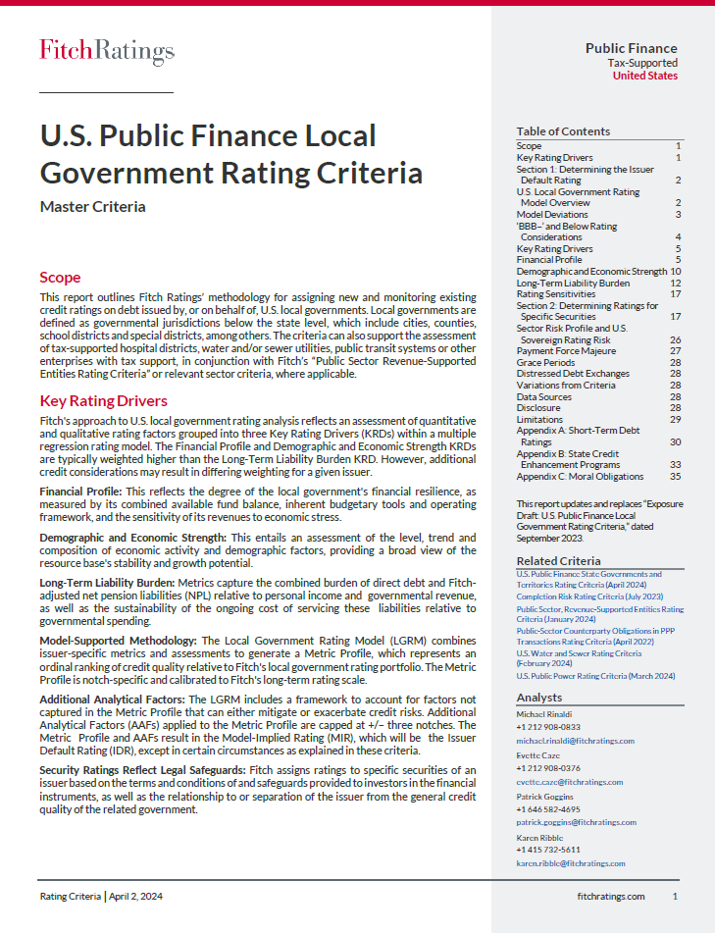
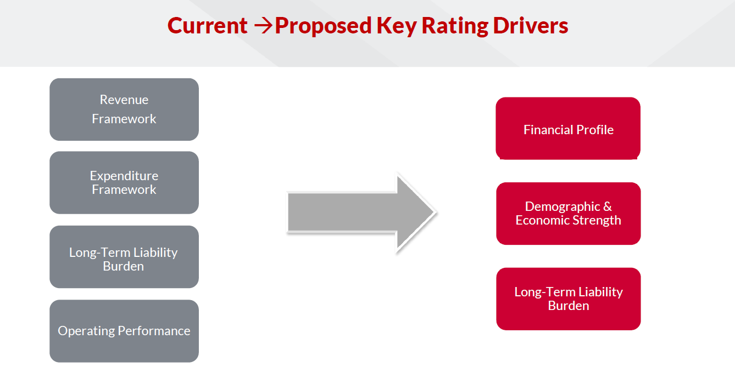
Fitch New Rating Methodology
New Methodology Overview
On April 2, 2024, Fitch published its new U.S. Public Finance Local Government Rating Criteria.
The new methodology reflects an assessment of quantitative and qualitative rating factors grouped into three Key Rating Drivers:
Financial Profile
Demographic and Economic Strength
Long-Term Liability Burden
The new methodology also includes a “Local Government Rating Model” and “Additional Analytical Factors” that will impact an issuer’s final credit rating.
Following the release of the new methodology, Fitch published a list of Issuers ‘Under Credit Observation’ (“UCO”) highlighting issuers that were identified for potential rating changes under the new Methodology.

Slide 16
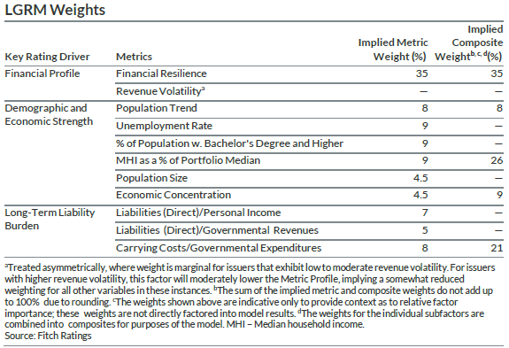
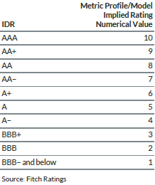
Fitch New Rating Methodology | LGRM
The U.S. Local Government Rating Model (LGRM) generates a Metric Profile, which represents a comparative evaluation of an issuer's overall credit quality based on the 11 key metrics related to three Key Rating Driver (KRD) categories, as shown below. Model weights and coefficients were established using a quantitative optimization process to find the best fit possible between the Metric Profile and existing IDRs.
    Metrics may be adjusted to account for historical data anomalies, forward-looking performance shifts or nonrecurring events that skew the time series results — which, if applicable, will be disclosed in the rating action commentary.
LGRM Weights
LGRM Correspondence Table

Slide 17
Fitch Sample Rating Scorecard

Slide 18





Rating Agency Strategy
Develop Rating Agency Strategy
Credit Presentation & Participant Preparation
Interaction with Rating Analysts
Follow-Up and Report Review
Surveillance
Rating Overview Review current ratings and recent rating agency commentary Scorecard Analysis Evaluate quantitative scoring under rating methodologies Credit Assessment Identify rating opportunities, strengths to highlight and challenges to mitigate
Credit Presentation Develop presentation that provides analysts information needed and addresses items identified in the credit assessment. Key areas include tax base, financials, demographic information and economic development. Participant Preparation Pre-meeting review of presentation with discussion of key elements to be highlighted and likely questions from analysts.
Rating Interactions Recommend form of interaction, including Rating Calls, Site Visits to the issuer by the analysts or Rating Meetings conducted at the rating agency offices in New York. Take the lead in ensuring the rating analysts are provided with all the required information they need in order to maximize the opportunity to benefit from the interaction.
Follow Ups Coordinate any required follow-up correspondence to help ensure a complete ratings process. Rating Report Review Interface with the rating agencies to coordinate the drafting and publication of the official rating reports.
Maintain Relationships Following the rating interactions, continue to develop the Issuer’s relationships with the rating analysts to further advance the Issuer’s rating narrative and pursue subsequent rating upgrades. Ongoing Surveillance Assist in ongoing rating surveillance and interactions with the rating agencies when a rating upgrade could be a possibility between debt issuances.

Slide 19

Rating Agency Strategy – Case Study
NC County Upgraded to Aaa
    Davenport was engaged by a North Carolina County on the issuance of General Obligation Bonds. At the time, the County had most recently been rated ‘Aa1’ by Moody’s in July 2020.
    Davenport developed a rating strategy and identified Moody’s economy score as a potential area for improvement - in particular, Moody’s view of the County’s low income/wealth levels and its assessed value base.
    Davenport developed a detailed Credit Presentation for the County which included highlighting a series of key factors to offset perceived weaknesses from certain metrics, such as the number of second homes in the County and relative age of population.
    Additionally, Davenport prepared a series of peer comparisons to other ‘Aaa’ rated counties nationally to put these factors into perspective.
    This process resulted in the County being upgraded from ‘Aa1’ to ‘Aaa’ on June 21, 2022.
July 1, 2020
“Wealth levels are below average for the rating category with median family income at 89.7% of the US median compared to 103.9% for the rating category”
June 21, 2022
“The rating also incorporates the strong wealth levels, as measured by full value per capita, given the significant number of second homes in the county, and the below average income levels, partially due to the large number of retirees.”

Slide 20
Disclaimer
The U.S. Securities and Exchange Commission (the “SEC”) has clarified that a broker, dealer or municipal securities dealer engaging in municipal advisory activities outside the scope of underwriting a particular issuance of municipal securities should be subject to municipal advisor registration. Davenport & Company LLC (“Davenport”) has registered as a municipal advisor with the SEC. As a registered municipal advisor Davenport may provide advice to a municipal entity or obligated person. An obligated person is an entity other than a municipal entity, such as a not for profit corporation, that has commenced an application or negotiation with an entity to issue municipal securities on its behalf and for which it will provide support. If and when an issuer engages Davenport to provide financial advisory or consultant services with respect to the issuance of municipal securities, Davenport is obligated to evidence such a financial advisory relationship with a written agreement.
When acting as a registered municipal advisor Davenport is a fiduciary required by federal law to act in the best interest of a municipal entity without regard to its own financial or other interests. Davenport is not a fiduciary when it acts as a registered investment advisor, when advising an obligated person, or when acting as an underwriter, though it is required to deal fairly with such persons,
This material was prepared by public finance, or other non-research personnel of Davenport. This material was not produced by a research analyst, although it may refer to a Davenport research analyst or research report. Unless otherwise indicated, these views (if any) are the author’s and may differ from those of the Davenport fixed income or research department or others in the firm. Davenport may perform or seek to perform financial advisory services for the issuers of the securities and instruments mentioned herein.
This material has been prepared for information purposes only and is not a solicitation of any offer to buy or sell any security/instrument or to participate in any trading strategy. Any such offer would be made only after a prospective participant had completed its own independent investigation of the securities, instruments or transactions and received all information it required to make its own investment decision, including, where applicable, a review of any offering circular or memorandum describing such security or instrument. That information would contain material information not contained herein and to which prospective participants are referred. This material is based on public information as of the specified date, and may be stale thereafter. We have no obligation to tell you when information herein may change. We make no representation or warranty with respect to the completeness of this material. Davenport has no obligation to continue to publish information on the securities/instruments mentioned herein. Recipients are required to comply with any legal or contractual restrictions on their purchase, holding, sale, exercise of rights or performance of obligations under any securities/instruments transaction.
The securities/instruments discussed in this material may not be suitable for all investors or issuers. Recipients should seek independent financial advice prior to making any investment decision based on this material. This material does not provide individually tailored investment advice or offer tax, regulatory, accounting or legal advice. Prior to entering into any proposed transaction, recipients should determine, in consultation with their own investment, legal, tax, regulatory and accounting advisors, the economic risks and merits, as well as the legal, tax, regulatory and accounting characteristics and consequences, of the transaction. You should consider this material as only a single factor in making an investment decision.
The value of and income from investments and the cost of borrowing may vary because of changes in interest rates, foreign exchange rates, default rates, prepayment rates, securities/instruments prices, market indexes, operational or financial conditions or companies or other factors. There may be time limitations on the exercise of options or other rights in securities/instruments transactions. Past performance is not necessarily a guide to future performance and estimates of future performance are based on assumptions that may not be realized. Actual events may differ from those assumed and changes to any assumptions may have a material impact on any projections or estimates. Other events not taken into account may occur and may significantly affect the projections or estimates. Certain assumptions may have been made for modeling purposes or to simplify the presentation and/or calculation of any projections or estimates, and Davenport does not represent that any such assumptions will reflect actual future events. Accordingly, there can be no assurance that estimated returns or projections will be realized or that actual returns or performance results will not materially differ from those estimated herein. This material may not be sold or redistributed without the prior written consent of Davenport.
Version 01/01/2024 ZL | TW

