Slide 1
July 2024 Investments 101
For Educational Purposes Only. Please see Disclosures attached.
NOT FOR FURTHER DISTRIBUTION.

Slide 2
For today’s discussion
Fixed-Income Management 101
Bond Basics
Defining Key Terms
Key Concepts
Applying to North Carolina Statute
Investment Policy Basics
2

Slide 3
Fixed income 101
What Exactly Is A Bond?

Slide 4
Fixed Income Securities
Definition: A debt obligation of a corporate, governmental entity, or trust. Pays periodic interest and returns principal at maturity. Its value can fluctuate.
Advantages
Fixed coupon rates typically help create predictable cash flow
Contractual obligation
Strategies may capture fair value appreciation if rates decline
Disadvantages
Inflation can erode the value of your future cash flows
May lose value if interest rates increase
Eroding credit negatively impacts value
4

Slide 5
What is a bond?
Lender purchases a bond from Borrower
Bond Principal
Borrower
Company or government
Lender
Borrower pays interest to Lender
Bond Principal
Borrower
Lender
At maturity, Borrower returns principal to Lender
Bond Principal
Borrower
Lender
5

Slide 6
What is a bond?
Bonds are debt obligations
Referred to as fixed-income securities; offers a fixed stream of income
Types of Bonds
Treasury Bonds
Federal Agency Bonds
Municipal Bonds
Investment-grade Corporate Bonds
High-yield Corporate Bonds
Asset-backed Bonds
Mortgage-backed Bonds
Convertible bonds
Foreign Bonds
IOU
Issuer Promises to pay % annually on $$ and repay principal by MM/DD/YYYY
6

Slide 7
How Do I Earn?
Interest Payment
+
Principal Returned
Initial Investment
Interest Payment
Interest Payment
Interest Payment
Simply buy securities
Hold them until maturity
Reinvest maturing funds into new security
But is there more to it?
MATURITY
0
1
2
3
4
TIME
7

Slide 8
How the bond market works
Not centrally exchanged
Broker prices differ
Prices depend on:
Market forces
Rate levels
Trading volume
Relationships
Broker inventory
It means you have to shop around
8

Slide 9
Broker-dealers and investment advisors in NC
Finance Officer Manages Investments
North Carolina Statute § 159‑30. Investment of idle funds.
(a) A local government or public authority may deposit at interest or invest all or part of the cash balance of any fund. The finance officer shall manage investments subject to whatever restrictions and directions the governing board may impose. The finance officer shall have the power to purchase, sell, and exchange securities on behalf of the governing board.
 | Broker – Dealer | Investment Advisor
Market Role | Agent and/or Market Maker | Advisor on Investment Program
FINRA Standard | Suitability Standard | Fiduciary Standard
Fee Structure | Bid-Ask Spread, Commissions | Asset Under Management
Focus | Typically Fulfills Transactions | Typically Implements Portfolio Strategy
9

Slide 10
Broker Dealer Transaction Process
Trade inquiries initiated by:
Investor
Offer (buying)
Bid (selling)
Broker
Calls with a trade or swap idea
Faxes, e-mails, posts on Web site inventory and trade ideas
10

Slide 11
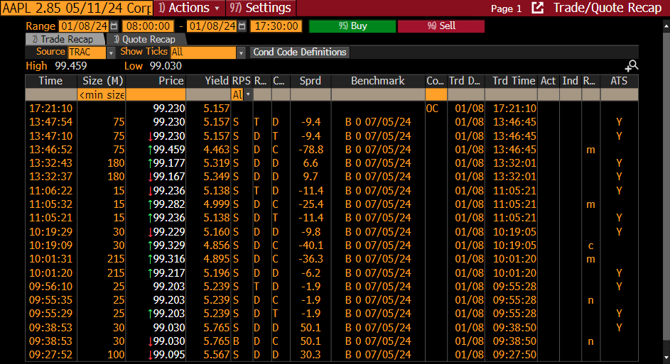
Competitive bids/OFFERS
Difference between highest and lowest price: 129 basis points
On a $10 million trade that equals $129,000!
Source: Bloomberg
Corporate Medium Term Notes are not eligible securities under North Carolina General Statute. This is shown for illustrative purposes on how the bond market functions.
11

Slide 12
Investment Advisors
Regulated by the SEC under the Investment Advisers Act of 1940
Acts as a fiduciary for client assets
Decisions based on compliance with policy, objectives, and state statute
Emphasis on the entire portfolio, rather than individual transactions
Provide comprehensive investment management services
Compensated on the basis of assets under management, not transactions
12
Source: Bloomberg

Slide 13
fiduciary
An individual or institution that has a special relationship of trust with another person or group legally responsible for their assets. Examples Include:
Treasurers
Finance Directors
Investment Personnel
Oversight Boards
Investment Advisors
Brokers are not fiduciaries at this time
By Law a Fiduciary Must:
Make decisions in the best interest of the beneficiary;
Always put the beneficiaries’ interests before their own; and,
Act prudently
13

Slide 14
Using bond market language
Key Terminology

Slide 15
Bond terminology—All these values!
Par Value—Face value of bond—it is the amount upon which coupon is calculated, and the amount you receive at maturity
Original Cost—The price you paid for a bond—it can be above, below, or at par value
Premium or Discount—The amount above or below par value paid for a bond
Amortized Cost (Book Value)—The carrying value of the bond on your books (original cost +/- premium amortized or discount accreted to date)
Market Value—The amount someone else is willing to pay for your bond
15

Slide 16
Bond terminology
Basis point (1/100 of 1% or .0001)
Spread
Difference between yields on differing debt instruments
Treasury yield is 1.00%;
Agency yield is 1.30%
Spread = 1.3 – 1.0 = 30 bps
16

Slide 17
Bond terminology
Yield—Annual rate at which you are expected to earn interest income assuming same rate reinvestment
Return—Rate you actually earned for a specific holding period
Total Return = Interest Income + Realized Gains/Losses + Unrealized Gains/Losses
Book Return = Interest Income + Realized Gains/Losses ONLY (no marking to market)
Yield and Return do not necessarily mean the same thing!
17

Slide 18
Understanding Total Revenue: Yield vs total return
Yield | Total Return
Forward-Looking | Backward-Looking
Annualized Earnings Rate of Return for Security or Basket of Securities at a Point in Time | Annualized Rate of Return for a Security or a Basket of Securities Over a Specified Historic Time Period
Assumes no changes in cash flow; reinvestment at same rate | Considers all changes in the portfolio, including market value fluctuations, reinvestments rates, and cash flows
Total Return = Income + Change in Market Value
18

Slide 19
Poll question #1
#1. Premiums and Discounts represent:
a. The amount originally paid for the security
b. The amount paid above or below par value
c. The amount someone is willing to pay for your bond

Slide 20
Understanding Bond Market Concepts
Key Concepts

Slide 21
Key Concept #1—price and rate move opposite one another
Bond prices and interest rates have an inverse relationship
Bond Prices
Interest
Rates
21

Slide 22
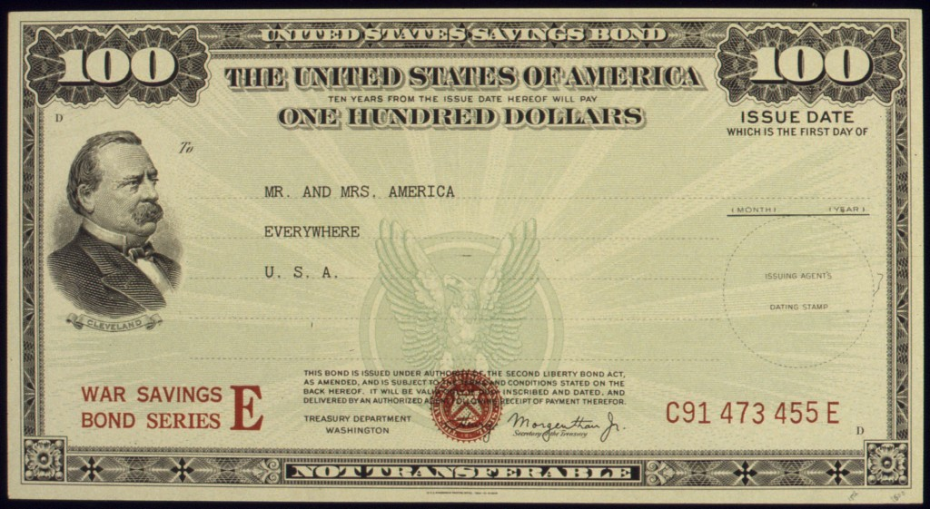
How does this work?
You purchase on 6/30/2024:
Par | Credit Quality | Coupon | Maturity | Income | Yield | Price
$1 million | AAA | 5% | 6/30/2025 | $50,000 | 5% | 100.000
22

Slide 23
Impact of rising rates
Rates rise on 7/1/2024, and someone else purchases a newly-issued security similar to yours, but with a higher coupon:
Your Bond | Credit Quality | Coupon | Maturity | Income | Yield | Price
$1 million | AAA | 5% | 6/30/2025 | $50,000 | 5% | 100.000
Their Bond | Credit Quality | Coupon | Maturity | Income | Yield | Price
$1 million | AAA | 6% | 6/30/2025 | $60,000 | 6% | 100.000
23

Slide 24
Impact of rising rates
Here’s some math to contemplate:
 | Par | Income | Yield
Their Bond | $1 million | $60,000 | 6%
Your Bond | $1 million | - $50,000 | 5%
 |  | = $10,000
Your security would have to be sold at approximately $990K to make up for the rise in interest rates
$1,000,000
-$10,000
$990,000
24

Slide 25
Poll question #2
Scenario
On 09/02/2022, your Agency buys at par:
3-year US Treasury Note
Yield to Maturity: 3.43%
Face Value: 100
On 09/01/2023 (the pricing date):
Market Yield
UST 2-year US Treasury yield: 4.881%
Face Value: 100
Your Agency’s UST note:
2-year to maturity
Fixed Coupon: 3.43%
Future Value: 100
If you wanted to sell your unit’s bond in the market on 09/01/2023, how could you convince someone to buy it?
Lower the Purchase Price
Raise the Purchase Price
Do Nothing – No One Will Want Your Lower Coupon Bond
25

Slide 26
How to Price a Bond in Excel
Excel Formula: PV ( rate, nper, pmt, FV, [type])
 | Field Meaning | Plain English | Value
Rate | Market Interest Rate | Yield-to-Maturity | 4.881%/2
NPER | Number of Periods | Number of Interest Payments Left | 2 years * 2 payments = 4
PMT | Payment | Each Coupon Payment ($) | +$3.43/2
FV | Future Value | Face (Par) Value | 100
PV | Present Value | Current Price of Bond | Solve for PV 97.27
US Treasuries pay interest semi-annually!

Slide 27
Impact of rising rates
Good News!: Interest income will increase.
Reinvestment depends on length of average maturity
Budgets will benefit from increased cash flow
Bad News!: The value of my bonds will go down.
Sales before maturity
GASB 31 and the Annual Comprehensive Financial Report (ACFR)
27

Slide 28
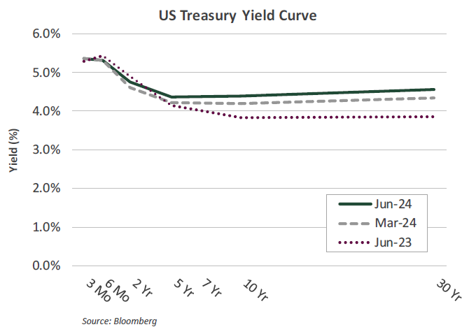
Key Concept #2—Term Structure of Interest Rates—known as the Yield Curve
Treasuries Are Government IOUs
That Pay Interest, and different interest rates for different time periods
Source: Bloomberg
Treasuries are considered among the safest bond investments due to government backing.
Yield curves are graphs depicting the yields of bonds of various maturities.
The shape and direction of the Treasury yield curve is closely watched by economists and investors.
28

Slide 29
Key Concepts: the Yield Curve
Term Structure of Interest Rates
Yield (%)
The longer the maturity of the bond, the higher the interest rate you are compensated
However, there are times when this is not true!
Maturity (Years)
29

Slide 30
What determines the shape of the yield curve?
Expectations Hypothesis: Equilibrium long-term rate is the rate long-term investors would expect to earn through successive investments in short-term bonds over the term to maturity of the long-term bond.
Liquidity Preference Hypothesis: Lenders prefer short-term loans, and to induce them to lend long-term, it is necessary to offer higher yields.
Segmented Market Hypothesis: Shape of the yield curve is a function of the policies of institutional investors/major financial institutions.
Other forces?
30

Slide 31
Different Yield Curves for Different Environments
The Holy Grail of Investment Indicators?
Normal
Flat
Inverted
It is possible for long-term rates to fall below short-term rates. This is an “inverted yield curve.”
Inverted yield curves have historically been associated with possible future recessions.
31

Slide 32
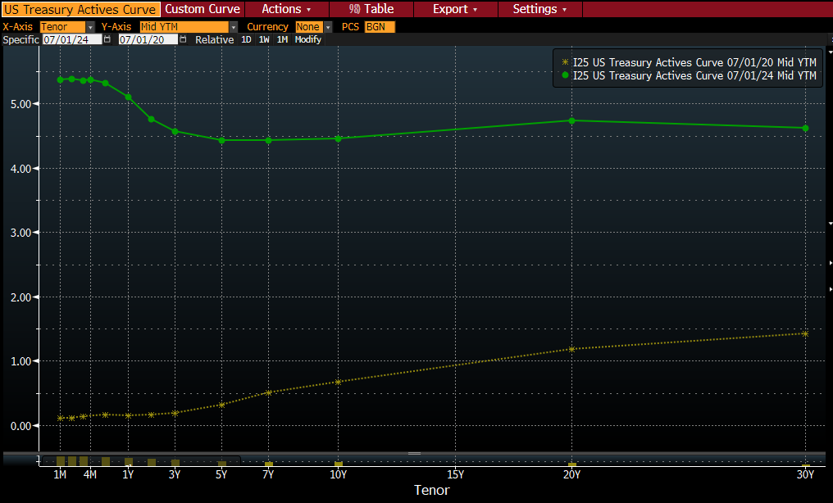
Rates are higher and curve is inverted
Source: Bloomberg
32

Slide 33
Be Aware of the inversion!
Pandemic
Will There Be a Recession?
Oil Shock/
Desert Storm
Dotcom Bubble
Great Recession
Source: Bloomberg, NBER
33

Slide 34
Poll question #3
#3 : Yield Curve Inversions:
a. May occur because investors anticipate future lower yields
b. Have a strong correlation with future recessionary periods
c. Cause shorter maturities to pay higher yield than longer maturities
d. All of the above

Slide 35
Key concept #3 – bond market segmentation
Bond Market
Not Bonds
Government
Corporations
Stocks
US Treasury Bills
Commercial Paper
Real Estate
US Treasury Notes
Certificate of Deposits (CDs)
US Treasury Bonds
Asset Backed Securities
Cryptocurrency
Federal Agency Bonds
Medium Term Notes
Derivatives
Municipal Bonds*
Other
Futures
Sovereign Bonds
Money Market Funds
Supranationals
Commodities
35

Slide 36
Bonds 101
North Carolina Government Statutes
Basics

Slide 37
Key Investment Objectives
1
Safeguard Principal
2
Meet Liquidity Needs
3
Achieve a Market Return/Yield
For Institutional Investor or Investment Professional Use Only – This material is not for inspection by, distribution
to, or quotation to the general public
37
5

Slide 38
U.S. Treasuries
Issuer:
U.S. Government
Credit:
AA+/Aaa/AA+, secured by the full faith and credit of the United States
Maturity:
4 weeks to 30 years
Type | Term to Maturity | Interest
Bills | 4 – 52 weeks | At Maturity
Notes | 1 – 10 years | Coupon
Bonds | 10 – 30 years | Coupon
Strips | 3 months – 30 years | At Maturity
Liquidity: High
North Carolina General Statute Limits:
Obligations of US or obligations fully guaranteed for both principal and interest by US government
No credit quality requirement
No maximum percentage
38

Slide 39
Federal Agencies/Government- Sponsored Enterprises
Issuer:
Credit:
Maturity:
Liquidity:
Yield:
Structure:
Agencies of the U.S. Government and government-sponsored enterprises AA+/Aaa/AAA
1 day to 30 years
Generally high, but depends on structure
Historically higher than U.S. Treasuries, now pressured by supply Bullet, callable (one-time, quarterly, continuous), and others
North Carolina General Statute Limits:
No credit quality requirement
No maximum percentage
12 specific GSEs permitted under §159-30(c)(2)
Most Common Agency Issuers
Federal Home Loan Banks
Federal National Mortgage Association
Federal Home Loan Mortgage Corporation
Federal Farm Credit Banks
39

Slide 40
Municipal Bonds (“MUNIS”)
Issuer:
Credit:
Maturity:
Liquidity:
Yield:
Structure:
Types:
Obligations of State and Local Governments
Generally Investment Grade
1 day to 30 years
Moderate
Tax-Exempt or Taxable
Bullet, variable, serial, callable, conduit, and others
General Obligations, Revenue Bonds
North Carolina General Statute Limits:
No credit quality requirement
No maximum percentage
Obligations of State of North Carolina § 159-30(c)(3) or Bonds/Notes of North Carolina local government or public authority 159-30(c)(4)
40

Slide 41
Savings certificates / CDs
Obligations of banks, savings and loans, and other financial institutions.
Issuer:
Nationally- or state-chartered bank, savings or federal association, state or federal credit union, or by a federally- or state-licensed bank branch of a foreign bank
Based on bank rating Typically 0 to 5 years Low
Depends on environment, and depends on credit quality
Credit:
Maturity:
Liquidity:
Yield:
North Carolina General Statute Limits:
Savings certificates must be issued by S&L organized under state of NC of federal S&L with principal office in North Carolina §159-30(c)(5)
Amounts greater than insured value must be fully collateralized
Certificates of deposits must be custodied by finance officer, who is responsible for safekeeping § 159-30(d)
No credit quality requirement
41

Slide 42
Commercial Paper
Unsecured promissory notes issued by corporations and financial institutions to raise funds on a short-term basis.
Issuer:
Credit:
Maturity:
Liquidity:
Yield:
Domestic and foreign corporations Investment grade: A-1/A-1+, P1, F-1
1 to 270 days, bankruptcy risk extends for 90 days after maturity Moderate to high
Higher than U.S. Treasury and Federal Agency obligations
North Carolina General Statute Limits:
Prime credit rating required (e.g., A-1+, A-1, P-1) of at least one NRSRO; no split ratings
No maximum percentage
42

Slide 43
Mutual Funds
SEC-registered open-end investment company that pools money from many investors and pools money in stocks, bonds, short-term money market instructions, or some combination of these assets.
Managed By:
Credit:
Maturity:
Liquidity:
Yield:
SEC-Registered Investment Advisor
Generally, AAAmf
N/A
Moderate to high
Higher than U.S. Treasury and Federal Agency obligations
North Carolina General Statute Limits:
Participating shares in mutual fund for local government investments
Investments are limited to those qualifying under §159-30(c)
Must be certified by Local Government Commission
No maximum percentage
43

Slide 44
Local Government Investment Pools
Funds created by pooling the assets of various local governments to benefit from shared liquidity, strategy and economies of scale. Managed by a state/county or professional money manager in accordance with local permitted investment statutes.
Issuers:
Credit:
Maturity:
Liquidity:
Yield:
Holds securities of various issuers, depending on stated investment strategy
May or may not be rated
Generally same day liquidity
Very high
Depending on permitted investments and investment strategy, can be similar to money market funds
North Carolina General Statute Limits:
A commingled investment pool established by interlocal agreement by 2+ units of local government pursuant to § 160A‑460 through § 160A‑464
Investments are limited to those qualifying under §159-30(c)
44

Slide 45
Repurchase agreements
Repurchase agreements (repos) are the sale by a bank or dealer of a government security with the simultaneous agreement to repurchase the security on a later date. Repos are commonly used by public entities to secure money market rates of interest.
Credit:
Maturity:
Liquidity:
Yield:
Collateral:
Rating of Counterparty
Generally overnight, up to 1 year
Very high
Depending on permitted investments and investment strategy, can be similar to money market funds
Generally, 102% of agreement
North Carolina General Statute Limits:
Counterparty: Broker-dealer must be recognized as primary dealer or the Bank’s deposits must be FDIC-insured
100% Collateralization using US Government direct obligations
45

Slide 46
Why an Investment Policy?
“An investment policy describes the parameters for investing government funds and identifies the investment objectives, preferences or tolerance for risk, constraints on the investment portfolio, and how the investment program will be managed and monitored. The document itself serves as a communication tool for the staff, elected officials, the public, rating agencies, bondholders, and any other stakeholders on investment guidelines and priorities. An investment policy enhances the quality of decision making and demonstrates a commitment to the fiduciary care of public funds, making it the most important element in a public funds program.”
GFOA Best Practice – “Investment Policy”

Slide 47
What Does an Investment Policy Do?
Defines the investment program
Legal and permitted activities and investments
Who’s in charge
Measurement of results
Relationship to counterparties
Provides protection for the government
Addresses the dynamic nature of the investment process

Slide 48
Policy Components - 1
Introduction and Statement of Intent
Overview of entity
Sound fiscal management
Adoption of policy
Approval by governing board
Scope
Funds covered by policy
Objectives
Safety, liquidity, yield/return & others
Delegation of Authority*
Statement of Prudence, Indemnification & Ethics
* REMINDER!
Finance Officer Retains Fiduciary Duty for Managing Investments

Slide 49
Policy Components - 2
Authorized Investments & Transactions
State Statutes
Risk tolerance
Types of securities & transactions
Maximum maturities & weighted average maturities
Credit criteria
Repurchase agreement criteria
Collateralization
Repurchase Agreements
Bank deposits

Slide 50
Policy Components - 3
Local Government Investment Pools/Mutual Funds
Criteria for evaluating pools and mutual funds
Authorized Financial Institutions, Depositories & Broker/Dealers
Criteria for selection
Competitive trade executions
Delivery, Safekeeping and Custody
Criteria for selecting custodian
Delivery versus payment (DVP) settlement
Fed wire
Depository Trust Company (DTC)

Slide 51
Policy Components - 4
Risk Management and Diversification
Addresses how market and credit risk will be managed
Maximum maturities, weighted average maturities, weighted average duration
Diversification among asset classes and issuers
Liquidity targets
Prohibited investments and practices
Reporting
Disclosure of activities & holdings
Methods for calculations
Frequency of reports & who receives them

Slide 52
Policy Components - 5
Performance Benchmarks
Criteria for selecting benchmarks
Minimum yield standards
Methods of calculation
Policies will often have a “Glossary of Terms” that follow the body of the Policy

Slide 53
Additional Policy Thoughts
Start by:
Examining State Statutes
Review sample investment policies, but don’t just copy
The Policy is an internal document
Involve staff responsible for investments
Prepare draft of new policy and anytime making revisions
Have the right parties review the drafts
The Policy is an external document
Distribute to outside parties
Get governing body approval
As resolution, ordinance, etc.
Perform annual reviews & updates

Slide 54
Investment Policy Resources
Government Finance Officers Association
“Sample Investment Policy”
(312) 977-9700 www.gfoa.org
Association of Public Treasurers
“Model Investment Policy”
(202) 737-0660 www.aptusc.org
Policy certification program

Slide 55
Internal Controls
Internal controls are designed to ensure assets are protected from loss, theft or misuse and should address the following areas:
Control of collusion
Separation of investment transaction authority from accounting and recordkeeping
Third-party safekeeping of assets
Clear delegation of authority to subordinate staff members
Staff training
Dual authorization of wire transfers
Written confirmation of telephone transactions for investments and wire transfers

Slide 56
Thank you!
Questions?

Slide 57
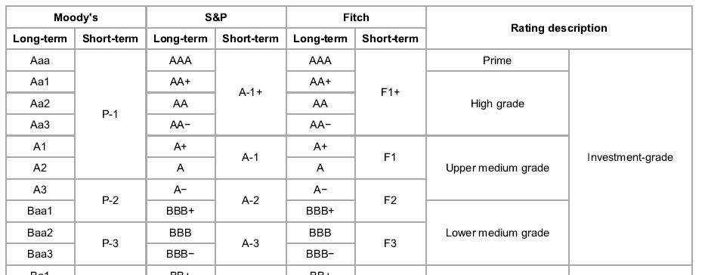
Bond credit ratings
Source: Standard & Poor’s, Moody’s, Fitch Ratings
Credit Outlook: Evaluates the financial condition of the issuer in relation to the economic environment
Credit Watch: Formal warning of the possible deterioration or upgrade of the financial strength and ability of the issuer to meet their debt obligations
Look Ahead
57

Slide 58
Official depositories (NC General Statute)
North Carolina General Statute § 147-78 authorizes and empowers the State Treasurer to select and designate official depositories for the deposit of State funds. Moreover, the State Treasurer has broad statutory authority “to select as many depositories in one place and in the State as may appear to him to be necessary and convenient for the various [agencies] of the State[.]” N.C.G.S. § 147-81.
Any financial institution wishing to become an official depository of the State must be one of the following:
a North Carolina chartered financial institution;
a federally chartered financial institution regulated by the Office of the Comptroller of the Currency with a branch in North Carolina; or
a non-resident, state-chartered financial institution with a branch in North Carolina.
The financial institution must be capable of providing full-service operations in the North Carolina market, and these operations must consist of at least a “brick and mortar” presence within the State. If the financial institution is headquartered out-of-state, the scope of services that it offers in North Carolina must be co-extensive with the scope of services offered in its “home” market. Moreover, the financial institution in question must not be limited to a specific line of business or to a specific type of clientele. For this reason, credit unions may not be official depositories of the State.
Source: Department of State Treasurer, State of North Carolina (Dec 2022)
58

Slide 59
©2024 Chandler Asset Management, Inc., An Independent Registered Investment Adviser.
This report is being provided for informational purposes only. No investment decision should be made based solely on the information provided herein. All investments involve risk, including loss of principal invested. The strategies referenced may not be suitable for all investors. The information contained herein is based on internal research derived from various sources and does not purport to be statements of all material facts relating to the strategies. While not guaranteed as to accuracy or completeness, some of the information has been obtained from sources we believe to be reliable. Opinions expressed herein are subject to change without notice. There can be no assurance that an account or specific investment product will be able to achieve its investment objective. No guarantee of investment performance is being provided and no inference to the contrary should be made.
Any forecasts, forward-looking statements and assumptions are inherently limited and should not be relied upon as an indicator of future results. Any opinions and views constitute judgments made by the author at the date of this presentation and may become outdated or superseded at any time without notice. Any statements concerning financial market trends are based on current market conditions, which will fluctuate.
Economic factors, market conditions and investment strategies will affect the performance of any portfolio and there are no assurances that it will match or outperform any particular benchmark. The data contained in this presentation is the property of those providers, which were obtained from sources believed to be reliable, but are subject to change at any time at the provider’s discretion. Unless otherwise noted, Chandler is the source of data contained in this presentation.
Fixed Income investments are subject to interest, credit and market risk. Interest rate risk: the value of fixed income investments will decline as interest rates rise. Credit risk: the possibility that the borrower may not be able to repay interest and principal. Low rated bonds generally must pay higher interest rates to attract investors willing to take on greater risk. Market risk: the bond market in general could decline due to economic conditions, especially during periods of rising interest rates.
References to specific securities are examples of securities held in a portfolio and are not intended to be, and should not be interpreted as an offer, solicitation, or recommendation to purchase or sell any financial instrument, an indication that the purchase of such securities was or will be profitable, or representative of the composition or performance of the portfolio. The information contained in this sample presentation was obtained from sources we believe to be reliable, but we do not guarantee its accuracy. Past performance is not indicative of future success.
disclosures
59

