Slide 1
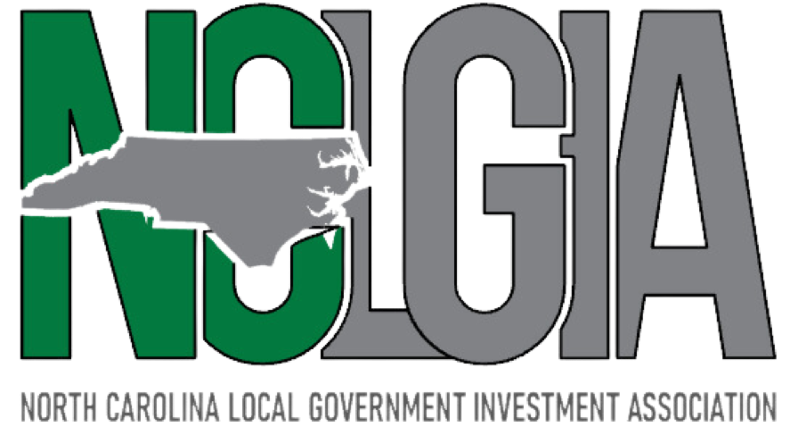
Top 10 Trends of a Well Run Treasury Department
© 2024 Three+One Company, Inc.

Slide 2
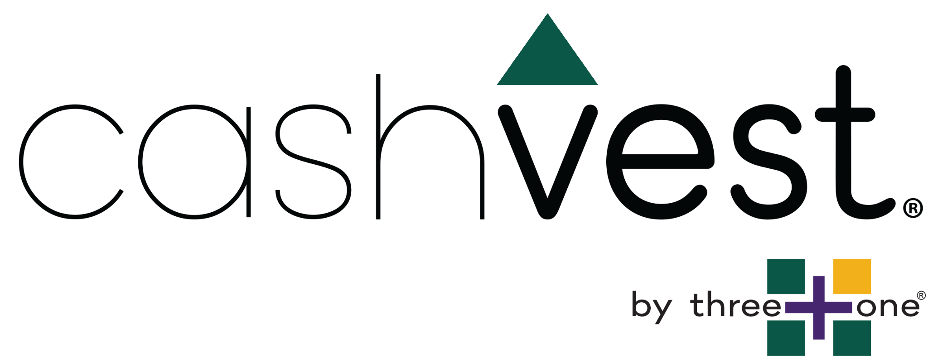
Presenters
Peter Forsgren
COO and Co-Founder pdf@threeplusone.us
(585) 484-0311 x701
Kevin Teborek
Business Development
kat@threeplusone.us
(585) 484-0311 x718
© 2024 Three+One Company, Inc.

Slide 4
1. Understand that data has power to help drive decision making
© 2024 Three+One Company, Inc.
Notes:
KT and PF will introduce the power of data. PF will ask what sources of data exists. KT will circulate and ask about it

Slide 5
“Most public entities say they don’t have the time to look at data or document any value found in it.”
-Ash Center for Democratic Governance and Innovation at the Harvard Kennedy School
© 2024 Three+One Company, Inc.
Notes:
KT will ask about data sources

Slide 6
© 2024 Three+One Company, Inc.

Slide 7
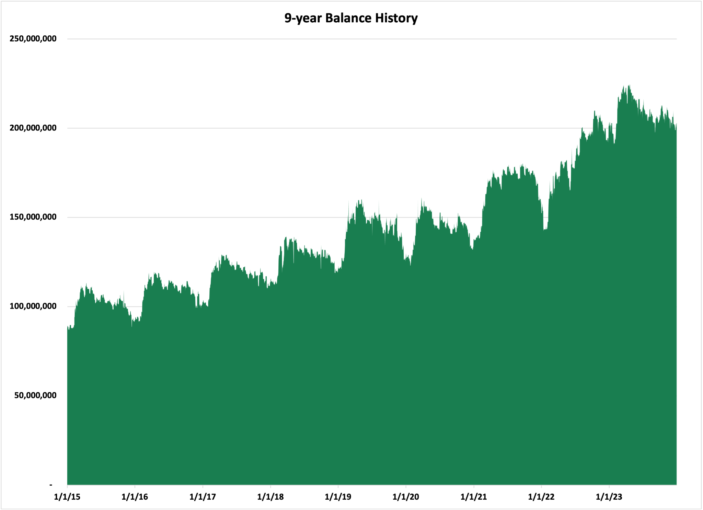
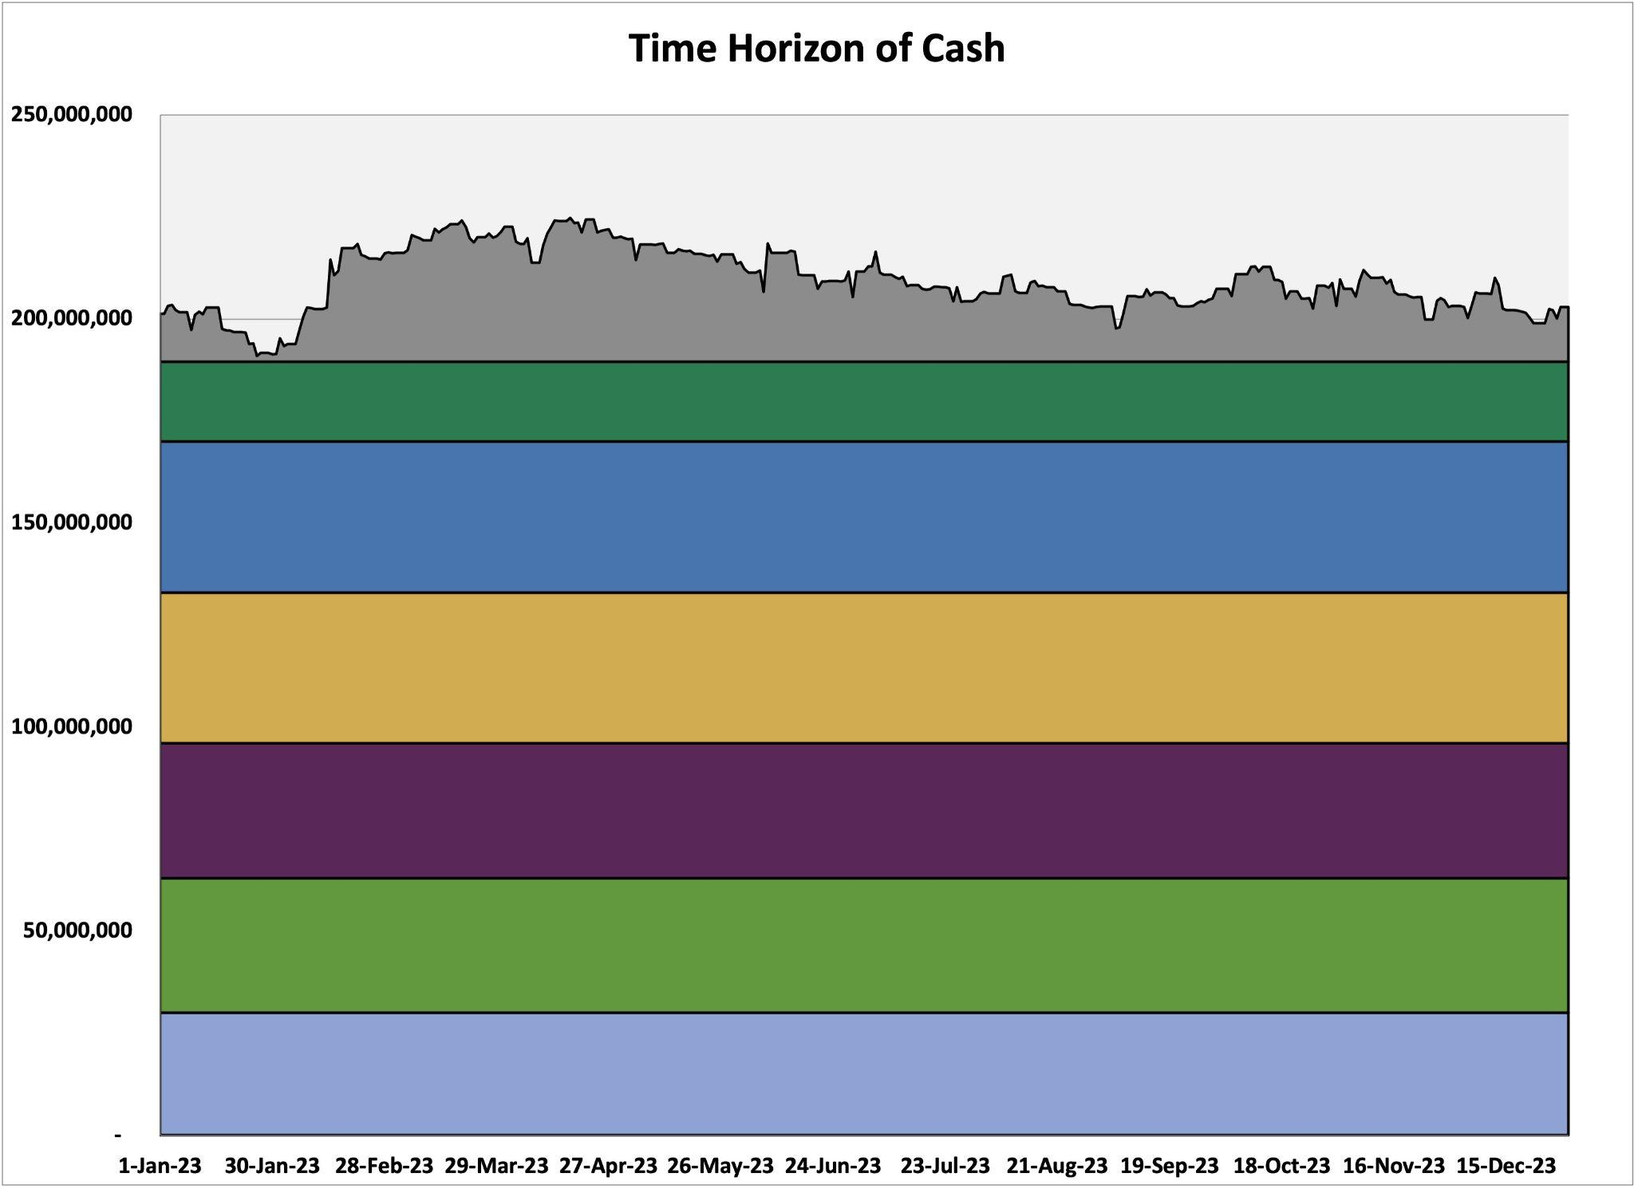
History is data that helps create a visual
Visuals of data tell story to help understand duration potential
© 2024 Three+One Company, Inc.

Slide 8
Case Study
Electronic Payments
Total checks issued < $100 = 14,901
Total dollars = $622,616 for an average size of $41
Cost to cut a check is $0.21 in banking fees + $1 for envelope & stamp = $1.21/check.
10% of total checks issued between $1,000 & $10,000 = 5,733
10% of the dollars in this range = $8,358,704
Cost of an ACH is $0.19. Total potential savings is $1.02/check
Total # of check reduction = 20,634
Savings = $21,046 annually
© 2024 Three+One Company, Inc.
Notes:
Use the data on different payment methods and amounts to pair with your vendor database to create different solutions for different vendors or payees
Assuming the goal of the County is to increase the vendors/residents receiving electronic payments here is the process we would follow:
Determine the total number of payments made by the County by all means:
ACH
Wire
Check
Procurement Card (Assuming you have a procurement card program lets include all those payments in our analysis.)
For those that receive a check lets analyze the vendors to determine by dollar volume and number of checks who we should target to simply convert to our current ACH program.
Or in #2 should we convert those vendors to participate in our procurement card program.
How many checks are we writing to our employees for reimbursements of various costs. Can we merge those payments into our payroll process, assuming the vast majority of those employees receive direct deposit?
Let’s also analyze from which departments those check requests are coming from. You probably already know intuitively which these are but if you have the data and can look at it, it might help with strategizing with options.
You might consider having the governing body adopt a policy that requires every new vendor going forward to sign up for ACH payments or they won’t be able to do business with the County. (Or upon renewal of current contracts you enforce this new requirement.)

Slide 9
2. Has an up to date business continuity plan in place
© 2024 Three+One Company, Inc.

Slide 10
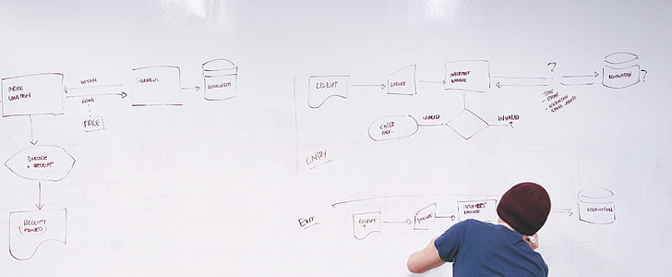
Business Continuity Planning
Can you develop, test, and maintain a plan to continue basic operations during and immediately after disruptive events?
Covid showed we could perform many treasury functions remotely and we made the choice to work remotely or at least minimize staff in office working. What lessons learned are we incorporating?
How does our treasury business continuity plan synch up with other financial functions in our government? (i.e. accounting, budget, purchasing)
Do we have duplicative systems/processes in the event an issue with one of our financial institutions? (Could we make vendor payments from a secondary bank?)

Slide 11
3. Is cyber security aware!
© 2024 Three+One Company, Inc.

Slide 12
10 Tips for Cyber Security
and Awareness
You are a target to hackers
Avoid Phishing scams beware of suspicious emails and phone calls
Be careful what you click
Keep software up-to-date
Practice good password management

Slide 13
10 Tips for Cyber Security
and Awareness
Never leave devices unattended
Use mobile devices safely
Backup your data
Safeguard Protected Data
Install antivirus/anti-malware protection
*Courtesy of UC Berkeley Information Security Office

Slide 14
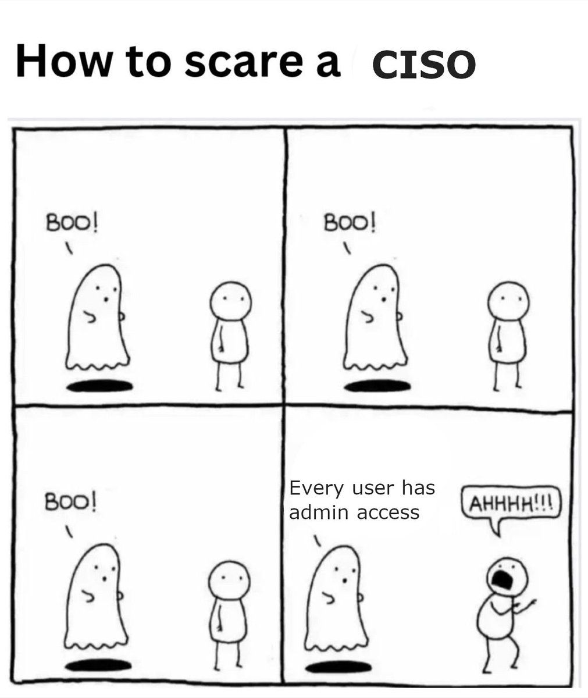

Slide 15
4. Open to innovation
© 2024 Three+One Company, Inc.

Slide 16
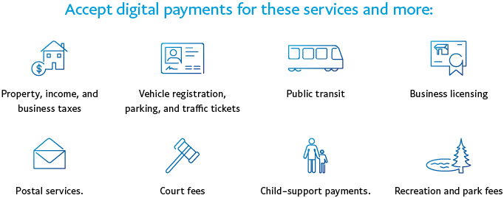
Logica Research (formerly Koski), March 2018; surveyed 2,000 Americans ages 18-75.

Slide 17
Ideas
Online payment portal
Letting the bank cut checks
Self-services and intelligent chat
Electronic payment policy
Touchless transactions and automation
Budgeting tools
Liquidity monitoring tools
Using innovative payment options like PayPal or Venmo
© 2024 Three+One Company, Inc.

Slide 18
5. Has an active investment policy
© 2024 Three+One Company, Inc.

Slide 20
Ask yourself - “What is an ‘active Investment policy’?”
Do we use all the available tools?
Do we get get feedback from investment professionals?
Does it support our internal controls?
Is it reviewed annually by employees?
Is it approved by your governing body?
Are we familiar with what is in it?
© 2024 Three+One Company, Inc.

Slide 21
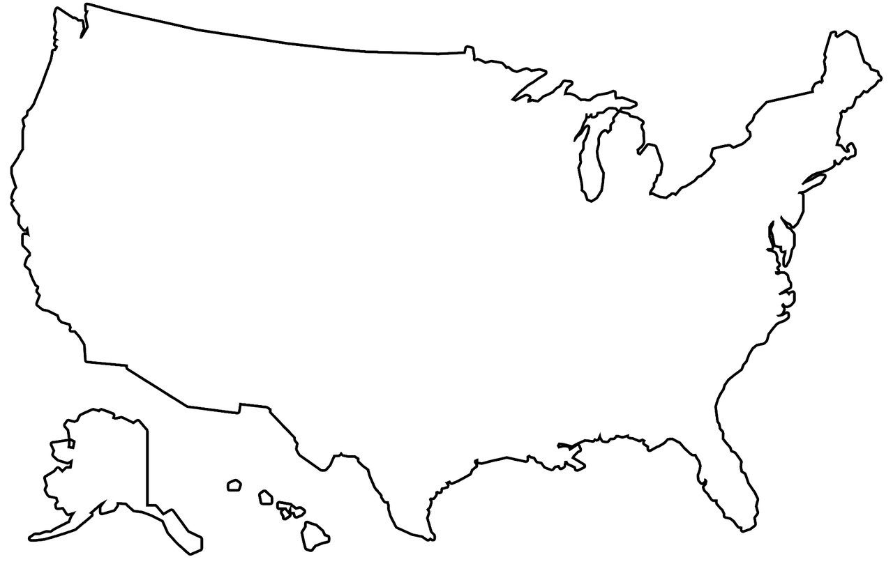
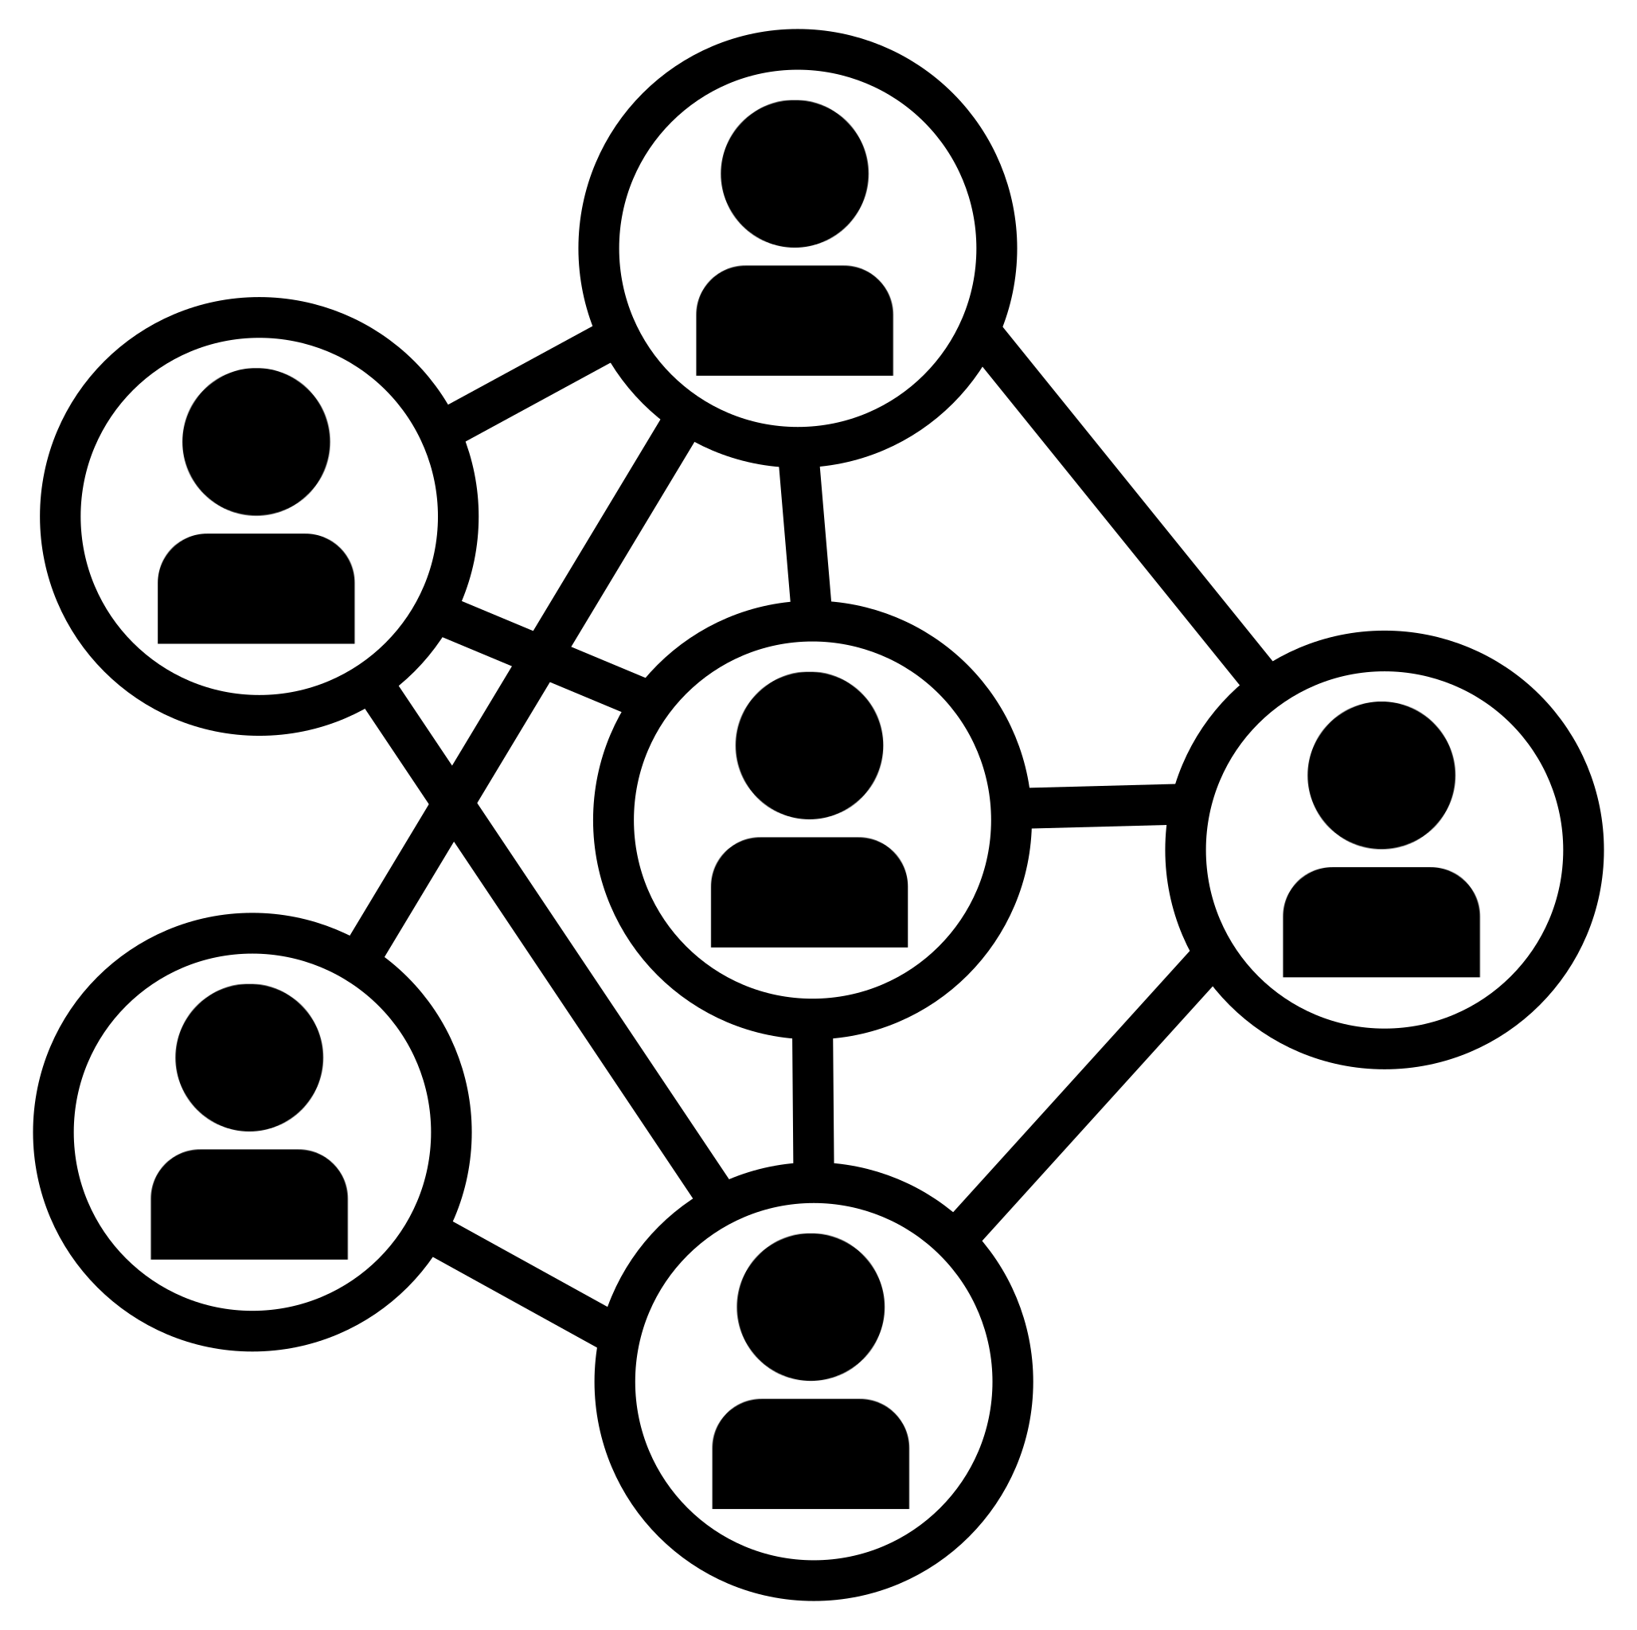
6. Knows peer
and market benchmarks
© 2024 Three+One Company, Inc.

Slide 23
Comparing peer bank benchmarks can
make a real difference in earnings!
Benchmarking bank rates against U.S. Treasury rates, and against other comparable banks, ensures that you and your taxpayers are receiving full marketplace value on deposits.
 | Term | Rate
Option #1 | 12-month CD | 5.38%
Option #2 | 12-month T-bill | 4.67%
Option #3 | 6-month CD | 5.50%
Option #4 | 6-month T-bill | 5.12%
Option #5 | 90-day CD | 5.39%
Option #6 | 90-day T-bill | 5.26%
Option #7 | Liquid | 5.24%
Range of actual interest rate quotes on a $5,000,000 investment as of January, 2024:
Benchmarks help you know more about what your cash is worth, and they ensure you are always maximizing the value on all financial resources.
$5m @ 5.50% = $275.500 interest revenue
$5m @ 5.12% = $256,000 interest revenue
© 2024 Three+One Company, Inc.
Notes:
While we have emphasized using treasuries for investing and the treasury yield curve for benchmarking….we also are constantly surveilling the market to see how bank money market rates, institutional money market rates, checking account rates, ECRs and bank CDs perform in any given market place. And while we know that treasuries are a very transparent market the local banking markets can have wide variations in rates on various instruments and arrangements so asking around for quotes from new institutions or institutions you don’t do much business with is a good thing every now and then.
In certain markets, which one of these options is the best for you might change.

Slide 24
Current Range of ECRs
Low Range
0%
Average
0.52%
High Range
2.33%
© 2024 Three+One Company, Inc.
Notes:
This represents the range of ECRs the clients in our database receive. It is important to note that a ZERO ECR is not necessarily a bad thing. You might choose to earn ZERO if you are willing to pay hard fees and if you then invest your available cash in instruments or accounts that earn more than the ECR your bank is willing to pay to you.

Slide 25
7. Optimizes its banking structures
Review bank account structure for efficiency and cost.
Look at business processes for both efficiency and internal controls and risks.
Monitor banking arrangements and products.
Understand your account structure and make sure you have a complete picture of your banking and business processes.
© 2024 Three+One Company, Inc.
Notes:
In review of Linda Patterson’s presentation yesterday, banks want to know more about your liquidity. They are using liquidity data to understand their balance sheet and if you can share your liquidity with them, they will be able to provide solutions with you.
-How many of you all have a requirements to work with a bank within your county?
-FDIC fee - What to do if you have this fee?
and holistic approach to investing..meaning can see cash in total and not get stuck only thinking about "funds"

Slide 27
Before
After
$
$
Tax Receipts
Account
$
Investment Account
Main Account
Money Market Account
$
$
Accounts Payable
Payroll
Federal Funds
$
© 2024 Three+One Company, Inc.
Notes:
and holistic approach to investing..meaning can see cash in total and not get stuck only thinking about "funds"

Slide 28
A | B
 | Current
Total Fees | $63,973
Substitutes (additions) | $41
Total Fees w/ Substitutes | $64,014
Market Rate | 0.20%
DDA Rate | N/A
MMDA Rate | 0.03%
ECR | 0.25%
FDIC | 0.00%
eECR | 0.25%
Historical Average Balance | $5,891,556
FDIC Fee ($) | $0
RR | 0%
Historical Balance Adjusted for RR | $5,891,556
Days in Proposed Settlement Cycle | 365
ECR Allowance | $14,729
Required Balance to Pay Zero Fees | $25,605,500
Excess / Deficit Balance | -$19,713,944
Net Value / Hard Fees | -$49,285
C
Initial
$36,935
$7,659
$44,594
0.20%
N/A
0.15%
0.38%
0.13%
0.25%
$5,891,556
$7,659
0%
$5,891,556
365
$14,729
$14,774,176
-$8,882,620
-$22,207
D
Negotiated
$10,000
$0
$10,000
0.20%
0.25%
0.40%
N/A
N/A
N/A
$5,891,556
$0
0%
$5,891,556
N/A
N/A
$5,000,000
$891,556
-$10,000
1
2
3
4
5
6
7
8
9
10
11
12
13
14
15
16
17
18
19
Potential Results
$345MM budget County
Monitor processes and structure
Know the benchmarks
Understand your account structure and make sure you have a complete picture
© 2024 Three+One Company, Inc.

Slide 29
RFP
8. Knows when to go out for a Request for Proposal (RFP)
© 2024 Three+One Company, Inc.

Slide 30
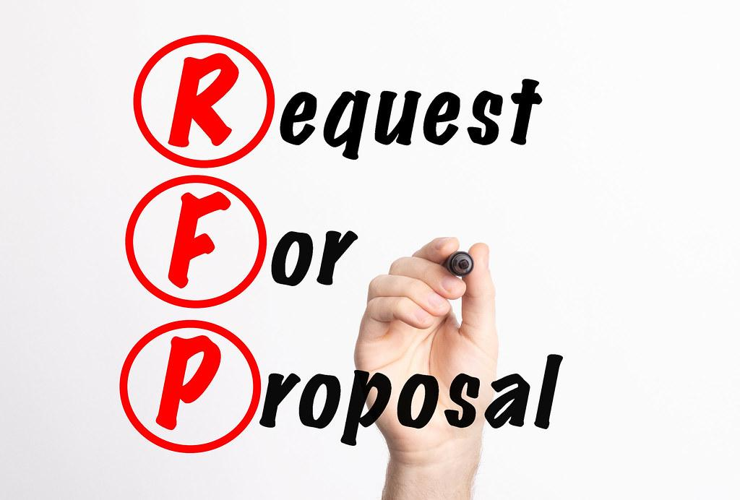
What are some reasons why I
should go out for an RFP?
Poor existing service.
Rates are slow to be adjusted or bank is difficult to negotiate rate adjustments in line with market place.
Local presence is not there anymore.
Show taxpayers that the entity is fulfilling their fiduciary responsibility to get the most value out of their tax dollars.
Potentially lock in an agreement for a set amount of time.

Slide 31
What are some reasons why I
should go out for an RFP?
Some pricing on high use services, like ACH or checks, is higher than competitors but bank won’t negotiate.
Technology or products offered are not robust enough to meet the needs of the municipality, meaning our needs as a client have changed and our bank can’t keep up.
State law requires it.
It has been 3/5/7/10 years since the last RFP.

Slide 32
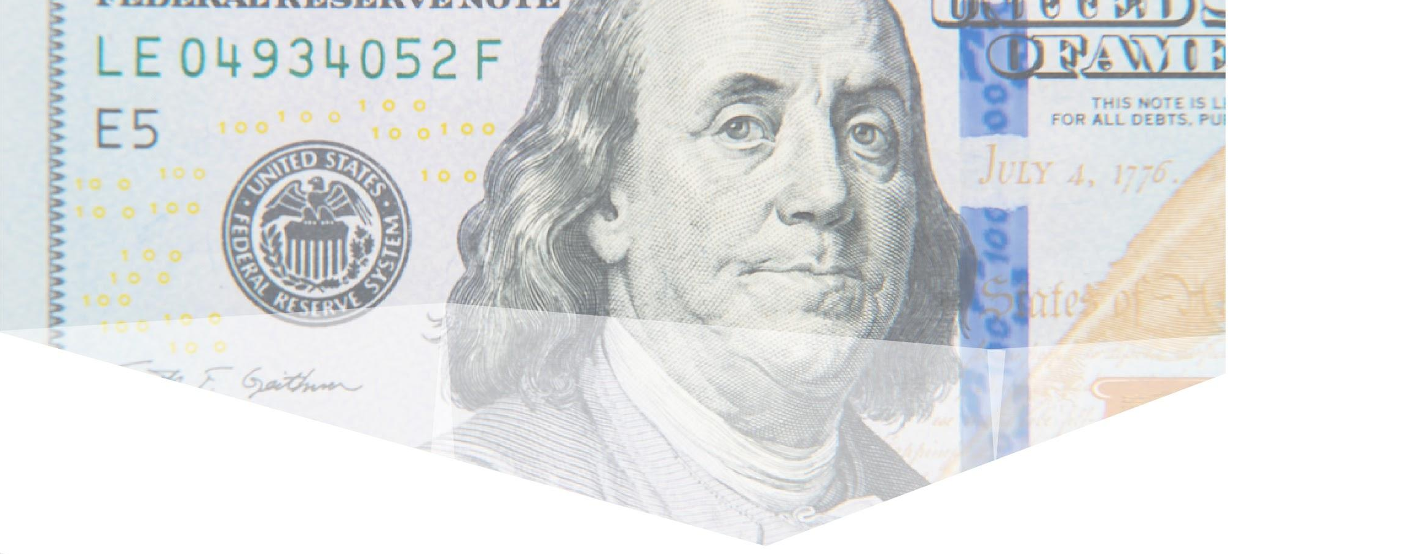
9. Complements cash flow with liquidity management
Daily ins and outs of revenues & expenditures
- cash flow
The measurement & value of all your entity's cash
- liquidity
© 2024 Three+One Company, Inc.

Slide 33
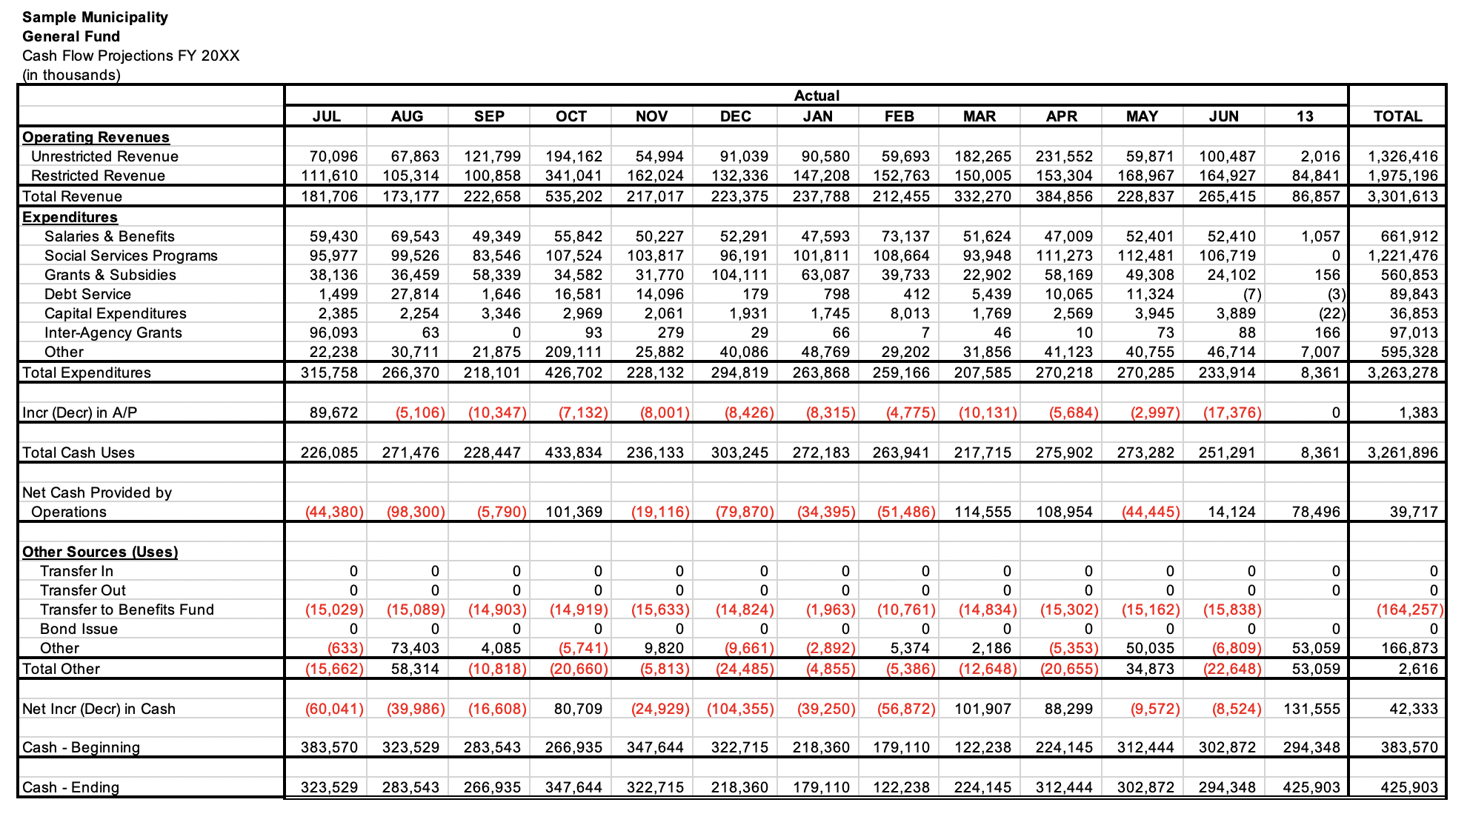
© 2024 Three+One Company, Inc.
Traditional Cash Flow Forecasting
Notes:
This is our traditional approach to cash forecasting.
We’d typically take this approach to each of our governmental fund types and add them together to get a view of our cash position.

Slide 34
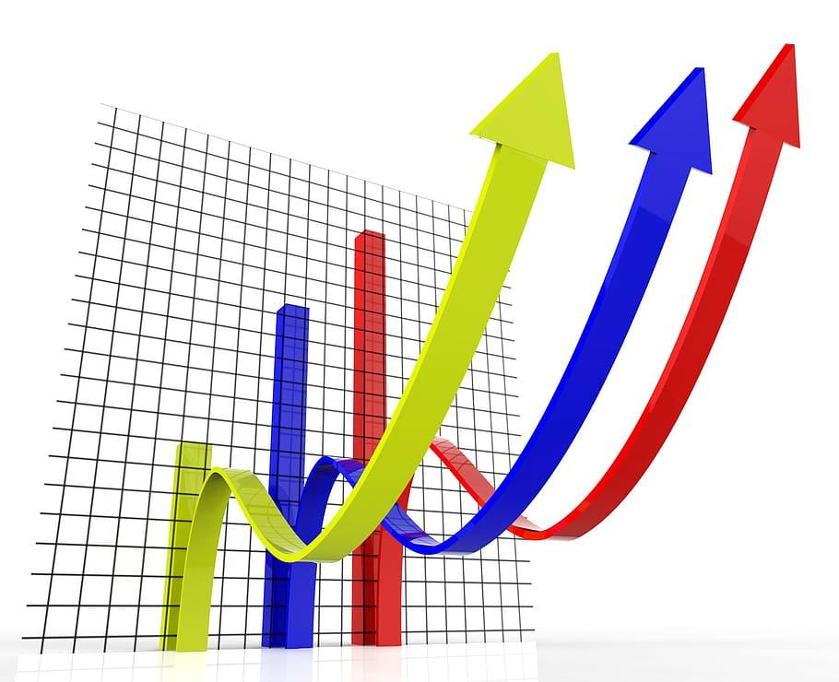
Cash Forecasting
Preparing this type of forecast allows the treasury function to look across government and be one of the important pillars of public financial management. Preparing and monitoring this type of forecast gives us early warning signals that our intuition and data may not recognize.
Every finance/treasury office should do some sort of cash forecast that as much as possible can be reconciled back to the municipality’s budget.
© 2024 Three+One Company, Inc.

Slide 35
Cash Forecasting
However, this type of forecasting must be paired with deliberate liquidity analysis to make sure we are optimizing our operations.
This type of forecasting also helps synch up coordination between debt and cash management.
© 2024 Three+One Company, Inc.

Slide 36
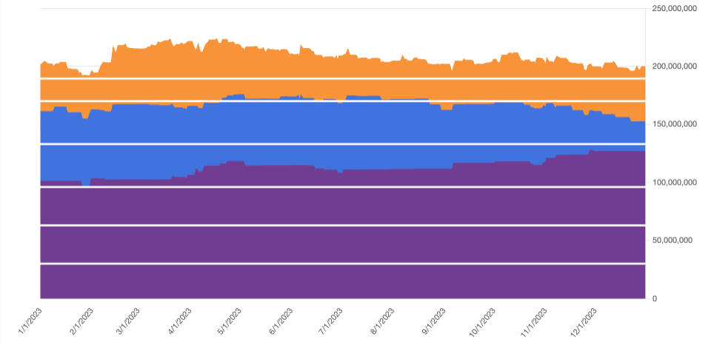
Liquidity Displayed for Decision Making
© 2024 Three+One Company, Inc.
Notes:
Using your banking data we perform an analysis that looks not only at the daily transactional data and builds a forecast but also stress tests the data to determine how long your cash will remain under your control so it can be more optimally invested
In our methodology the “working capital” is the cash you’d typically have on deposit at your main receiving and disbursing accounts and your “cushion” is that cash you might keep in a bank money market account or in your local government pool. Beyond the those two layers we separate your other cash into “levels” based on how long we think it will be in your control even adjusting for the “worst case” scenarios.
By determining these layers we can confidently construct an investment strategy that allows us to take advantage of the yield curve by investing for very modest lengths of time.

Slide 37
Liquidity Displayed for Decision Making
© 2024 Three+One Company, Inc.
Notes:
This table are the numbers related to the prior slide that allows you to make investments. Not every client has all these levels. The levels, amounts, and “durations” are based on our stress testing.
THE BENCHMARK RATE FOR THIS TABLE WAS AS OF May 31, 2022 EOD.

Slide 38
10. Balances liquidity with yield
© 2024 Three+One Company, Inc.
Notes:
A 30 year bond will be just as safe as a 2 year bond, but if you have a pessimistic view of the US Treasury or any other issuer then you might see a 30 year as less safe than a 2 year.
Treasury bills, bonds and notes they are all highly liquid meaning they can be traded easily, nearly 24/7 with transparent prices and pricing. However, a 30 bond is more price volatile than a 2 year bond given how bonds are priced. Bonds will longer maturities are more price sensitive to changes in prevailing interest rates. So while all Treasury bills, bonds and notes are highly liquid a 30 year bond is less liquid by this definition in that its price is more sensitive to market changes than a 2 year note.
As we will discuss when we talk about the yield curve a longer maturing will almost always have a higher yield than a shorter maturity. This is generally because over a longer period of time an investor needs to be compensated for liquidity risk and inflation risk in the case of Treasury securities. If we are talking about corporate bonds we’d also have to add in some measure of credit risk which would further increase the yield differential.

Slide 39
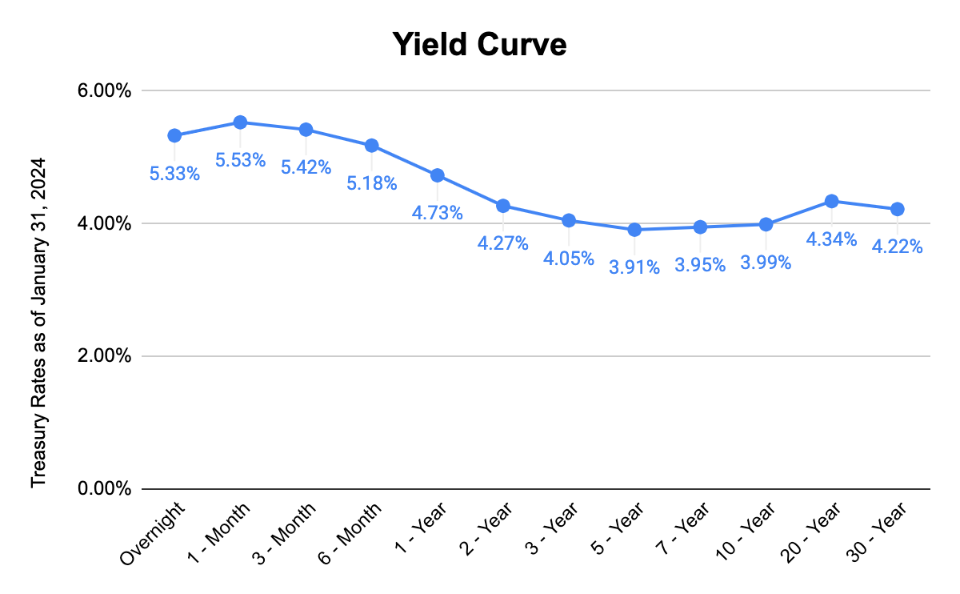
© 2024 Three+One Company, Inc.
Notes:
This slide is just to set the data series for the discussion.

Slide 40
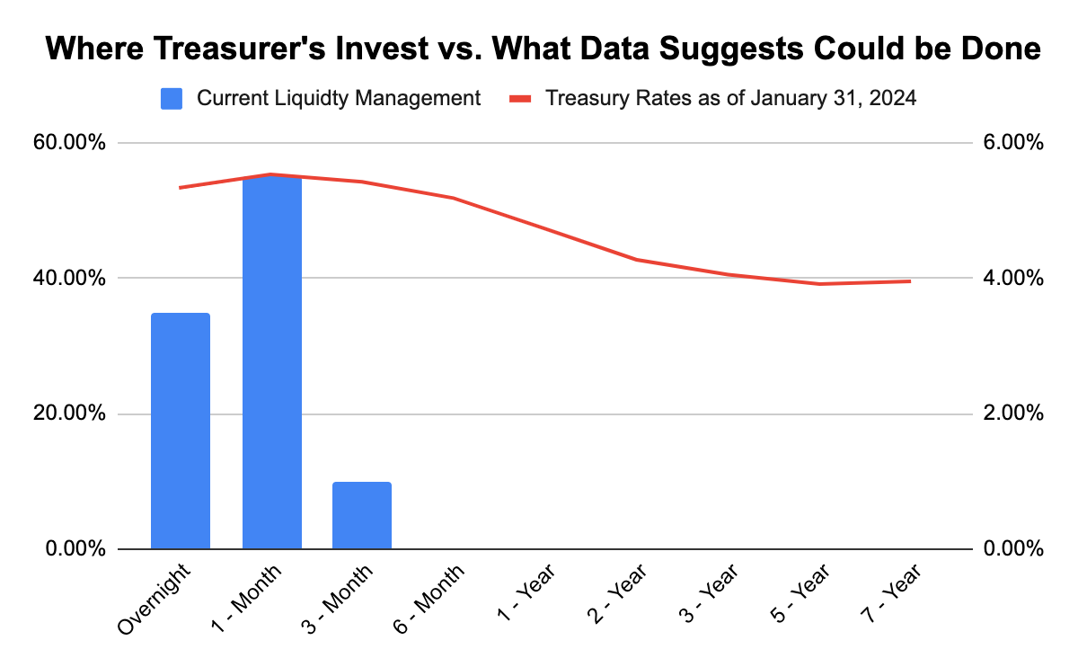
© 2024 Three+One Company, Inc.
Notes:
Many public treasurers or finance officers with responsibility for investing public funds end up investing in this manner.
The vast majority of public investors are fiscally conservative and risk averse.
At today’s rates this sort of investment strategy will earn 2.27%

Slide 41
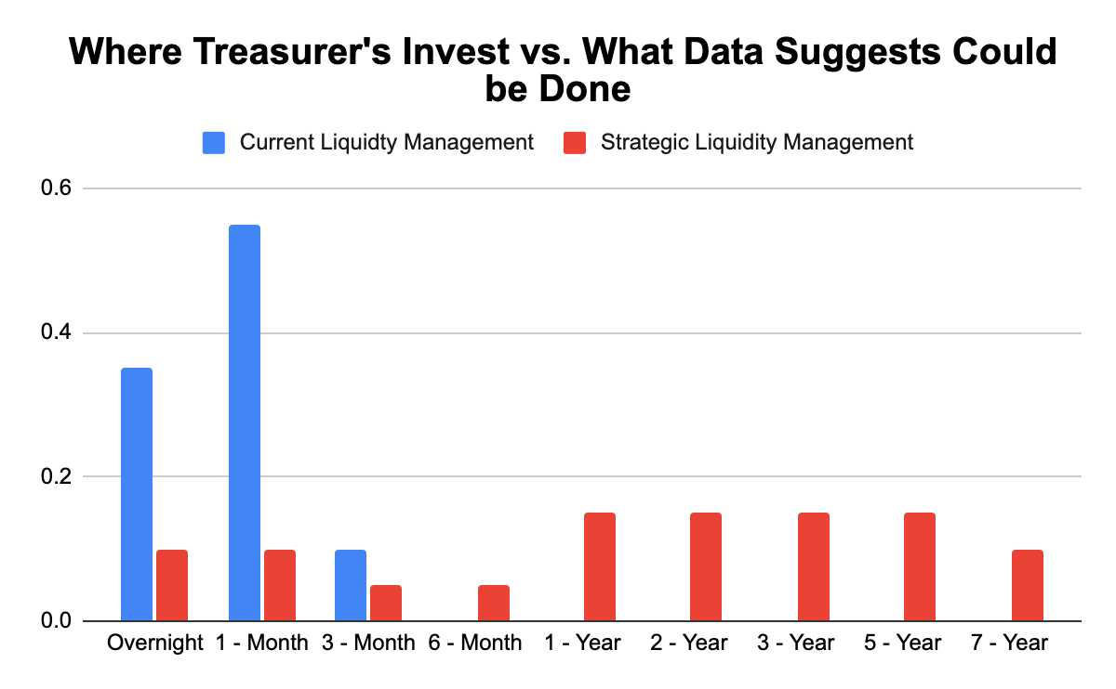
© 2024 Three+One Company, Inc.
Notes:
Most public treasuries would like to be here.
And the vast majority have an investment policy that allows them to do this with treasury securities or CDs.
The yellow bar is where they would like to be invested.
The expected return of this “strategy” is 2.15%. Where 2.15% is the sum of the weighted expected returns by levels/maturities.

Slide 42
Comparing the two “strategies”
Portfolio 1 -
expected return of 4.17%
Portfolio 2 -
expected return of 5.07%
Increased expected return of 0.90% on a base of $10 million means $90,000 more resources.
Moving from an expected return of 4.17% to 5.07% is a 20% increase in expected interest earnings.
Most importantly….this has been achieved without taking on credit risk (we are only using Treasuries).
© 2024 Three+One Company, Inc.
Notes:
We are taking on a certain amount of duration/maturity risk. The weighted average maturity of this portfolio goes from 100 to over 500 days. However….this is mitigated by the fact the fact that we have laddered in the selected treasury investments.

Slide 43
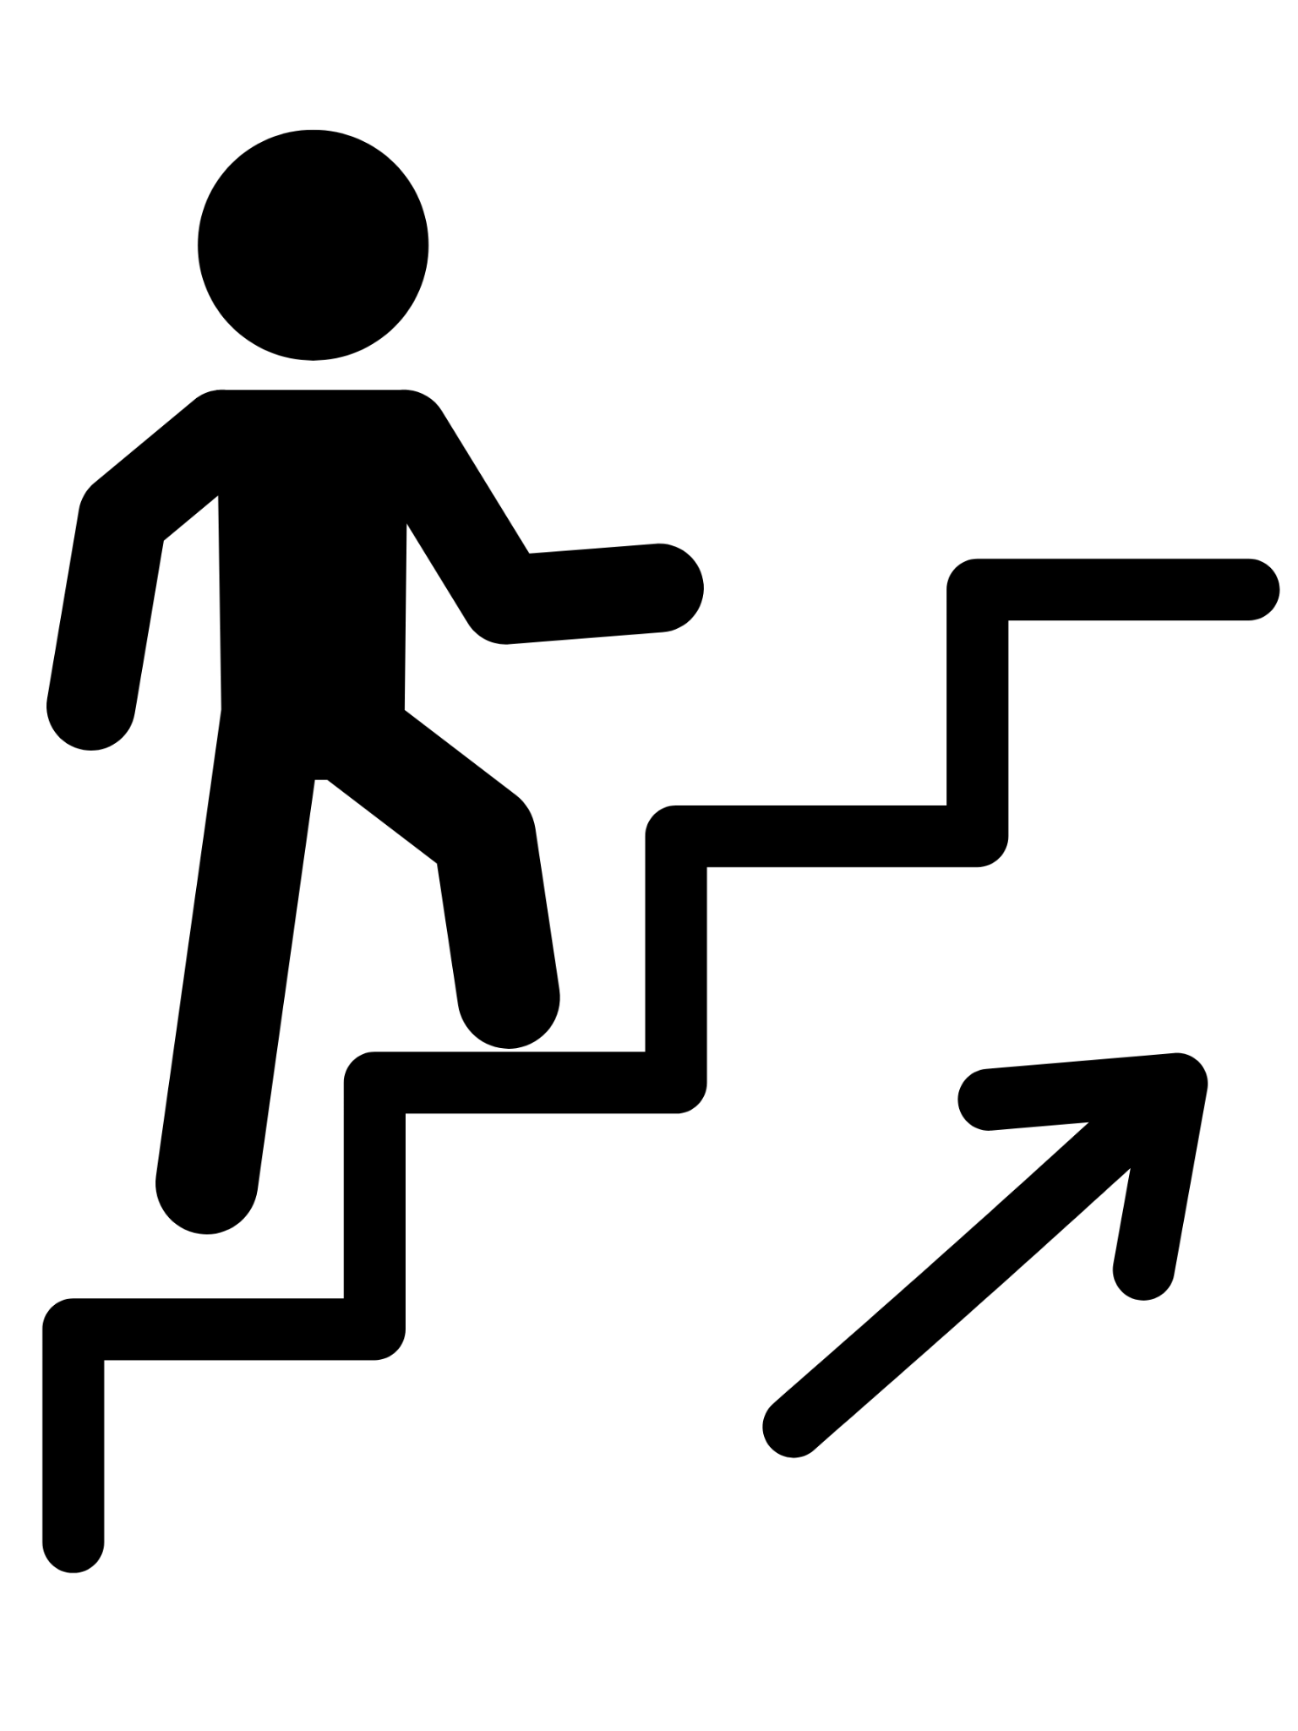
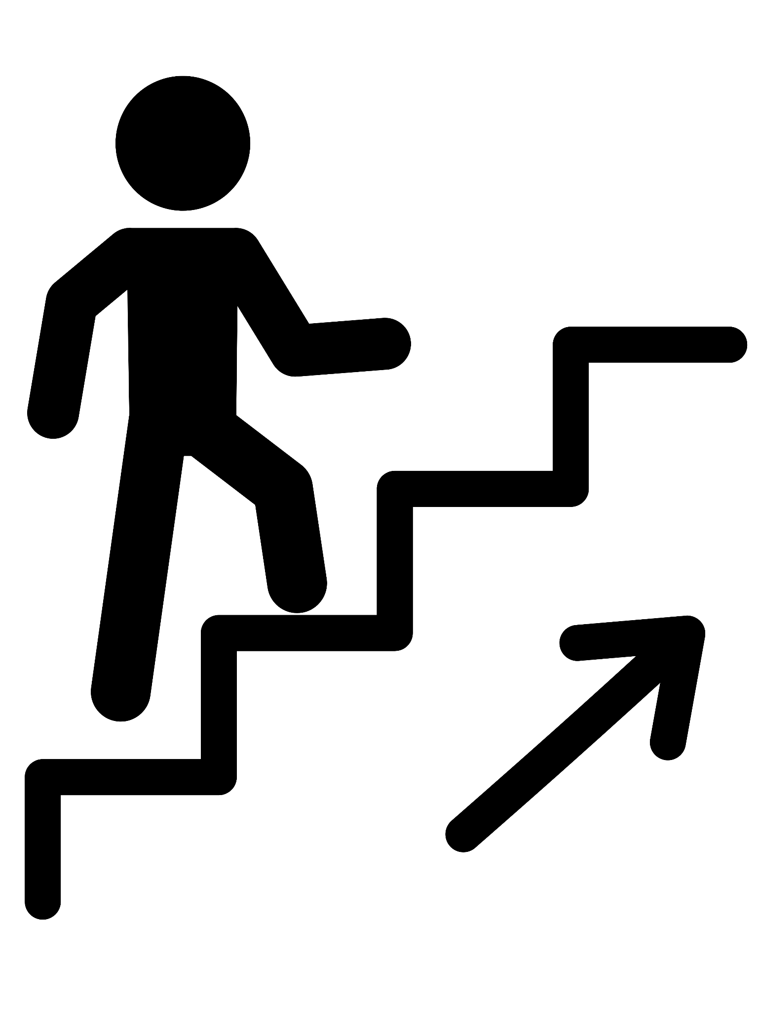
Prudently investing public funds is
a bit like climbing a staircase
Stable, steady, upward progression is the key. The sooner you put available cash to work earning interest, the higher your net earnings will be. A series of safe, dependable, laddered investments that take into consideration the factors of, “how much”, for “how long”, and then researching the most advantageous interest rates available, is the key to success.
© 2024 Three+One Company, Inc.
Notes:
This slide is to reinforce our ladder approach to placing/investing funds but also to advocate for a treasurer to take steps to use the data to extend the portfolio and start investing.

Slide 44
Key Takeaways
1
Understand that data has power to help drive decision making
6
Knows peer and market benchmarks
2
Has an updated business continuity plan in place
7
Optimizes its banking structures
3
Is cyber security aware!
8
Knows when to go out for a Request for Proposal (RFP)
4
Open to innovation
9
Complements cash flow with liquidity management
5
Has an active investment policy
10
Balances liquidity with yield
© 2022 Three+One Company, Inc.
Notes:
1. Understand that data has power to help drive decision making
2. Has an updated business continuity plan in place
3. Is cyber security aware!
4. Open to innovation
5. Has an active investment policy
6. Knows peer and market benchmarks
7. Knows when to go out for a Request for Proposal (RFP)
8. Optimizes its banking structures
9. Complements cash flow with liquidity management
10. Balances liquidity with yield

Slide 45
© 2022 Three+One Company, Inc.

Slide 46
Thank You
Peter Forsgren
COO and Co-Founder pdf@threeplusone.us
(585) 484-0311 x701
Kevin Teborek
Business Development
kat@threeplusone.us
(585) 484-0311 x718
© 2024 Three+One Company, Inc.

