Slide 1
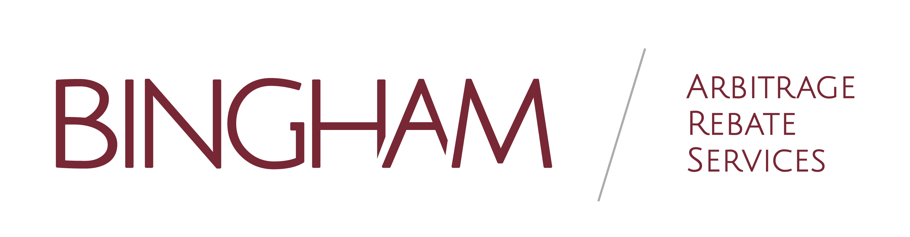
NC Local Government Investment Association
2024 Winter Conference
Basics of Arbitrage Rebate Compliance
“Like I need something else to worry about!”

Slide 2


Arbitrage rebate rules, deadlines and exceptions
Local government lessons
Considerations when planning a bond issue
How an issuer might benefit from having arbitrage
Objectives

Slide 3
Arbitrage Rebate
and Yield Restriction
Tax Code in place to:
Prevent issuing more bonds than are necessary - Issue what you need.
Prevent issuing bonds earlier than necessary - Issue when you need.
Prevent bonds from remaining outstanding longer than necessary.
Notes:
1986 Tax Law.

Slide 4
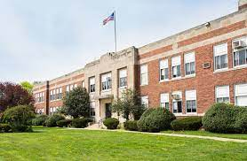
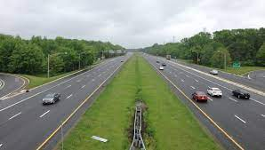
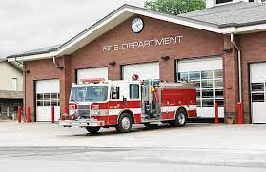
What Kind of Debt Requires Arbitrage Rebate and Yield Restriction Calculations?
    Applies to every tax-exempt borrowing
    Examples include:
    Bonds: General Obligation, Revenue, Limited Obligation, Certificates of Participation
    BANs and Short-term Variable Notes
    Notes, Leases, Commercial Paper
    Installment Financing Contracts / Agreements
    Taxable issues receiving subsidies (BABs, QZABs, QSCBs)
    (Filing any type of IRS Form 8038 means
    post-issuance compliance for arbitrage
    rebate and / or yield restriction is required.)

Slide 5

Local Government Lessons
Not an Arbitrage Expert
But You don’t have to be,
You just need understanding.
DISCLAIMER
Alamance County, NC

Slide 6
Alamance County

Slide 7

Alamance County

Slide 8
Alamance County’s History
  Historically Small Issuer
  July 2018 Outstanding Debt - $53 million

Slide 9
History
November 2018 – Voters approved bond referendum
  $150 million for public schools
    Construct new high school
    Renovations at nine other school campuses
  $39.6 million for community college
    Construct Biotechnology Center, Student Services Building, Public Safety Training Center
    Renovations in other campus buildings

Slide 10
Bond Sale, Series 2021
April 2021 – County issues bonds
  Results:
  Par Amount - $151,150,000
  Premium - $23,158,051
  True Interest Cost - 1.4389%
  Arbitrage Yield – 1.3297%

Slide 11
Bond Sale proceeds
Tax Exempt proceeds can earn interest.
Invested proceeds
  NCCMT
  Commercial Paper

Slide 12
Interest rate history

Slide 13
Arbitrage-What is it?
The difference between the interest paid on tax-exempt bonds and the interest earned by investing the proceeds of the tax-exempt bonds in taxable higher yielding securities.
Definitions

Slide 14
Arbitrage Rebate
Investment earning on your bond proceeds in excess of the declared tax-exempt bond yield
Rebated to Federal Government
Definitions

Slide 15
Arbitrage-how to handle
Enlist assistance
Evaluated every year
Experiences

Slide 16
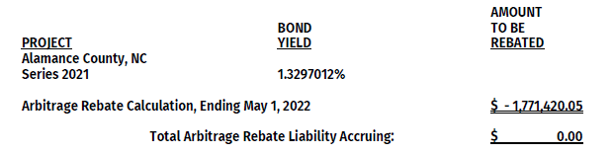
Evaluation
Year 1

Slide 17
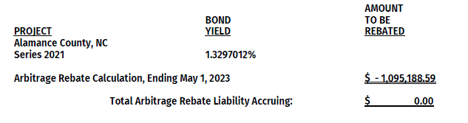
Evaluation
Year 2

Slide 18
Bond Sale, Series 2023
October 2023 – County issues bonds
  Results:
  Par Amount - $15,135,000
  Premium - $935,414
  True Interest Cost – 4.2436%
  Arbitrage Yield – 4.0378%
  Current Investment Interest Rates – 5.26%

Slide 19
Arbitrage Rebate and Yield Restriction -
Two Sets of Tax Code Rules
    Arbitrage Rebate Rules
    Yield Restriction Rules (Capital Projects)
    Compliance is due at least every 5 years while gross proceeds remain outstanding.
    (Tax Reform Act of 1986)
If project proceeds are held longer than 3 years, outstanding project proceeds are to be yield restricted and earn limited income. The yield restriction calculation becomes a factor for compliance purposes.
(Tax Reform Act of 1969)
f Rules and Two Separate Calculations
It’s the law no matter if a payment is due or not
Notes:
ARC begins on the date of issue. Yield Restriction begins when temporary period expires. Separate calculations.

Slide 20
    Yield Restriction (Capital Projects)
    The IRS regulations permit unspent capital projects proceeds to be invested at a yield in excess of the bond yield for the first 3 years after the bonds are issued. However, such excess earnings are still subject to the arbitrage rebate rules.
    If bond proceeds remain unspent after the end of the 3-year temporary period and are earning an investment return in excess of the bond yield, the issuer is required to make “yield reduction” payments to the federal government to effectively reduce the investment return to a yield not materially higher than the bond yield. Any required yield reduction payments must be made by the issuer to the federal government on the same schedule that it is required to make arbitrage rebate payments to the federal government.
Definitions

Slide 21
Gross Proceeds Subject to Post Issuance Compliance
Project / Construction
Cost of Issuance
Capitalized Interest
Debt Service Reserve
Escrow
Sinking Funds
Interest Earnings
Pledged Proceeds
Transferred Proceeds

Slide 22

“I need to spend all my Construction Proceeds within three years, or I’ll lose my tax-exempt status” – FALSE
“I should keep my gross proceeds in cash, so I’ll avoid arbitrage earnings” – FALSE
“If I invest some of the gross proceeds in tax-exempt investments, that will help lower my arbitrage earnings” - FALSE
“If I spend all of my Construction Proceeds within two years, I’ve met the 2-Year Spending Exception” – MAYBE
Myth Busters

Slide 23
Exceptions
Small Issuer Exception *
Spending Exceptions
6-month spending exception
18-month spending exception
2-year spending exception
Bona Fide Debt Service Fund Exception
* Yield restriction still applies for Small Issuers.

Slide 24
Small Issuer Exception
Government entity with general taxing power issues $5 million or less of cumulative tax-exempt financings in one calendar year, they are exempt from the rebate requirements.
Yield restriction rules still apply to Small Issuers for effective temporary periods.
Legislative changes increased the Small Issuer Exception limits:
Up to $15 million with at least $10 million used to finance public schools for bonds issued after December 31, 2001.

Slide 25

Spending Exceptions
Six-Month Exception:
100% at 6 Months
Eighteen-Month Exception:
15% at 6 Months
60% at 12 Months
100% at 18 Months (5% reasonable retainage)
Two-Year Construction Exception:
10% at 6 Months
45% at 12 Months
75% at 18 Months
100% at 24 Months (5% reasonable retainage)
* Interest earnings are included in spending exception calculation. Meet a spending exception and you get to keep your positive arbitrage earnings!
Notes:
DSR Funds – not eligible for spending exception.

Slide 26
“18-Month Exception”
Exception #2
Not limited to Construction Issues
15% within 6 months
60% within 12 months
100% within 18 months
*Cannot be Used with the 2-year exception*

Slide 27
“Two-Year Construction Exception”
Exception #3
Applies Only to a “Construction Issue”
Issuer must expect that 75% of the issue will be spent on “construction expenditures.”
“Construction expenditures” generally do not include land acquisitions.
“Constructed Personal Property” (e.g. customized fire truck)
  Expenditure Requirements
  10 % within 6 months
  45% within 12 months
  75% within 18 months
  100% within 24 months
  For 6, 12 and 18 months, issuers estimate of investment earnings may be used.

Slide 28
Bona Fide Debt Service Fund Exception
Bona fide debt service funds are exempt when used primarily to achieve a proper matching of revenues with debt service payments within each bond year.
The fund has to deplete properly each bond year (1/12 of principal and interest payments for the immediately preceding bond year).
Once qualified as a bona fide debt service fund, this type of fund is typically excluded from the arbitrage rebate calculation when annual earnings are less than $100,000. In cases where the average debt service does not exceed $2,500,000, the $100,000 earnings limitation is treated as satisfied.

Slide 29
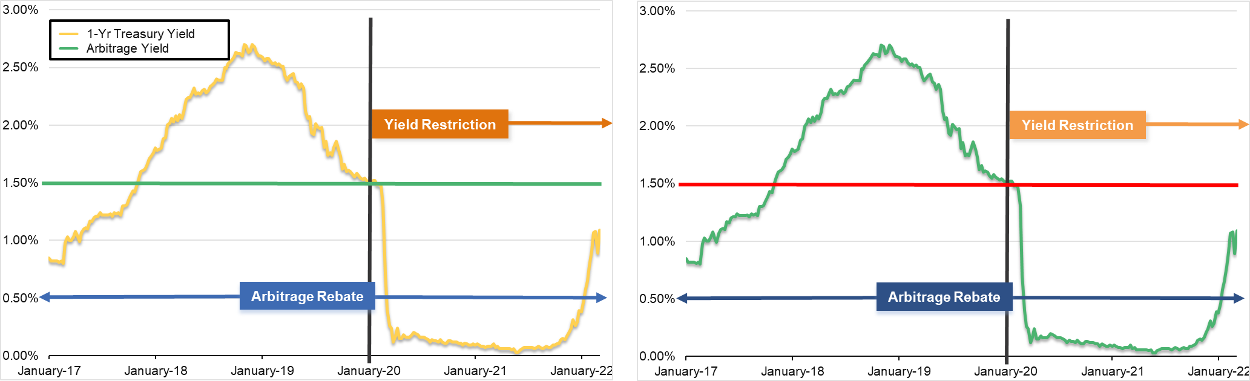
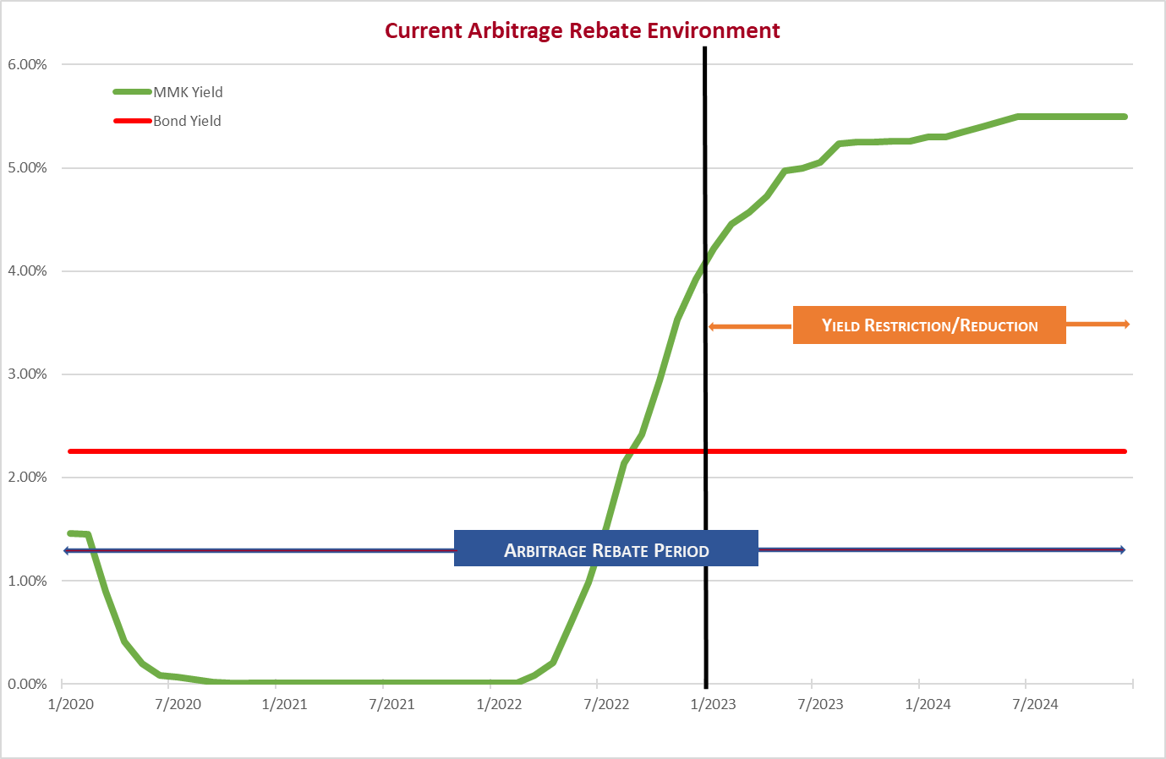
Why All The Chatter About Arbitrage Liabilities?
5-year period starting in 2017…
Very different from 5-year period starting in 2020…
Arbitrage Rebate versus Yield Restriction

Slide 30
Higher Investment Rates Create Natural Arbitrage
For illustrative purposes only.
Notes:
Series 2019’s – we are seeing yield reduction liabilities. Payments will be due in 2024.

Slide 31
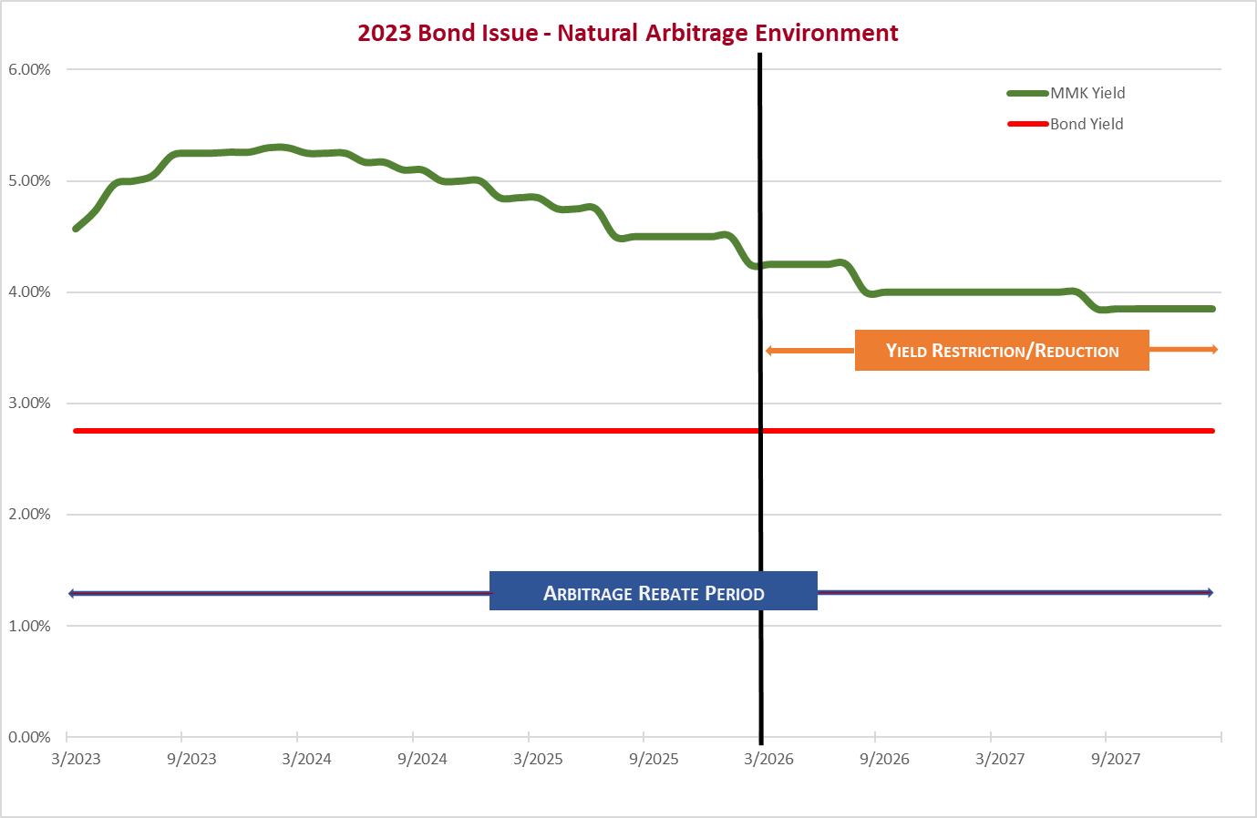
Series 2023 – Natural Arbitrage
For illustrative purposes only.
Notes:
Series 2023’s positive arbitrage from the start.

Slide 32
Current Arbitrage Rebate Examples
Water and Sewer Issue
$290,733,000
Revenue Bonds
Series 2022
Bond Yield 2.182%
Year 1, March 2023
Arbitrage Rebate Liability $936,104.82
Town Issue
$17,110,000
Limited Obligation Bonds
Series 2023
Bond Yield 2.94%
6 Month Evaluation, September 2023
10% required for Exception / 21.22% spent
Arbitrage Rebate Liability $179,677.55

Slide 33
Rebate versus Yield Restriction Comparison
Arbitrage rebate
Yield restriction
Example:
First Installment Period
(Years 1 - 5)
Investment Yield: 1.90%
Bond Yield: 2.25%
Arbitrage: -0.35%
No Rebate payment due
Example:
First Installment Period
(Years 4 – 5)
Investment Yield: 4.500%
Bond Yield + .125%: 2.375%
Earnings over
Bond Yield: 2.125%
Yield Reduction payment due
If both arbitrage rebate and yield reduction amounts are positive, you only owe one payment. The higher amount is due to the IRS.

Slide 34
Current Yield Reduction Example
County Issue
$107,170,000
General Obligation Public Improvement Bonds
Series 2019
August 2022
Years 1 – 3: Arbitrage Rebate Liability $-2,733,761.72
Yield Reduction – N/A $ 0.00
August 2023
Years 1 – 4: Arbitrage Rebate Liability $-2,197,151.22
Year 4: Yield Reduction $ 556,131.36

Slide 35
Current Yield Reduction Example
City Issue
$18,270,000
General Obligation Parks and Recreation Bonds
Series 2019
May 2022
Years 1 - 3: Arbitrage Rebate Liability $ - 615,576.60
Yield Reduction – N/A $ 0.00
May 2023
Years 1 - 3: Arbitrage Rebate Liability $ - 549,967.59
Year 4: Yield Reduction $ 72,787.36

Slide 36

    Check with bond counsel regarding reimbursement resolutions.
Have early testing completed semi-annually to stay ahead of meeting a spending exception.
Have compliance reports completed annually versus waiting until the fifth-year/installment period.
Maintain good records by keeping:
  Bank/Investment/Trust Statements
  Bond Transcript
  Past Arbitrage Rebate Reports
  IRS requirement: Keep all records for tax-exempt issues at least 3 – 6 years after bonds paid in full.
Notes:
Reimbursement at the beginning of the issue & possible reimbursement if project finished and gross proceeds left.

Slide 37
Documentation!
WHO is in charge of overseeing compliance?
WHO is responsible for making sure calculations/reports are completed/filed?
WILL your department complete calculations in house? Or will an outside firm be hired?
Use of proceeds/Change in use
Education and Training
Record Keeping
Written Procedures for Arbitrage Rebate Compliance
Notes:
What is the IRS looking for in the unit’s written procedures?

Slide 38
If you owe a rebate payment (due 60 days after the evaluation date), and it isn’t the final computation date, you must pay at least 90%. The final payment can be deferred until the end of the calculation period.
Paying rebate/yield reduction payments will NOT cause an IRS audit.
If you are late with your payment, you have to write an “innocent failure” letter to explain (Revenue procedure 2005-40 and 2005-28).
Not paying arbitrage rebate or yield reduction payments can result in a loss of tax-exemption for your bonds.
Have a policy and process in place, mark your calendars!
Arbitrage Rebate Compliance and Follow Up
Notes:
Evaluation date may be anniversary or another chosen bond year. If you owe – check and Form 8038-T.

Slide 39

You earned the most bang for your buck!
Your investment return was good.
You may have more money to apply to your project with more interest earnings.
Being prepared when the installment date arrives, no one is caught off guard and everyone is ready when the payment is due.
Arbitrage Earnings Can Be A Good Thing!

Slide 40
Bingham Team
President
Kim Hoyt
Vice Presidents/Account Managers
Meredith Fraley
Patrick Bainter
Andre Barrett
Financial Analysts
John Cario
Suzan Fedock
Shelby Thomas
Kiran Shrestha
Business Development
Jeff Moore

Slide 41

Questions

Slide 42
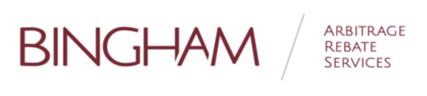
Follow Up
Jeff Moore 336-823-1066
jmoore@bingham-ars.com
info@bingham-ars.com
Susan Evans 336-570-4026
susan.evans@alamancecountync.gov

