Slide 1




Internal controls over cash & investments
Presented by Tim Lyons, CPA
Mauldin & Jenkins, PLLC
NCLGIA Winter Conference
February 18, 2026
Pinehurst, NC
Notes:
Note title
Type your notes here. They will be viewable in presenter view.

Slide 2


Agenda
Quick Overview of Internal control
Internal Controls over Cash Receipts
Internal Controls over Cash Disbursements
Internal Controls over Investments
Other Considerations and Wrap Up
Notes:
Note title
Type your notes here. They will be viewable in presenter view.

Slide 3
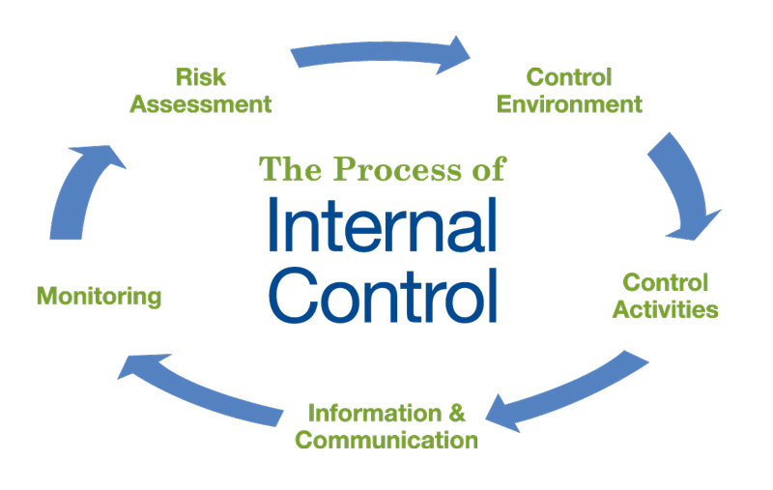
Overview of Internal Controls
Notes:
Internal Control: Process to provide reasonable assurance of reliability (both internal and external financial reporting), effectiveness/efficiency of operations, and compliance with applicable laws, regulations, etc.

Slide 4
Overview of Internal Controls
Control Environment
Five Elements of Internal Control
Control Environment – Tone at the Top
Risk Assessment – Identification and Analysis
Control Activities – Policies and Procedures
Information / Communication – Enables people to carry out their responsibilities
Monitoring – Assess quality of internal controls over time
Risk Assessment
Control activities
Information / Communication
Monitoring

Slide 5
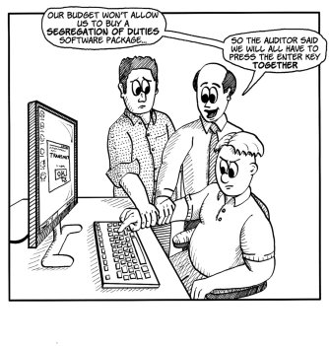
Overview of Internal Controls
Duties to be Segregated
Authorization of transactions
Custody of assets
Recordkeeping
Reconciliation

Slide 6
Overview of Internal Controls
Authorization of Transactions
The process of reviewing and approving transactions or operations
Verifying cash collections and daily balancing reports;
Approving purchase requisitions or purchase orders;
Approving timesheets, payroll certifications, leave requests and cumulative leave records;
Approving change orders, computer system design or programming changes

Slide 7
Overview of Internal Controls
Custody of Assets
The process of having access to, or control over, any physical asset such as cash, checks, equipment, supplies, or materials
Access to any funds through the collection of funds or processing of payments;
Access to safes, lock boxes, file cabinets or other places where money, checks or other assets are stored;
Custodian of a petty cash or change fund

Slide 8
Overview of Internal Controls
Recordkeeping
The process of creating and maintaining records of revenues, expenditures, inventories, and personnel transactions. These may be manual records or records maintained in automated computer systems
Preparing cash receipts or billings, purchase requisitions, payroll certifications and leave records
Entering charges or posting payments to accounts receivable
Maintaining inventory records

Slide 9
Overview of Internal Controls
Reconciliation
Verifying the processing or recording of transactions to ensure that all transactions are valid, properly authorized and properly recorded on a timely basis; this includes following up on any differences or discrepancies identified.

Slide 10
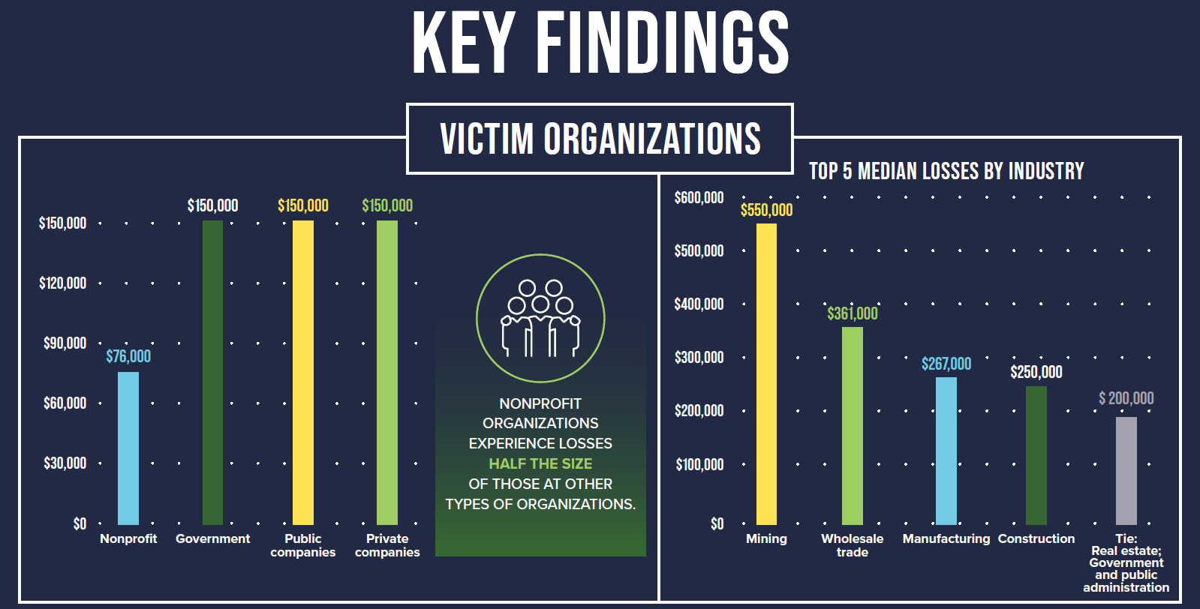
Fraud Risk Factors
Notes:
ACFR “Report to the Nations” for 2024

Slide 11
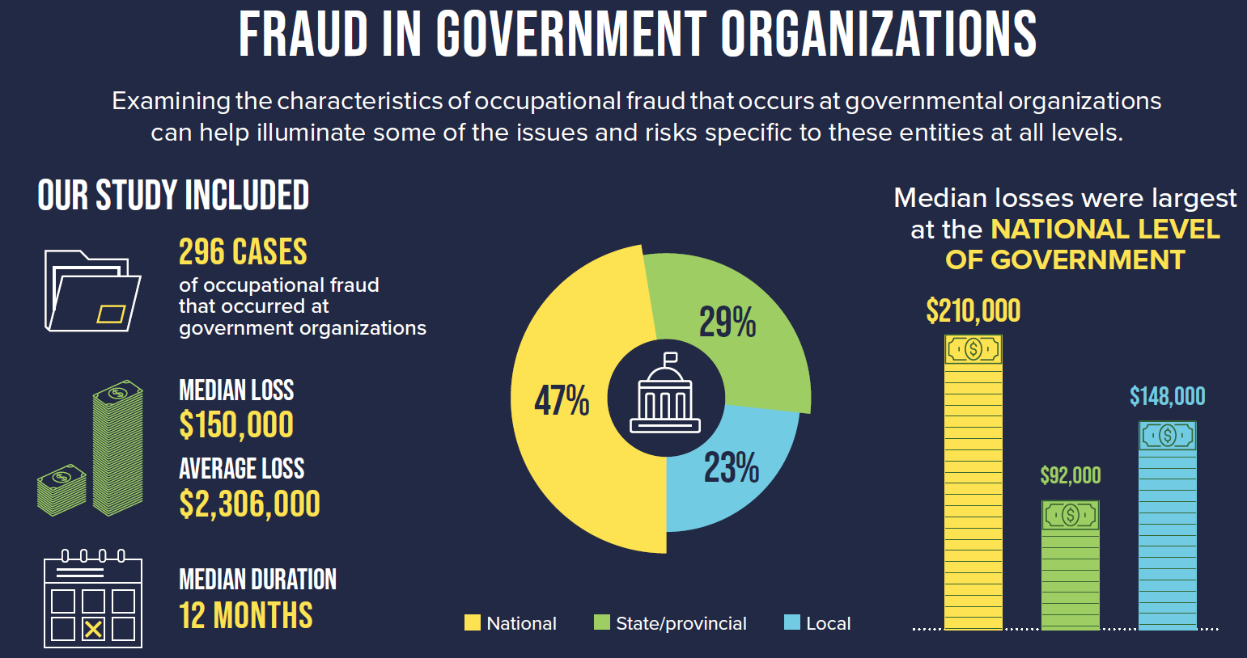
Fraud Risk Factors

Slide 12
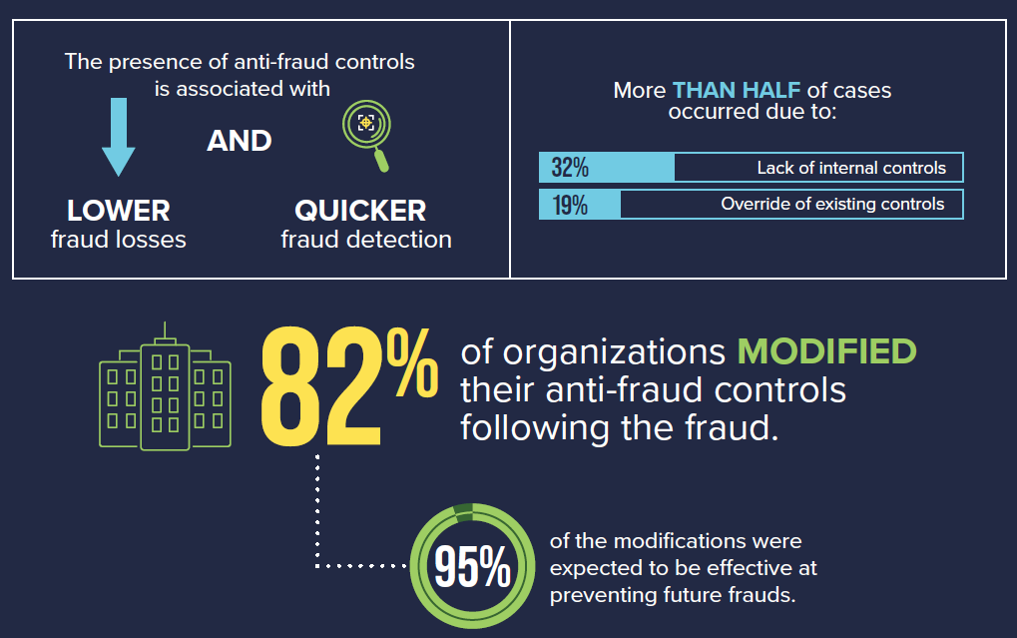

Slide 13
Internal Controls over Cash Receipts
Perform daily reconciliations of cash received through walk-in traffic and mail.
Reconciliations of cash register tape to cash drawer, daily cash receipts to postings, etc.
Deposit cash receipts on a daily basis.
Monthly (or even daily) reconciliation of general ledger to bank balance.
Notes:
Note title
Type your notes here. They will be viewable in presenter view.

Slide 14
Internal Controls over Cash Receipts
Individuals responsible for the following should be separate:
Opening mail or copying checks received
Posting cash receipts
Preparing deposits
Depositing cash receipts
Reconciling bank statements
Notes:
Note title
Type your notes here. They will be viewable in presenter view.

Slide 15
Internal Controls over Cash Receipts
For walk-in receipts:
All employees receiving cash should use pre-numbered receipts or a cash register
All checks should be restrictively endorsed upon receipt
Standard daily cash register reconciliation forms
Cashier funds should be counted and reconciled at the end of each shift and the reconciliation should be reviewed by a supervisor
Notes:
Note title
Type your notes here. They will be viewable in presenter view.

Slide 16
Internal Controls over Cash Receipts
For mailed receipts:
Someone independent of accounting department should open mail and restrictively endorse checks
Same person as above should also log each item
Accounting department should record the checks in the accounting system and deposit funds daily
A third person should periodically compare and contrast deposit slips to the daily log of incoming checks to ensure all receipts were deposited
Notes:
Note title
Type your notes here. They will be viewable in presenter view.

Slide 17
Internal Controls over Cash Receipts
For electronic receipts:
Bank drafts, electronic funds transfer (EFT), internet payments, etc.
Reports identifying individual receipts must be generated on a daily basis and reconciled to the funds received and deposited per the bank
Access to the report(s) should be separate from the responsibility to reconcile the bank statement
Notes:
Note title
Type your notes here. They will be viewable in presenter view.

Slide 18
Internal Controls over Cash Disbursements
Individuals responsible for the following should be separate:
Initiator of purchases
Approver of purchases
Receiving good/services
Preparation of checks
Accounts payable and issuance of checks

Slide 19
Internal Controls over Cash Disbursements
General Controls:
Bank accounts are authorized by the governing board or appropriate level of management
Individual(s) responsible for signing checks is/are authorized by the governing board or appropriate level of management
Mechanical check signers and signature plates
Dual signatures for checks over a certain amount
Prohibit checks payable to cash
Use of “Positive Pay”

Slide 20
Internal Controls over Cash Disbursements
Check Processing:
Prepared after proper matching to support documentation
Support documentation is appropriately marked/canceled with the check number
Signed by authorized signers
Dual signatures obtained, if required
Check for clerical accuracy, pricing, quantities received, brand name, etc. to the vendor invoice
Check signer reviews all supporting documents
Promptly recorded to the general ledger

Slide 21
Internal Controls over Cash Disbursements
Accounts Payable:
Reconcile monthly vendor statements
A/P subsidiary ledger is compared to open invoices
Appropriate individual is reviewing reconciliations
Access to the vendor list is restricted and ANY changes made are captured/logged and reviewed

Slide 22
Internal Controls over Cash Disbursements
Electronic Disbursements:
BEFORE utilizing, establish policies and procedures that address:
What online banking & EFT activities will be utilized?
Who is authorized to initiate transactions?
Who will approve electronic transactions?
Who will record electronic transactions?
Who will review and reconcile?

Slide 23
Internal Controls over Cash Disbursements
Electronic Disbursements:
Strong internal & IT controls
Written agreements with banks and third parties
Dual controls authorizing non-repetitive transactions
Dual controls to establish repetitive transactions
Establish transactions limits
Use of passwords / pin numbers / call-back verification

Slide 24
Internal Controls over Investments
Investment Policies and Procedures Should Address:
Segregation of duties:
Authorization, execution of trades, recording, and reconciliation
Conflicts of interest:
Internal investment staff, trading, holding/custodial services, and financial advisor(s)
Adherence to State (and other) laws
Risk appetite
Regular reconciliation to the general ledger for all amounts (investment balances and related income).

Slide 25
Compensating Controls
What if we can’t achieve perfect segregation of duties?
Sometimes, it’s not practical OR cost effective!
Examples of compensating controls include:
Timely reconciliation and review of all bank accounts
Lockbox service for cash receipts
Outsourcing
Cross-train employees!
Change the bank rec person
Require one (1) week of vacation

Slide 26

Questions?
Notes:
Note title
Type your notes here. They will be viewable in presenter view.

