Slide 1



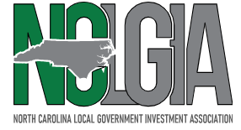

Arbitrage Rebate Compliance
Practical Insights and what Bond Issuers are seeing in today’s market
Brandon lofton, Robinson bradsaw
Deanna rios, Lincoln county
Kim hoyt, bingham Arbitrage Rebate services, inc.
February 19, 2026

Slide 2
What is Arbitrage?
County issues $100 million of tax-exempt bonds to build new schools.
Bonds have a yield of 4%.
County invests bond proceeds and earns 6% yield on investments.

Slide 3
Why it Matters.
General Principle.
Reasonable Expectations.
Rebate owed.
Tax-exempt Status of Bonds.

Slide 4
Compliance.
Bond proceeds.
Arbitrage Yield Restriction.
Temporary Periods.
Rebate Payments.
Yield Reduction Payments.

Slide 5
Rebate Spending Exceptions.
Six-Month Exception.
Eighteen-Month Exception.
Two-Year Exception.

Slide 6
5-Year Arbitrage Rebate Compliance Timeline
Bond Closing
Annual Monitoring
Years 1–4
5-Year Installment
Form 8038-T
(if applicable)
Years 6–9
Monitoring
Final Computation
At Maturity

Slide 7
IRS Filing Requirements
5-year installment payments (60 days)
Final payment at maturity or redemption (60 days)
Form 8038-T filing (only if payment due)
Yield reduction payments when applicable
(currently applicable)

Slide 8
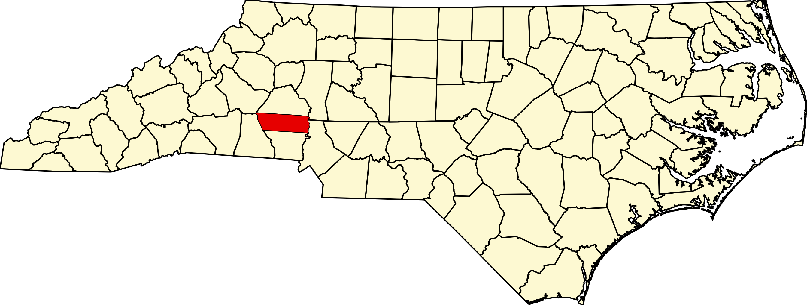
Lincoln County – Profile
The County has experienced strong growth, largely due to its proximity to the Charlotte metropolitan region.
Middle-to-upper middle income suburban/rural households.
Older median age than state and national averages.
Strong commuter influence from the Charlotte metro economy.
Population (2024 est.): 97,611
2020 Census: 86,810
Growth (2020–2024): +12.4%
Population Density: ~330/sq. mile

Slide 9
Lincoln County – Compliance
Water and Sewer Revenue Bonds Series 2018
Amount: $13.895 Million / Bond Yield: 3.5258%
Purpose: Water and Sewer System Improvements
Arbitrage Rebate: 1st Installment = $ - 653,084.32
2nd Installment = $ - 695,112.93
Yield Reduction: 1st Installment = $ - 80,469.46
2nd Installment = $ - 100,766.80
Water and Sewer Revenue Bonds Series 2020
Amount: $28.435 Million / Bond Yield: 1.0749%
Purpose: Utility System Capital Improvements
Arbitrage Rebate: 1st Installment = $ - 504,471.14
Yield Reduction: 1st Installment = $ - 1,283.85

Slide 10
Lincoln County – Recent Compliance
$19,640,000
Installment Financing Contract
Dated: September 22, 2021
Bond Yield = 1.9199741%
September 1, 2023
Years 1 – 2: Arbitrage Rebate Liability $ - 273,457.92
Years 1 – 2: Yield Reduction N/A
(Balance in Project Fund = $8,284,427.98)
_________________________________________________________________________________________________________________________
September 1, 2024
Years 1 – 3: Arbitrage Rebate Liability $ - 185,835.19
Years 1 - 3: Yield Reduction N/A
(Balance in Project Fund = $567,426.27)
_________________________________________________________________________________________________________________________
September 1, 2025
Years 1 – 4: Arbitrage Rebate Liability $ - 180,214.24
Year 4: Yield Reduction (Payment Due) $ 4,935.82
(Balance in Project Fund = $116,634.98)

Slide 11
Lincoln County – Recent Compliance
$27,225,000
Limited Obligation Bonds
Series 2024
Bond Yield = 3.3311108%
August 7, 2025
Year 1: Arbitrage Rebate Liability $ 412,777.30
Year 1: Yield Reduction N/A
(Balance in Project Fund = $23,749,853.27)

Slide 12
Why Arbitrage Rebate Compliance is Getting More Attention
Market Conditions:
Rise in interest rates
Higher short-term investment yields
Increased likelihood of positive arbitrage
Issuer Impact:
More frequent IRS payments
Budgeting challenges
Greater scrutiny of compliance processes
Not unusual – many Issuers are experiencing similar outcomes

Slide 13
What Issuers are Experiencing
Increased frequency of installment payments
Yield reduction payments replacing rebate in certain situations
Payments arising even when spending exceptions were expected
Construction funds with delayed expenditures
Important Point:
Payments do not indicate non-compliance — they indicate compliance is working

Slide 14
Positive arbitrage can be a good thing!
Sample Calculation
Bond Yield = 3.5%
Investment Yield = 2.85%
$20,000,000.00
1,781,580.95
(372,443.62)
(9,060.00)
0.00
$21,781,580.95
Sample Calculation
Bond Yield = 3.5%
Investment Yield = 3.75%
$20,000,000.00
2,425,879.98
279,230.53
(9,060.00)
270,170.53
$22,155,709.45
Sale Proceeds
Investment Earnings
Rebate Amount
Computation Credits
Rebate Payment
Project Proceeds Available
Additional money to apply to the Project: $374,128.50
For illustrative purposes only.

Slide 15
Myths: Arbitrage Rebate and Yield Reduction
Myth:
Arbitrage rebate or yield reduction payments mean something went wrong.
Reality:
Payments often reflect strong market performance and timely compliance — not an error or audit issue.
_______________________________________________________________________________________________________
Myth:
If we expected to meet a spending exception, arbitrage payments won’t apply.
Reality:
Spending exceptions are fact-specific and timing-sensitive; delays or partial spending can still trigger rebate or yield reduction.

Slide 16
2025 IRS 8038-T’s Filed (Bingham Clients)
Arbitrage Rebate Payments:
$21,110,569
Yield Reduction Payments:
$32,895,388
8038-T’s filed for the year 2025: 134

Slide 17
Post-Issuance Compliance
Adopt written compliance procedures
Maintain accurate expenditure and investment records
Coordinate with trustee and service providers
Maintain organized digital records and documentation for audit readiness.

Slide 18
Best Practices for Bond Issuers
Have compliance reports completed annually versus waiting until the fifth-year/installment period.
Calendar compliance deadlines.
Inform your arbitrage rebate firm of changes to an issue, such as being refunded. Evaluation dates change.
Maintain good records by keeping:
Bank/Investment/Trust Statements
Bond Transcript
Past Arbitrage Rebate Reports
IRS requirement: Keep all records for tax-exempt issues at least 3 – 6 years after bonds paid in full.

Slide 19
Questions?

