Slide 1


Fleet Funding Options
Thursday, February 20th
CONFIDENTIAL AND PROPRIETARY
© 2025 Enterprise Fleet Management, Inc.

Slide 2

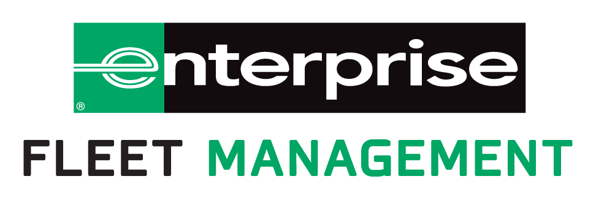
OVERVIEW
FUNDING OPTIONS EXPLAINED
IMPACT ON TCO
EXAMPLES
QUESTIONS
TODAY’S GOALS
CONFIDENTIAL AND PROPRIETARY
© 2025 Enterprise Fleet Management, Inc.

Slide 3

OVERVIEW

Slide 4

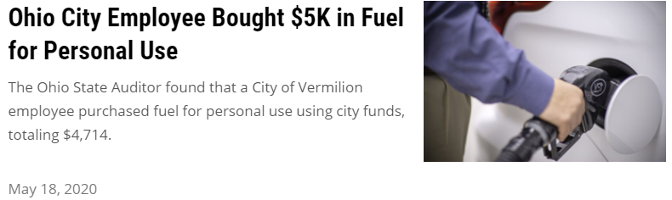
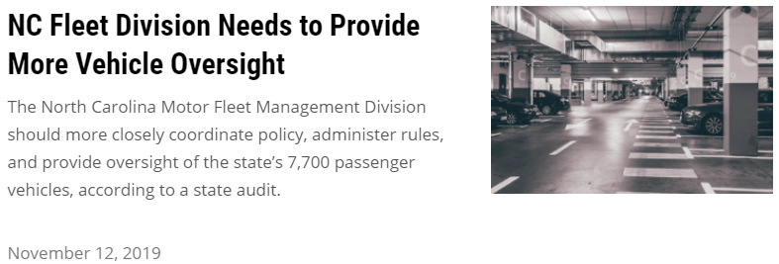
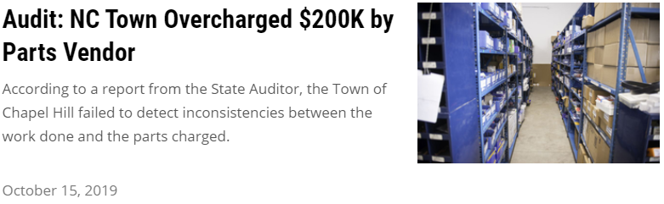
TODAY’S CHALLENGES
TASKED TO DO MORE WITH LESS
Limitations on Revenue Sources
Underfunded and Unfunded State Mandates
Cost of Living Adjustments
Post-employee Benefits
Capital Deferment
CONFIDENTIAL AND PROPRIETARY
© 2025 Enterprise Fleet Management, Inc.

Slide 5
GOVERNMENT FLEETS
COMMON PRACTICES
Capital Budget Determines Growth & Replacements
  Multiple Departments with Multiple Plans & Budget
Access to Volume Buying Power
  State Contract
  TIPS
  E&I
  Sourcewell
  Sheriff Association
Low Annual Mileage
  5,000-10,000 Average Annual Miles
Aged Fleet
  Typical average age of fleet is over 10 years
  Underutilized vehicles
  Sell through public auction or Govt Deals
CONFIDENTIAL AND PROPRIETARY
© 2025 Enterprise Fleet Management, Inc.

Slide 6

GOVERNMENT FLEETS
COMMON PRACTICES
CHALLENGES CREATED
Capital Budget Determines Growth & Replacements
  Multiple Departments with Multiple Plans & Budget
Access to Volume Buying Power
  State Contract
  TIPS
  E&I
  Sourcewell
  Sheriff Association
Low Annual Mileage
  5,000-10,000 Average Annual Miles
Aged Fleet
  Typical average age of fleet is over 10 years
  Underutilized vehicles
  Sell through public auction or Govt Deals
Capital Deferment
  Once behind in replacements, its hard to catch up
  Requires significant capital investment to get back on track
Great Vehicle Pricing!
  Significantly lower than commercial or retail
Keep in Fleet Longer
  Low mileage is often used to justify capital deferment
Aged Fleet
  Increased Operating Expenses (Maintenance, Fuel etc)
  Increased Downtime
  Poor image
  Decreased Fuel Economy
  Decreased Safety
CONFIDENTIAL AND PROPRIETARY
© 2025 Enterprise Fleet Management, Inc.

Slide 7

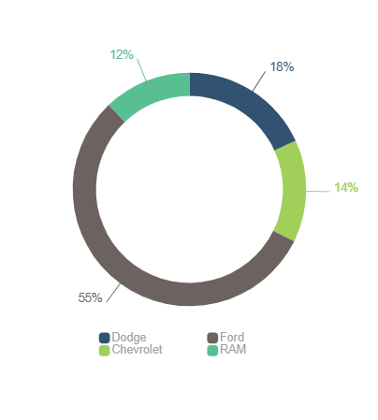

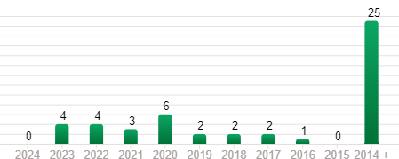










EXAMPLE
Total fleet size: Total fleet value:
Fleet Profile
49
$586,813
Manufacturer breakdown
Model year analysis
10 years
and older
Avg holding
Period (in years)
Avg age
12.4 years
14.4
Avg annual
acquisitions
Manufacturers
in fleet:
3.4
4
Odometer distribution
Average Odometer: 62,865
65%
14%
14%
6%
32 vehicles
7 vehicles
7 vehicles
3 vehicles

Slide 8
FUNDING
OPTIONS
EXPLAINED

Slide 9

VEHICLE FINANCE OPTIONS

Slide 10
PAY CASH
PROS & CONS
Pros
  Own vehicle outright, never an instance of fleet inequity or penalties
  No ongoing monthly/ annual payment obligations
  No debt or interest factor
  Flexibility with hold periods
  Rights to resale gains when vehicle is sold
Cons
  Vehicles are depreciating assets and will never be worth as much as you initially paid
  Requires significant capital upfront
  Opportunity Costs – once money is spent on depreciating asset it can no longer be used to satisfy other needs or investments
CONFIDENTIAL AND PROPRIETARY
© 2025 Enterprise Fleet Management, Inc.

Slide 11
TRADITIONAL FINANCE
PROS & CONS
Pros
  Cash flow friendly
  Builds equity in vehicle over term
  End user owns vehicle once paid off
  End user has all rights to resale equity once sold
Cons
  Requires underwriting and credit requirements
  Booked as debt
  Ongoing payments
CONFIDENTIAL AND PROPRIETARY
© 2025 Enterprise Fleet Management, Inc.

Slide 12
LEASING
PROS & CONS
Pros
  Cash flow friendly
  Builds equity in vehicle over term
  End user owns vehicle once paid off (Open End)
  End user has all rights to resale equity once sold (Open End)
  Flexibility on terms
  Only paying interested on financed portion
  Ability to roll equity
  Reduces the impact of mid-year budget ammendments
Cons
  Requires underwriting and credit requirements
  Ongoing payments
  Negative perception due to bad retail experiences
  Penalties at the end of term (Closed End)
  Always have a payment
CONFIDENTIAL AND PROPRIETARY
© 2025 Enterprise Fleet Management, Inc.

Slide 13
LEASING
OPEN VS CLOSED ENDED
Open Ended Leasing (Equity)
Closed Ended Leasing (Net, Walkaway)
Can be categorized as Operating or Capital
  Operating Lease – booked as monthly lease expense, doesn’t count as debt
  Capital Lease – simulates asset purchase, counts as debt
  Tax ownership is available on both Operating & Capital Leases
Lessee builds equity in the vehicle over the term and has the rights to the resale gains when sold
No penalties for over-mileage, wear/ tear, early termination etc.
Only obligation of lessee is to satisfy unpaid principal at anytime
Categorized as an operating lease only
Commonly referred to as a Net, Walkaway or Dealer Lease.
Has set term, mileage allotment and expectations on acceptable wear/tear.
Lessee has no obligation to resale equity
Penalties are typically assessed upon the turn in of the vehicle for over-mileage, excessive wear/ tear, early termination etc.
Typically lower monthly payments than open ended leases
Under new FASB lease guidance both operating and capital leases are now carried on balance sheet – previously operating leases were not required to be on the balance sheet – did not impact a client’s liabilities and future payment obligations.
CONFIDENTIAL AND PROPRIETARY
© 2025 Enterprise Fleet Management, Inc.

Slide 14
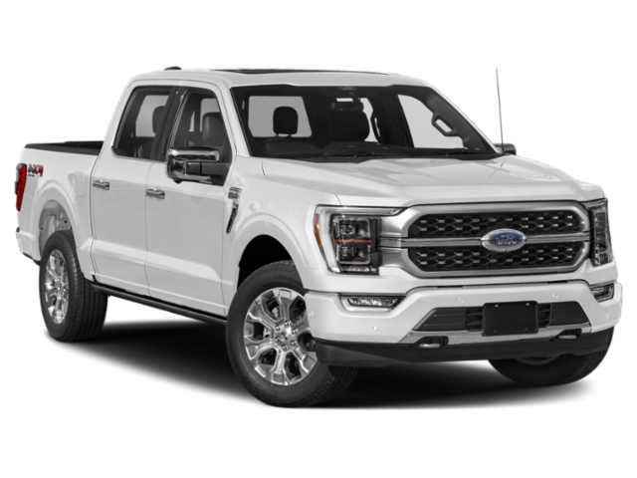




UNDERSTANDING THE EQUITY LEASE
Delivered Price - $50,000
Comparing Funding Options
Equity Lease
Financing vehicle down to a residual instead of $0 at term.
  Reduces monthly principal payment by $160 compared to Finance
  $9,500 of unpaid principal at term, can be satisfied by extension, equity roll or payoff
  Finance
  Finances full amount of the vehicle over the term
  Company owns the asset at end of term
  Cash Buy
  Pay full amount of vehicle upfront, own throughout life cycle
Equity Lease- Total Depreciation $30,000
60 months *1.35% Monthly Depreciation = 81% of Delivered Price
($675/month in Principal)
Estimated Resale - $20,000
Equity
$10,500
Unpaid Principal - $9,500
Traditional Finance $50,000
$0 Loan Balance ($835/month in Principal)
CONFIDENTIAL AND PROPRIETARY
© 2025 Enterprise Fleet Management, Inc.

Slide 15
UNDERSTANDING THE EQUITY LEASE
Delivered Price - $50,000
Comparing Funding Options
Equity Lease
Financing vehicle down to a residual instead of $0 at term.
  Reduces monthly principal payment by $160 compared to Finance
  $9,500 of unpaid principal at term, can be satisfied by extension, equity roll or payoff
  Finance
  Finances full amount of the vehicle over the term
  Company owns the asset at end of term
  Cash Buy
  Pay full amount of vehicle upfront, own throughout life cycle
Equity Lease- Total Depreciation $30,000
60 months *1.35% Monthly Depreciation = 81% of Delivered Price
($675/month in Principal)
Estimated Resale - $20,000
Equity
$10,500
Equity Roll Impact
$50,000 Factory Invoice
-$10,500 Equity Roll
$39,500 Delivered Price
$533/month in Principal
Unpaid Principal - $9,500
Traditional Finance $50,000
$0 Loan Balance ($835/month in Principal)
CONFIDENTIAL AND PROPRIETARY
© 2025 Enterprise Fleet Management, Inc.

Slide 16
IMPACT ON TCO

Slide 17




EFFECTIVE VEHICLE LIFECYCLE
Determining the right time to replace vehicles
DEPRECIATION
FUEL
MAINTENANCE
OPTIMAL TIME
TO REPLACE
COST
TIME
CONFIDENTIAL AND PROPRIETARY
© 2025 Enterprise Fleet Management, Inc.

Slide 18
TOTAL COST OF OWNERSHIP
IMPACTS OF LOWERING FLEET AGE
Reduced Operating Expenses
  Maintenance, Fuel
Reduced Downtime
Increased Fuel Economy
Increased Safety for Drivers
More Predictable Budgeting
Sustainable Replacement Process
Higher Resale Values
CONFIDENTIAL AND PROPRIETARY
© 2025 Enterprise Fleet Management, Inc.

Slide 19
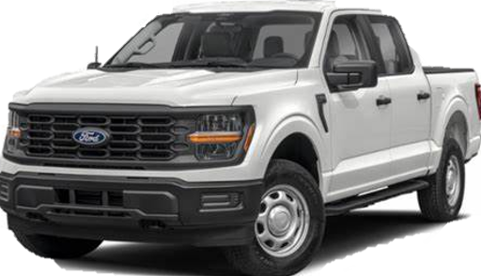

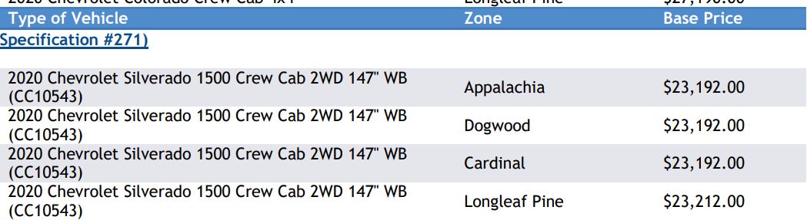
GOVERNMENT BUYING POWER
2025 Ford F-150 XL SuperCrew Cab 5.5 ft. Box 145 in WB
MSRP: $50,290
NC STATE CONTRACT
2025 Ford F-150 XL SuperCrew Cab 5.5 ft. Box 145 in. WB
(W1L)
$41,987
Wholesale Value
Age | VEHICLE | Avg Odometer | Avg Sale Price | Loss of Value
1 Year Old | 2024 Ford F-150 XL Crew Cab 4x4 | 7,500 | $34,996 | $6,991
5 Years Old | 2020 Ford F-150 XL Crew Cab 4x4 | 37,500 | $23,314 | $18,673

Slide 20
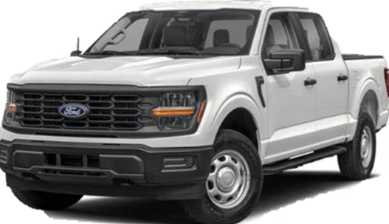
TOTAL COST OF OWNERSHIP
TOTAL COST OF BUY & HOLD FOR A Ford F-150 XL Crew Cab 4x4
Comparing (2) Equity Leases to (1) Pay Cash & Hold over a 10 year period
Average Annual Spend
$8,503
$7,073
Key Observations
Analysis assumes identical invoice cost
Lease Option assumes (2) 60 month/ 37,500 mile Equity Leases (10 total years)
Cash Option assumes purchase and hold for 10 years.
CONFIDENTIAL AND PROPRIETARY
© 2025 Enterprise Fleet Management, Inc.

Slide 21
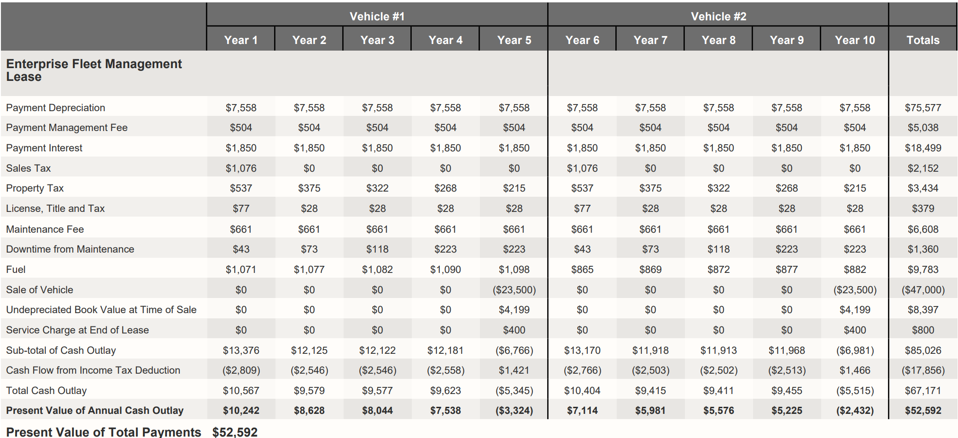
TOTAL COST OF OWNERSHIP
NET PRESENT VALUE OVER 10 YEARS
CONFIDENTIAL AND PROPRIETARY
© 2025 Enterprise Fleet Management, Inc.

Slide 22
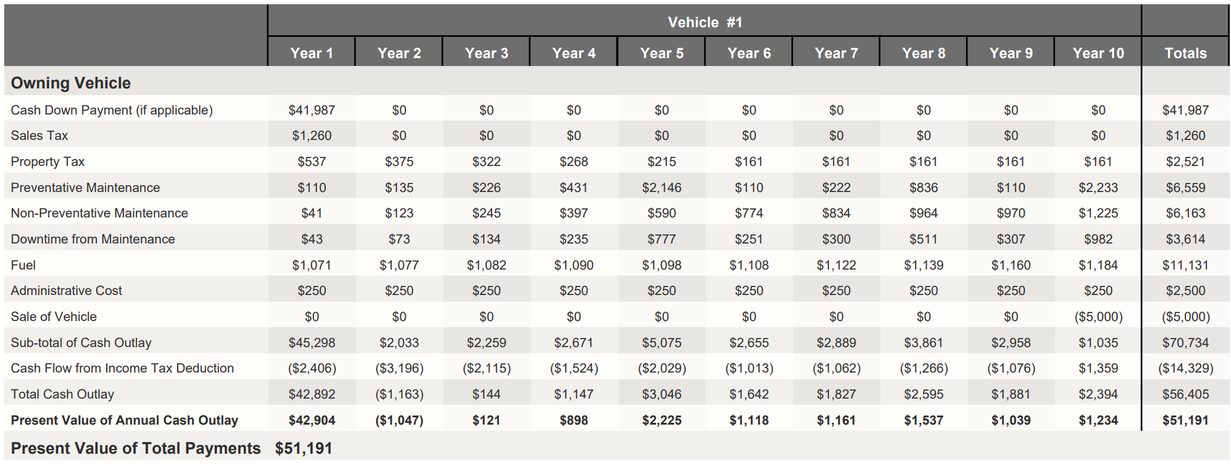
TOTAL COST OF OWNERSHIP
NET PRESENT VALUE OVER 10 YEARS
CONFIDENTIAL AND PROPRIETARY
© 2025 Enterprise Fleet Management, Inc.

Slide 23

VEHICLE SAFETY
BENEFITS OF CRASH AVOIDANCE TECHNOLOGY
Notable Standard Safety Features
Forward Collison Warning plus Autobrake - 2018
50% Front-to-rear crashes
56% Front-to-rear crashes with injuries
23% Claim rates for injuries to other people in vehicles
13% Claim rates for damage to other vehicles
Tire Pressure Monitoring Systems (TPMS)
  Mandated as standard equipment on all new vehicles after 2007
Advanced Air Bags
  Mandated as standard equipment on all new vehicles after 2007
Electronic Stability Controls (ESC)
  Mandated as standard equipment on all new vehicles after 2012
Backup Cameras
  Mandated as standard equipment on all new vehicles after 2018
Blind Spot Detection - 2018
14% Lane-change crashes
23% Lane-change crashes with injures
Rear Automatic Braking - 2016
62% Backing crashes
30% Claim rates for damage to other vehicles
Lane Departure Warning - 2012
11% Single-vehicle, sideswipe and head-on crashes
21% Injury crashes of the same type
CONFIDENTIAL AND PROPRIETARY
© 2025 Enterprise Fleet Management, Inc.

Slide 24
EXAMPLES

Slide 25
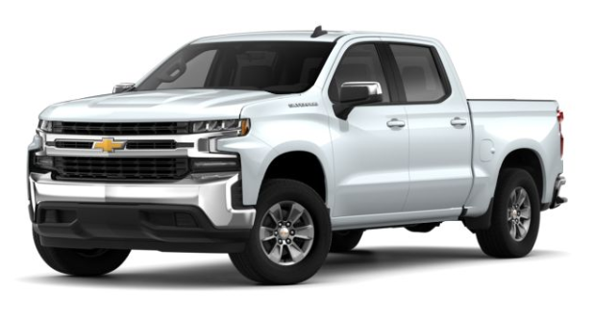
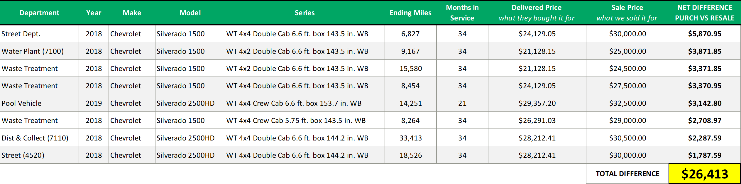
GOVERNMENT BUYING POWER

Slide 26
EXAMPLE ENTITY – FLEET PROFILE

Slide 27
EXAMPLE ENTITY – FLEET PLANNING ANALYSIS

Slide 28
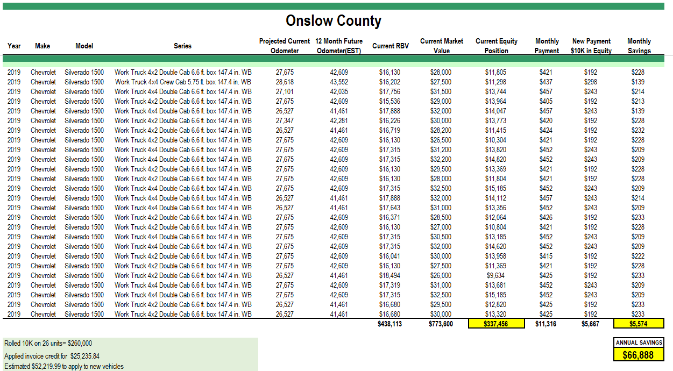
Example Client

Slide 29
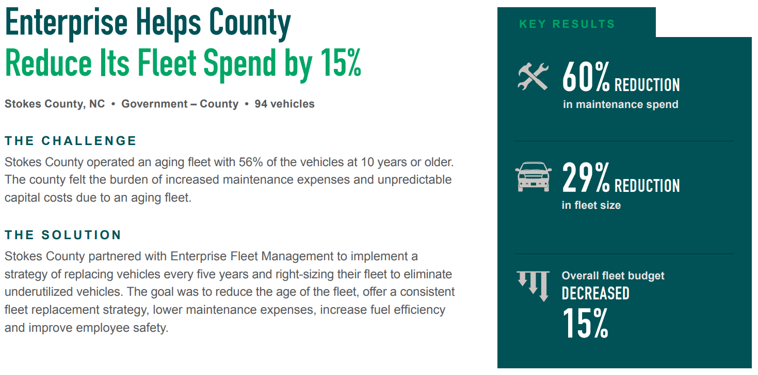
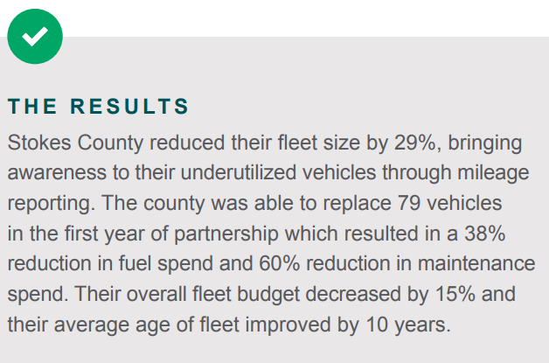
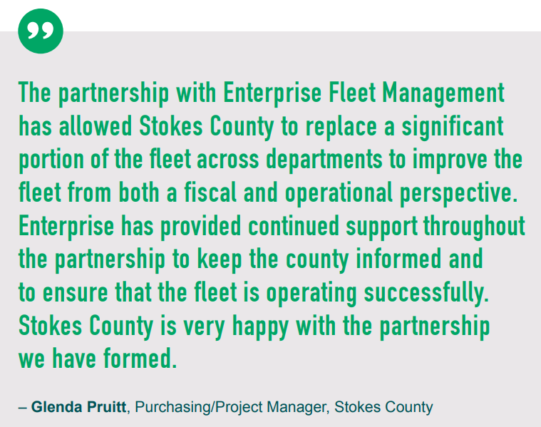
STOKES COUNTY RESULTS
ANNUAL REVIEW
Notes:
A fleet strategy should focus on balancing minimal operational costs with the flexibility and safety required for a growing business. This involves:
Cost and Replacement Analysis to determine lowest cost options
Annual Fleet Planning Cost Analysis to validate mobility strategy
Administrative Structure to ensure consistency and compliance
By aligning with industry best practices, our approach meets diverse mobility needs while minimizing costs. It also offers the adaptability necessary to excel through various business cycles.
Our process starts with setting data-driven benchmarks to craft an optimal fleet plan. We then establish overarching goals, operational protocols, and performance metrics to support our business forecast and execute the plan effectively.

Slide 30

QUESTIONS?

Slide 31

THANK YOU
Chad Elbert
Senior Account Executive
Chad.J.Elbert@efleets.com
704-591-1332
Rob Holman
Client Strategy Manager
Robert.S.Holman@efleets.com
704-654-9987

