Slide 1
KBRA Rating Overview
and Credit Update
North Carolina Local Government Investment Association
Winter 2025 Conference
February 19, 2025 @ 11:00 to 12:00
Presenter: Peter Scherer
Senior Director, Public Finance
The following presentation is being provided to you on a confidential basis and may only be shared internally on a need-to-know basis and may not be otherwise disclosed to anyone outside your organization without the written permission of KBRA.

Slide 2

Agenda
Introduction
Analytical Approach
Methodological Discussion (i.e. how we rate…)
  U.S. Local Government GO
  U.S. Special Tax Revenue Bonds
Credit Trends
Natural Disasters
Q&A

Slide 3

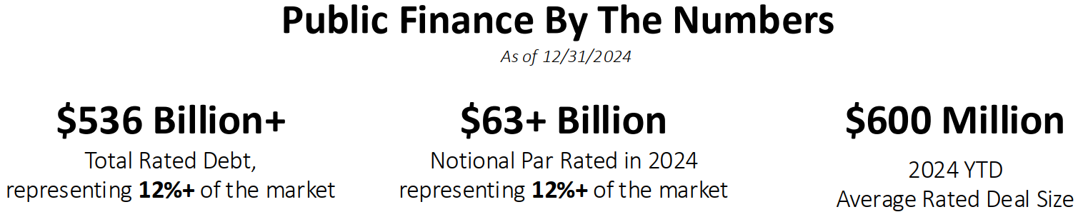
Introduction
Public finance methodologies (14) cover:
  Cities and States
  Transportation
  Districts
  Leases
  Airports
  Healthcare
  Higher Education
Source: KBRA

Slide 4
Analytical Approach
Importance of
Analytical Judgement
Focus on
Management
Supplemental
Analysis
No scorecards
No prescribed weights
Focus on rating drivers for each rating determinant
Overarching impact across rating determinants
Policies, procedures, and guardrails matter
Bankruptcy assessment
ESG management

Slide 5

KBRA Methodological Approach – U.S. Local Government GO
Rating Determinants
  Management Structure and Policies
  Debt and Additional Continuing Obligations
  Financial Performance and Liquidity
  Municipal Resource Base

Slide 6
KBRA Methodological Approach – U.S. Local Government GO

Slide 7
KBRA Methodological Approach – U.S. Local Government GO

Slide 8
KBRA Methodological Approach – U.S. Local Government GO

Slide 9
KBRA Methodological Approach – U.S. Local Government GO

Slide 10
Trends and Concerns – U.S. Local Government GO
Trends
  Moderating tax receipts
  Waning federal pandemic funds
  Record but declining reserves
Concerns
  Inflationary impact fully accounted for?
    Capital plans
    Labor contracts
  Reserve draws despite relatively strong economy
  Structural balance
  Federal policy changes

Slide 11

KBRA Methodological Approach – U.S. Special Tax
Rating Determinants
  Legal Framework
  Nature of Special Tax Revenues
  Economic Base and Demographics
  Revenue Analysis
  Coverage and Bond Structure

Slide 12
KBRA Methodological Approach – U.S. Special Tax

Slide 13
KBRA Methodological Approach – U.S. Special Tax

Slide 14
KBRA Methodological Approach – U.S. Special Tax

Slide 15
KBRA Methodological Approach – U.S. Special Tax

Slide 16
KBRA Methodological Approach – U.S. Special Tax

Slide 17
Trends and Concerns – U.S. Special Tax
Trends
  Sales and PIT: Moderating from extraordinary stimulus-fueled growth
  Gas Taxes: Flattening and declining gas tax receipts in some states
  Mass Transit: Leaning more heavily on dedicated taxes
Concerns
  Slower growth means less capacity for special tax bond programs
  Farebox reliant mass transit systems relying on temporary budget fixes
  Flattening gas tax receipts pressure funding for roads and infrastructure
  Federal policy changes

Slide 18
Credit Trends – Reserves Have Peaked
Reserves recently swelled to historic highs due to:
  Pandemic-related federal assistance
  Stimulus fueled tax receipts
Average fund balance as % of expenditures at FYE:
  2019: 14.0% (pre-pandemic)
  2023: 38.8% (peak)
  2025: 24.0% (budgeted)

Slide 19
Credit Trends – Revenues and Expenditures are Moderating
State revenue and expenditure growth is easing
Revenues
  Modest decline in 2020
  Rapid growth in 2021 and 2022
  Now growing slowly
Expenditures
  Constrained in 2020 and 2021
  Significant growth beginning in 2022
  Decline budgeted for 2025
Federal policy changes may add to budget pressure

Slide 20
Credit Trends – Sales Tax Receipts are Growing Slowly
Collections have slowed from stimulus- and inflation-fueled surge
Receipts not keeping pace with inflation (3.0% in Jan) in 8 of 12 states tracked by KBRA in Q4

Slide 21
Credit Trends – Gasoline Consumption Has Flattened
Fuel consumption flat since 2007
Pressures funding available for roads and infrastructure
Areas that are not growing may be experiencing declining gas tax receipts
Negative implications for borrowing capacity and debt service coverage

Slide 22
Credit Trends – Mass Transit Ridership Still Recovering
Ridership still well below 2019 level
December 2024 vs December 2019
  Bus: -16.0%
  Rail: -28.9%
Large funding gap for systems dependent on farebox revenues
Many systems do not yet have long term solutions to funding gaps

Slide 23

Natural Disasters – General Rating Perspective
Ratings are impacted if disasters move the needle on key rating metrics
Immediate credit concerns
  Scale of impact relative to overall tax base
  Revenue disruptions and delays
  Emergency expenditures and cleanup
  Liquidity stress
  FEMA Reimbursement (baseline 75%, but often higher)
Intermediate credit concerns
  Infrastructure repair and hardening
  Impact on debt ratios
  Liability
Longer-term credit considerations
  Tax base recovery
  Vulnerability to recurring hazards

Slide 24
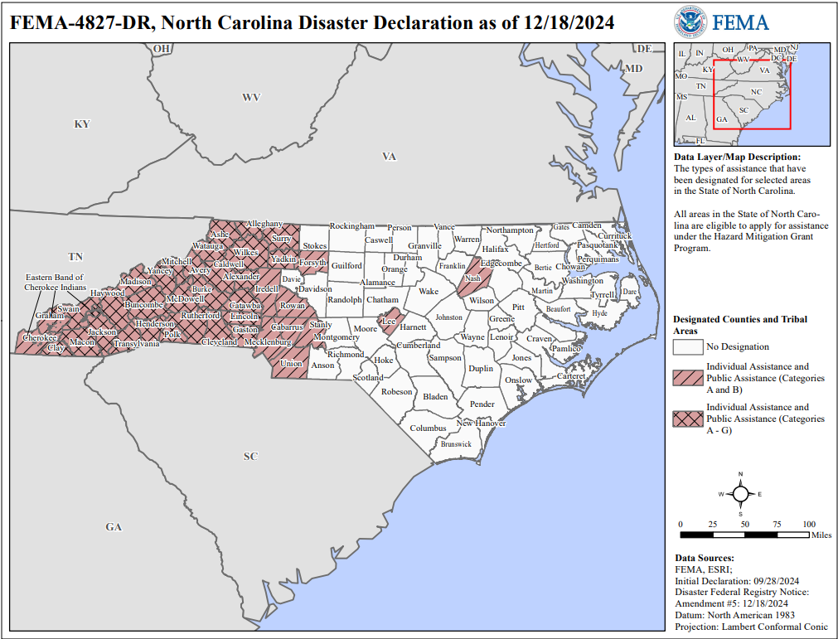
Natural Disasters – Helene and North Carolina (Sep 2024)
Devastation 500 miles from landfall underscores risk of severe storms even far from the gulf coast
Wide ranging impact with ~$60 billion in damage/needs per 12/13/2024 North Carolina Office of State Budget and Management
  73,000 homes damaged
  6,900 roads and bridges damaged
Large uninsured property losses
Very strong financial strength of State and anchoring City of Ashville signal strong capacity to support rebuilding
Rating stability however will likely be determined by the pace of economic recovery, evolution of debt metrics, and management of liquidity pressure and reserves over time.

Slide 25
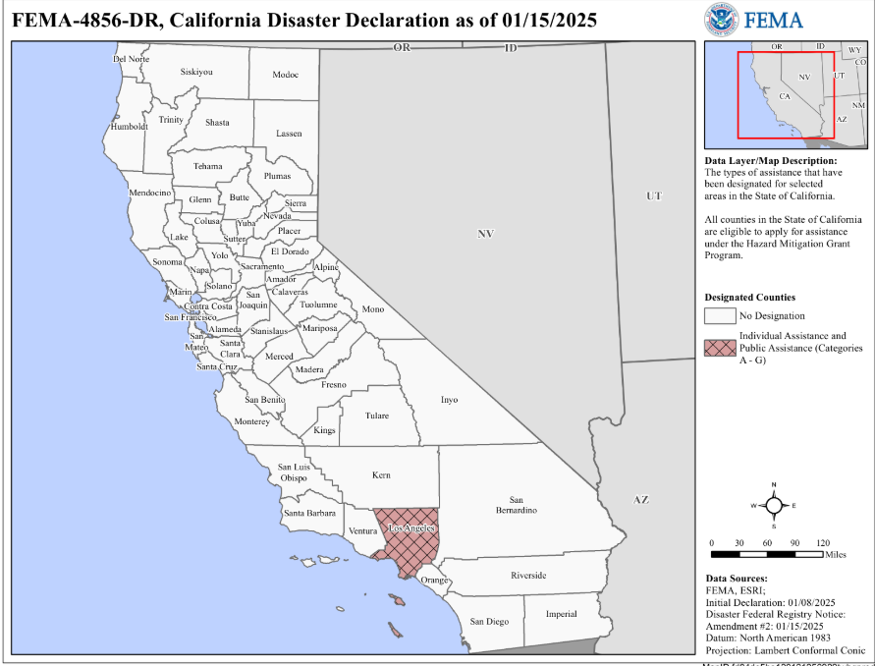
Natural Disasters – California Wildfires (Jan 2025)
Recurring and increasingly severe fires in the Los Angeles area are a concerning trend
January 2025 fires impact per 2/10/2025 California Legislative Analyst’s Office:
  19,000 parcels
  $28 billion in AV
  Other estimates put economic impact much higher
Executive order granting property tax extensions to 218,000 parcels could have negative cash flow implications
Potential liability for utilities are a paramount concern

Slide 26

Questions

Slide 27




© Copyright 2025, Kroll Bond Rating Agency, LLC and/or its affiliates and licensors (together, “KBRA”). All rights reserved. All information contained herein is proprietary to KBRA and is protected by copyright and other intellectual property law, and none of such information may be copied or otherwise reproduced, further transmitted, redistributed, repackaged or resold, in whole or in part, by any person, without KBRA’s prior express written consent. Information, including any ratings, is licensed by KBRA under these conditions. Misappropriation or misuse of KBRA information may cause serious damage to KBRA for which money damages may not constitute a sufficient remedy; KBRA shall have the right to obtain an injunction or other equitable relief in addition to any other remedies. The statements contained herein are based solely upon the opinions of KBRA and the data and information available to the authors at the time of publication. All information contained herein is obtained by KBRA from sources believed by it to be accurate and reliable; however, all information, including any ratings, is provided “AS IS”. No warranty, express or implied, as to the accuracy, timeliness, completeness, merchantability, or fitness for any particular purpose of any rating or other opinion or information is given or made by KBRA. Under no circumstances shall KBRA have any liability resulting from the use of any such information, including without limitation, for any indirect, special, consequential, incidental or compensatory damages whatsoever (including without limitation, loss of profits, revenue or goodwill), even if KBRA is advised of the possibility of such damages. The credit ratings, if any, and analysis constituting part of the information contained herein are, and must be construed solely as, statements of opinion and not statements of fact or recommendations to purchase, sell or hold any securities. KBRA receives compensation for its rating activities from issuers, insurers, guarantors and/or underwriters of debt securities for assigning ratings and from subscribers to its website. Please read KBRA’s full disclaimers and terms of use at www.kbra.com.
Kroll Bond Rating Agency, LLC is not affiliated with Kroll, Inc., Kroll Associates, Inc., Kroll OnTrack, Inc. or their affiliated businesses.

