Slide 1

FISCAL
RESILIENCE
Melissa Moore
Chief Financial Officer
Buncombe County

Slide 2
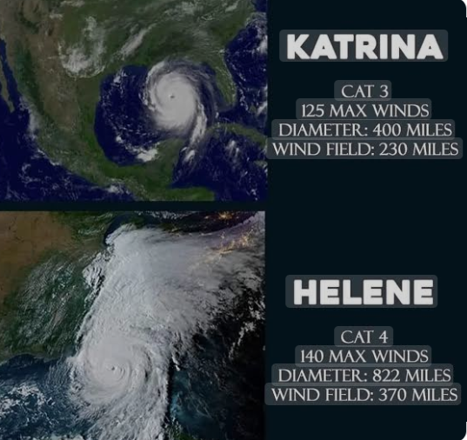
Natural Disasters Happen – Be Prepared
State of Emergency from Sept 25, 2024 – June 30, 2025
Hurricane Helene hit Sept 27th
Presidential disaster declaration Sept 28th – 100% for 6 month
Estimated damages $53-78B
Notes:
Helene was bigger than us.
City of Asheville mainly had power restored beginning of Oct, while the county and rural areas took much longer
County offices opened Oct 23rd
Public Schools opened Oct 25th
Biltmore Estate opened Nov 2nd
Boil water notice lifted Nov 18th

Slide 3
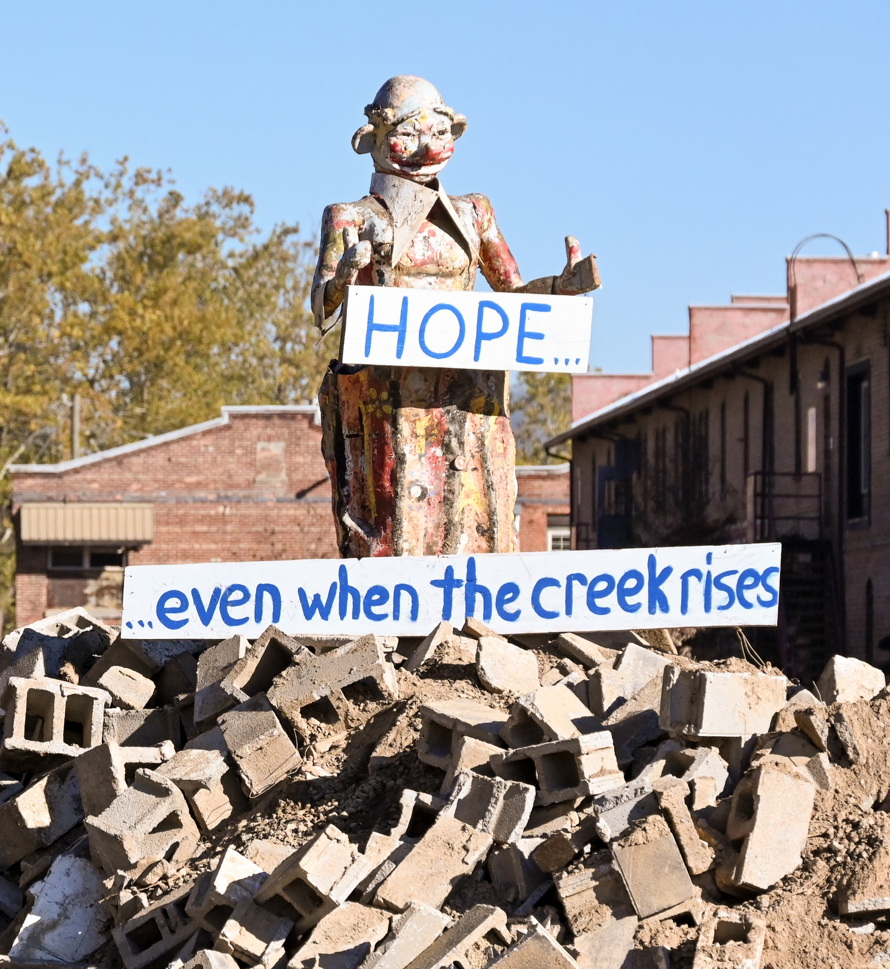
Fiscal Resilience
the ability to respond and recover from economic shock without placing the organization at risk of financial failure, ensuring long-term financial health

Slide 4
Fiscal Resilience
the ability to respond and recover from economic shock without placing the organization at risk of financial failure, ensuring long-term financial health
Fiscal Policy
What sets the guiderails?
Fund Balance
Available funds
Cash Flow
Forecast your cash needs

Slide 5
FISCAL POLICY

Slide 6
Revenue Shortfall
Policy Driven Fiscal Discipline
ALERT: Projected revenue shortfall is 1.5% less than the adopted tax revenue budget.
  Freeze newly created positions
  Implement a time delay in filling vacant positions
MINOR: Projected shortfall 2.5%
  Suspend funding capital maintenance
  Suspend capital outlay purchases
  Reduce number of temporary workers
MODERATE: Projected shortfall 3.5%
  Managed hiring/freeze vacant positions
  Reduce travel, training, office supplies
MAJOR: Projected shortfall 4.5%
  Reduce overtime, critical repairs only, freeze publications
  Prepare reduction in force plans
CRISIS: Projected shortfall 5%
  Reduction of service, elimination of programs, reduction in force plan activated
Indicators – Warning signs present in leading economic indicators. Monthly reports to monitor revenue impact.
Phases – Serve to classify and communicate the severity of the estimated revenue shortfall.
Actions – Preplanned steps to be taken to counteract projected revenue shortfall.

Slide 7
Revenue Shortfall
Policy
Reductions
Impact
Revenue shortfall is not addressed in Financial Management Policy
Budget reductions across all departments
Hiring freeze
Reduction in School funding
Reduction of services
Burnout
Public Trust
Notes:
CPE POLL/Show of hands – do you have a policy setting minimum Fund Balance? If yes, keep hands raised 25%, 20%, 15%, below?

Slide 8
Fund Balance
Policy Driven Fiscal Discipline
MINIMUM: General Fund’s fund balance should be at least 25% of annual operating expenditures.
TARGET: As a goal, the organization will strive to achieve 30% fund balance.
USES: Reserves will be used for emergencies or unforeseen expenditures, except when balances can be reduced because their levels exceed guideline minimums.
Minimum levels reserves
Target levels
Allowable Uses

Slide 9
FUND BALANCE

Slide 10
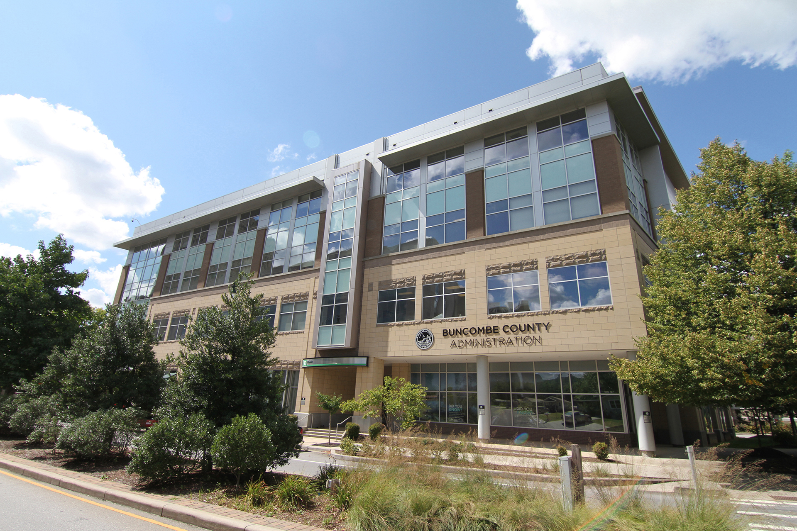

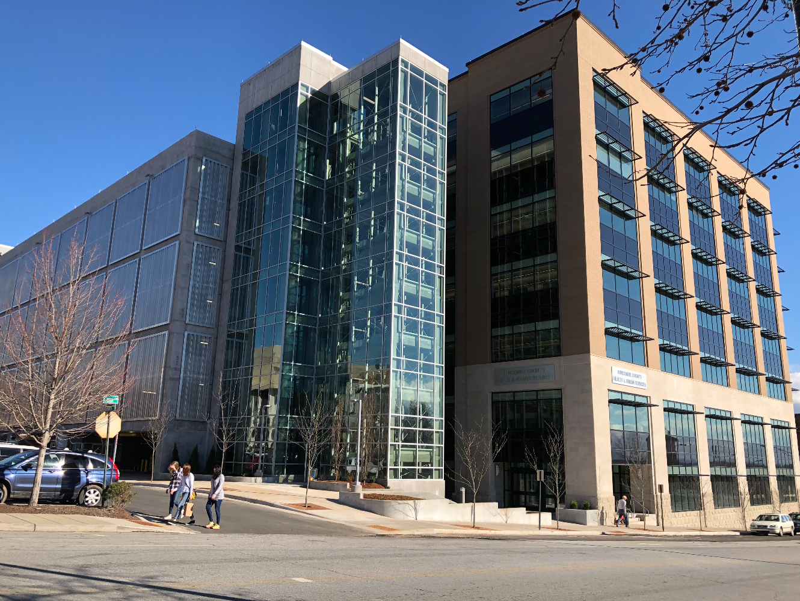
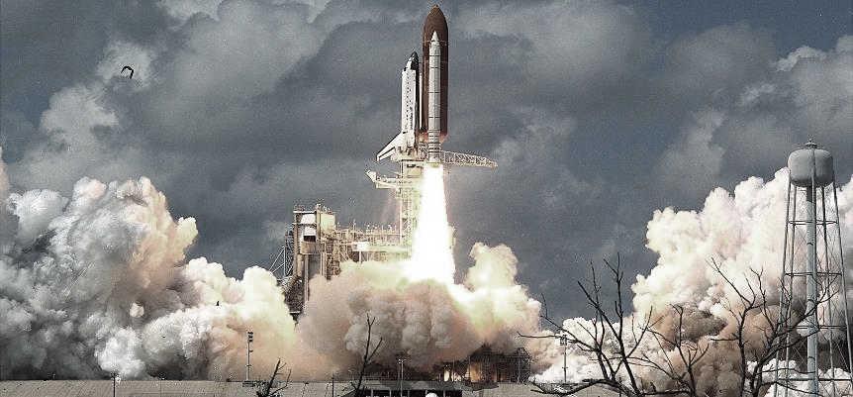
Fund Balance
Definition
An accounting term used for the difference between assets and liabilities, used as a measure of financial condition.
Recommended
Funding used to cover loss of revenue, declines in the economy, natural disasters, public safety and health emergencies.
Notes:
Does your organization, elected officials, or community correlate Fund Balance to equal Cash?
Review Recommended uses of Fund Balance. Do you agree on the recommended uses of Fund Balance? Do any of you use Fund Balance to fund operating costs? Was this part of your long-range plan? AND was there remaining Fund Balance to fund the Recommended uses?

Slide 11
Fund Balance
Policy
Use of Funds
Reality
… minimum available Fund Balance 15%
Reductions of fund balance in prior year and current year
Lack of available fund balance to absorb decline in revenue
Notes:
CPE POLL/Show of hands – do you have a policy setting minimum Fund Balance? If yes, keep hands raised 25%, 20%, 15%, below?

Slide 12

Credit Rating Considerations | Fund Balance
Each of the Credit Rating Agencies evaluates Fund Balance as a portion of its overall rating assessment. Below is an example of the different tiers.
Key Rating Agency Threshold for Available Fund Balance as % of Revenues:
Available Fund Balance
― Very Strong (AAA):
― Strong (AA):
― Adequate (A):
― Weak (BBB):
― Very Weak (BB):
> 15%
8% to 15%
4% to 8%
1% to 4%
< 1%

Slide 13
CASH FLOW

Slide 14
Cash Flow
Cash Gives you Options
Cash Out
Base operations
Disaster expenditures
Cash needs to fund Recovery
Cash In
Revenue shortfall
Investments maturing
State Cash Flow Loans received
Notes:
CPE POLL at the end of this slide discussion - Do you currently have a cash flow forecast?
General Fund $440M
Debris original estimate $70M right-of-way only, doesn’t include waterway, private property debris removal
Current spend $4M
Emergency Work - $24M includes OT - $4M, Exempt/non-exempt, not budgeted, 9 months out still not close to gathering all documentation required to submit for reimbursement
Permanent work – slow out flow of cash, waiting insurance claims, FEMA to cover deductibles and other non covered insurance damage TBD, damage to land, river parks washed away
FEMA average 3-6 year reimbursement. This includes permanent work in the timeline.
Lots of rumors about FEMA ending or restructuring and our ability to get paid back. Budget ordinance is based on continued spending on a future revenue source (FEMA). What happens if the funding is stopped????
Inflows 3% decline of organic revenue (excludes appropriated FB) overall
1.8% decline in Property tax
4.7% decline in sales tax
5.4% decline in other revenue
Occ Tax estimated 26% decline YTD
FEMA CDL Program Community Disaster Loan, requires 5% revenue loss, can be used for operating cost. Prior disasters have been granted loan forgiveness. Max $5M loan total.
Are your investments quickly converted to cash?
Cash is going out the door much faster than coming in. Cash in is a big WILD CARD.

Slide 15
Are you Fiscally Resilient?
Policy
Fund Balance
Liquidity
Weekly cash needs to fund recurring operations.
Seasonal spikes
Sudden changes
Cash inflows based on reimbursement
Warning signs
Rating downgrade items to watch for: fund balance and loss of tax base

Slide 16
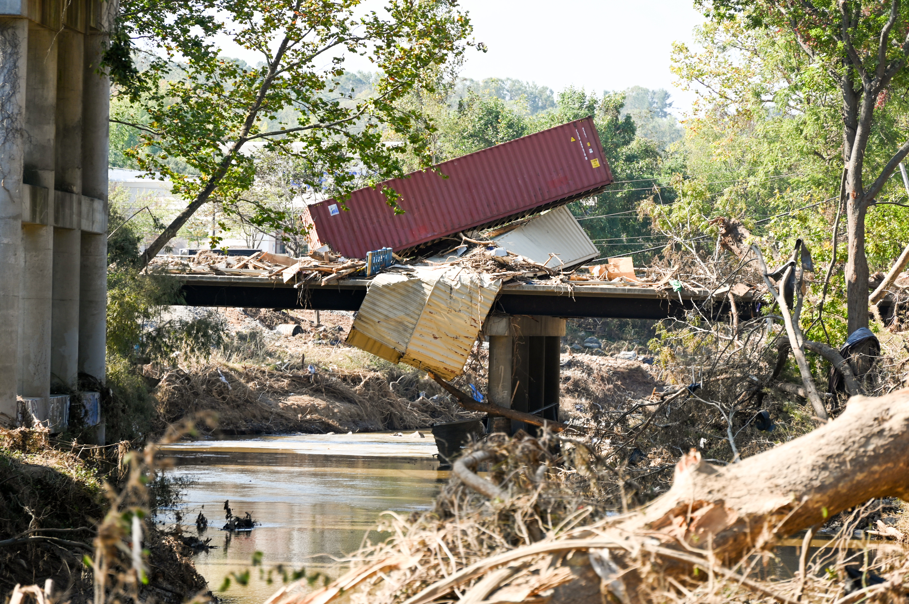
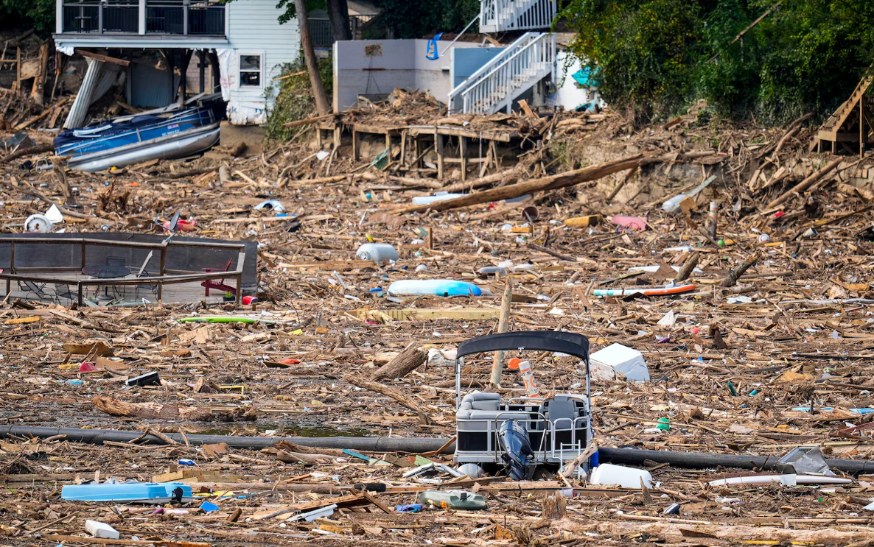
Never assume….
it will never happen here.
Notes:
Never manage under the assumption that is will never happen here, never happen to you. Be prepared. Your community depends on local government in their most vulnerable desperate hour. Be READY!

Slide 17

Melissa Moore:
Chief Financial Officer
Contact Numbers:
828-793-0326
Email Address:
Melissa.moore@buncombenc.gov
Thank You

