Slide 1
Andy smith
Managing Director Office: 803.413.4991 Email: asmith@firsttryon.com 6101 Carnegie Blvd Suite 210 Charlotte NC 28209
North Carolina Local Government Investment Association Conference
Alternative Debt Options
February 6, 2024

Slide 2
Available Financing Structures in North Carolina

Slide 3
Available Financing Structures in North Carolina

Slide 4
Available Financing Structures in North Carolina

Slide 5
Marketplace to Issue Debt
Issuers have two primary marketplaces to issue bonds – public market and bank placement.
  Bonds sold in the public market are sold to a variety of different investors (mutual funds, insurance companies, individuals) and require the preparation of an offering / disclosure document and obtaining credit ratings.
  Bonds sold via a direct placement are sold directly to a single bank / lender and do not require an offering / disclosure document or credit ratings.
In addition, issuers can look to state (i.e. State Revolving Fund loans) or federal (i.e. USDA) sources if the entity and project meet their requirements.
The LGC generally requires all new money, G.O. Bonds to be sold in the public market.
The appropriate marketplace for a financing depends on several factors including size, security, credit quality, desired term, interest rate and market conditions.
Public Sale vs. Bank Placement vs. SRF vs. USDA

Slide 6
Pros and Cons of Bank vs. Public Market
Bank Placement
Pros | More streamlined issuance process with lower staff time commitment and the ability to lock in interest rates sooner Lower upfront costs of issuance Greater prepayment flexibility No credit rating requirements No (or limited) ongoing reporting requirements
Cons | Subject to changes in interest rate / market environment Subject to changes in banks’ interest / willingness to lend
Public Sale
Pros | Large market with broad buyer base No issue securing long-term financing (20+ years)
Cons | Not able to lock in interest rate until closer to closing More in-depth issuance process with greater staff time commitment Higher upfront costs of issuance More restrictive prepayment provisions (typically 10-year no prepayment option) Ongoing reporting / continuing disclosure requirements Initial and periodic rating agency interactions

Slide 7
Current Environment
Given the sharp and continuous increase in rates over the first 10 months of 2022, many issuers “flipped” from the public market to the bank market due to:
  Less day-to-day volatility in the bank market;
  Lower interest rates in the bank market; and
  Ability to lock in the interest rate earlier in the process.
However, following the collapse of Silicon Valley Bank in March 2023 and the ensuing liquidity crunch that many banks faced, many issuers have “flipped” from the bank market to the public market due to:
  Tightening of credit conditions by certain banks;
  Shortening of financing terms by certain banks;
  Higher interest rates than the public market; and
  Heightened focus by banks on existing / prospective clients (i.e. those that come with deposits)
The dynamic between the bank market and the public market can change quickly.

Slide 8
Estimated Debt Service / Cost Comparison – Bank Placement vs. Public Sale
Note: Information presented, including interest rate, is estimated and subject to change.

Slide 9
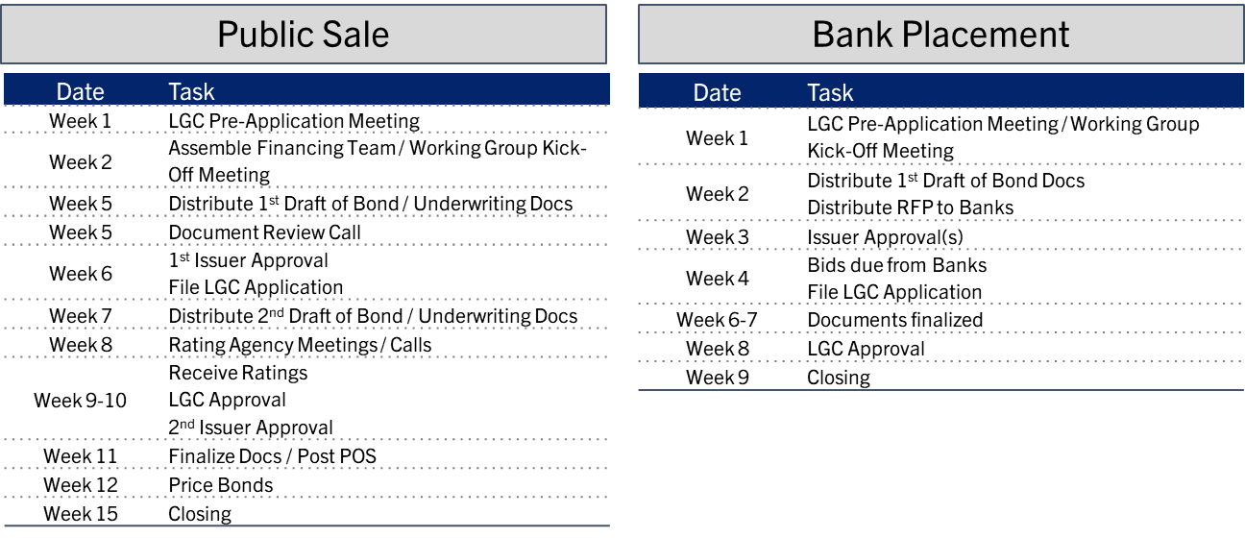
Life Cycle of a Bond Transaction
Once an entity selects its desired financing structure, it can begin the debt issuance process.
The primary steps involved in a financing schedule include:
  Meeting with LGC staff
  Assembling the working group
  Documenting the transaction
  Obtaining credit ratings (public sale only)
  Pricing the bonds
The typical life cycle of a financing is 60 to 100 days depending on the complexity of the financing and the market in which the debt is issued (public market vs. bank placement).

Slide 10
Equipment / Rolling Stock Financings
Typically financed in bank / leasing corp. market
Terms commensurate with useful life of assets
Master financing structure is more advantageous (rates, ease of execution)
Escrow feature for multiple asset financing
Prepayment for assets (fire trucks are primary example)
  Payment / Performance Bond
  Municipality listed as dual beneficiary

Slide 11
The Importance of Capital Planning
A key element to the financial health of an organization and its ability to deliver services to citizens and businesses is a properly prepared capital plan.
  Allows governments to properly procure, design, construct, maintain, and operate key capital assets such as infrastructure, technology, and equipment.
  Critical to essential public services such as water, sewer, transportation, etc.
  Important element of a government’s economic development program and strategic plan.
Without a sound multi-year capital plan that identifies capital needs, funding options, and operating budget impacts, it can be difficult for governments to address the needs of their citizens, both current and long-term.
Source: GFOA

Slide 12
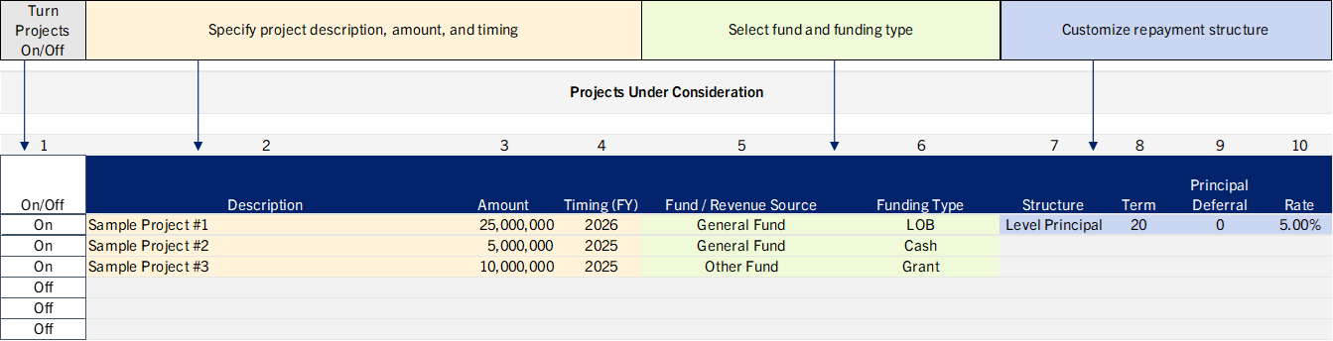
Identifying a Need
Effective capital planning allows a government to identify needs, both in the near-term and long-term.
Once a need is identified, the next step is to determine the best way to fund the need.
Having an effective capital planning model can make it easier to determine whether certain needs are funded using cash, grants, or debt.
Source: GFOA

Slide 13
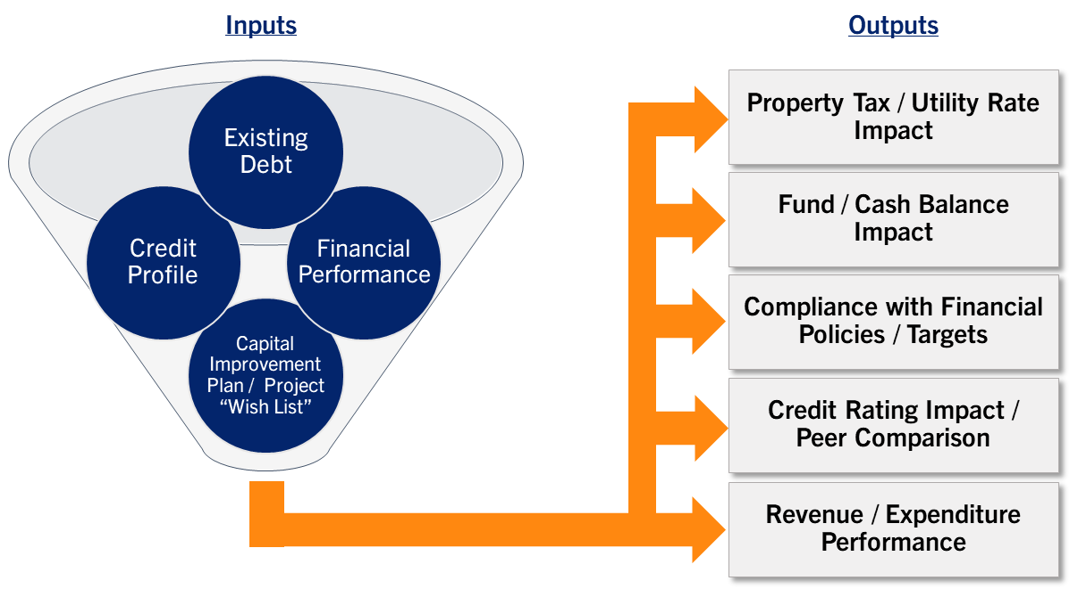
Incorporating the Capital Plan into a Financial Model
A capital planning model is most efficient and effective when it has the following attributes:
  Simple and easy to use by staff
  Dynamic enough to run scenarios live
  Provides clear outputs
  Specific to the government’s situation
  Holds the attention of non-finance people (elected officials, managers, etc.)
  Analyzes a problem and provides a solution

Slide 14
Dashboard Graphics / Outputs
SAMPLE

Slide 15
Dashboard Graphics / Outputs
SAMPLE

Slide 16

FIRSTTRYON.COM
MSRB Registrant
DISCLAIMER: This communication was prepared by First Tryon Advisors, LLC (“First Tryon Advisors”) and is for informational purposes only and should not be construed as an offer or solicitation to sell or buy any securities. This material does not provide tax, regulatory, accounting, or legal advice. Prior to entering into any proposed transaction, recipients should determine, in consultation with their own investment, legal, tax, regulatory and accounting advisors, the economic risks and merits, as well as the legal, tax, regulatory, and accounting characteristics and consequences, of the proposed transaction.
Any proposal included in this communication is confidential information of First Tryon Advisors and is solely for the benefit of the recipient(s), and the recipient(s) is (are) not authorized to sell, redistribute, forward or deliver this communication to any other person without the prior written consent of First Tryon Advisors.
The statements within this material constitute the views, perspective and judgment of First Tryon Advisors at the time of distribution and are subject to change without notice. First Tryon Advisors gathers its data from sources it considers reliable; however, it does not guarantee the accuracy or completeness of the information provided within this communication. The material presented reflects information known to First Tryon Advisors at the time this communication was prepared, and this information is subject to change without notice. First Tryon Advisors makes no warranties regarding the accuracy of this material.
Any forecasts, projections, or predictions of the market, the economy, economic trends, and equity or fixed-income markets are based upon current opinion as of the date of issue, and are also subject to change. Opinions and data presented are not necessarily indicative of future events or expected performance. Actual events may differ from those assumed and changes to any assumptions may have a material impact on any projections or performance. Other events not taken into account may occur and may significantly affect the projections or estimates. Certain assumptions may have been made for modeling purposes only to simplify the presentation and/or calculation of any projections or estimates, and First Tryon Advisors does not represent that any such assumptions will reflect actual future events. Accordingly, there can be no assurance that estimated projections will be realized or that actual performance results will not materially differ from those estimated herein.
First Tryon Advisors is registered as a municipal advisor with the Securities and Exchange Commission (“SEC”) and the Municipal Securities Rulemaking Board (“MSRB”). Neither the SEC, MSRB, nor any other regulatory organization endorses, indemnifies, or guarantees First Tryon Advisors’ business practices or selling methods.

