Slide 1


WELCOME
WINTER 2026 CONFERENCE

Slide 2


















OUR
SPONSORS

Slide 3

Conferences
Summer
Winter
July 21-23, 2026
Wilmington
Feb 21-23, 2027
.Pinehurst

Slide 4
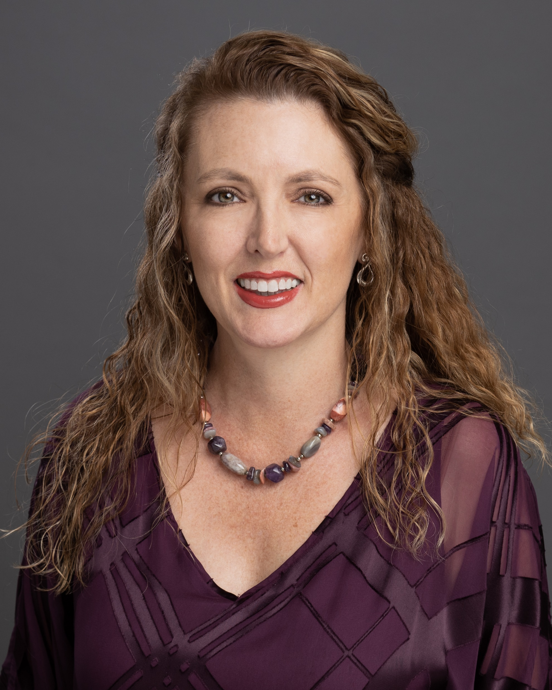
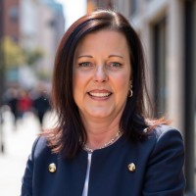
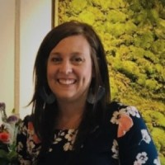
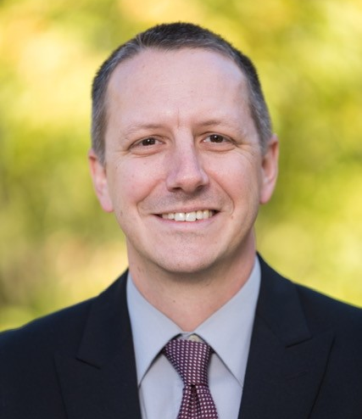
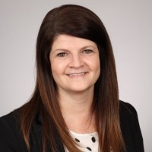
President
Secretary
Events
Ashley Grindstaff
Melissa Moore
Teresa
Fulk
Vice President
Membership
Seth Larson
Tina Stroupe
Meet our Board of Directors 2025 - 2026

Slide 5






Investment Strategy
Portfolio management, government investment pools, and investment advisors +
Network with Peers
Cash Management
Build relationships with industry experts
Cash handling, cashflow forecasting, electronic payment types +
Membership
Benefits
Current Conditions
Managing Debt
Economic & legislative updates, market changes, leadership discussions
Bond issuances, credit rating, bank financing +
Policy Development
Investment, Debt Management, Cash Handling, Financial Management

Slide 6
SURVEY
An emailed survey will be sent after the conference.
Please make sure to complete the survey by February 27th to be eligible for a random drawing of gift cards.
The survey results are anonymous.

Slide 7
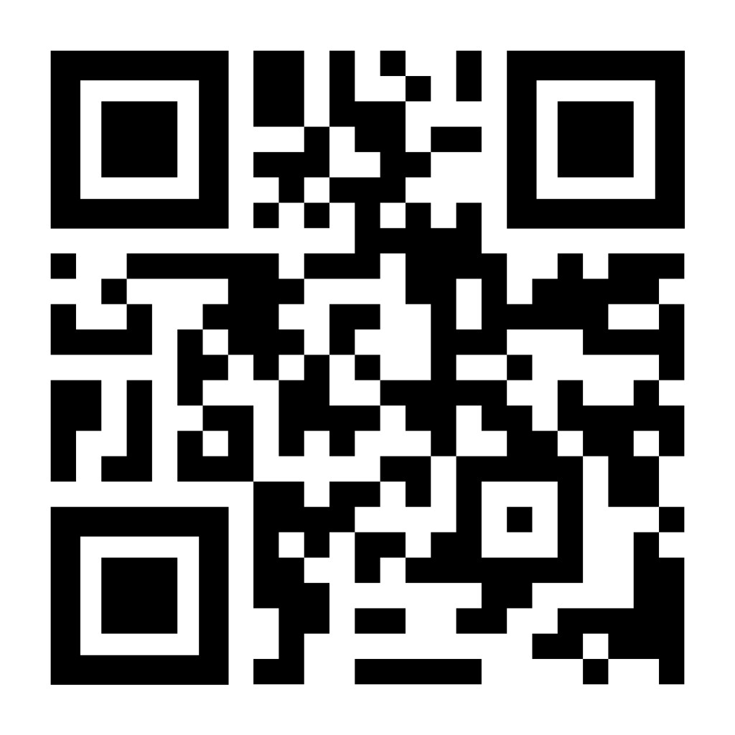
DINNER
SIGN-UP
.

Slide 8
PLATINUM
SPONSOR
PREMIUM SPONSOR

Slide 9
PLATINUM
SPONSOR
PREMIUM SPONSOR

Slide 10
PREMIUM
SPONSOR
PLATINUM SPONSOR

Slide 11
GOLD SPONSOR

Slide 12

SILVER SPONSOR

Slide 13

BRONZE SPONSOR

