Slide 1
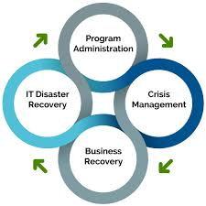
Business Continuity & Disaster Recovery

Slide 2
Jinizha Johnson – Durham County All-Hazards Planner
Jinizha Johnson is the All-Hazards Planner for Durham County’s Office of Emergency Services, Emergency Management Division.
She earned her B.A. in Political Science from Alabama State University in 2015. Jinizha began working in local government in Montgomery, Alabama during her senior year of college and was promoted to Montgomery’s City/County Emergency Management Agency in 2017. She moved back home to North Carolina in 2022 and started working as an All-Hazards Planner for Durham County.
She is responsible for updating plans that aid in departmental operations and coordination with state and local stakeholders during an emergency or disaster, such as the Emergency Operations Plan, Mass Care Shelter Plan and Durham County’s section of the Eno-Haw Hazard Mitigation Plan. She is also the Continuity Manager for Durham County Government and the City of Durham Government, ensuring that each department has an updated and tested Continuity of Operations Plan (COOP).
Sam Collis – J.P. Morgan Chase Cyber Resiliency Exercise Coordinator and Emerging Threats Analyst
Sam Collis is a Cyber Resiliency Exercise Coordinator and Emerging Threats Analyst for Cybersecurity & Technology Controls (CTC), Firmwide Technology Resiliency (FTR).
He is responsible for educating JPMC clients on best practices in Cybersecurity & Fraud Prevention by delivering presentations, facilitating cyber playbook development workshops, and conducting tabletop exercises to test organizational readiness and the efficacy of cyber playbooks.
Sam has been wit the firm for 26 years, working across roles in Accounting, Technology Operations, Risk & Controls, Network Security, Vulnerability and Configuration Management, and Security Operations. In that time, he has played a significant role in strengthening firmwide technology controls and led efforts to adopt Agile, transform firewall security, application security and vulnerability remediation.
Sam holds a BS in Business Administration from California University of Pennsylvania with the concentration in accounting. He is ITIL Foundations certified and experienced working in Agile, and ISO frameworks.

Slide 3

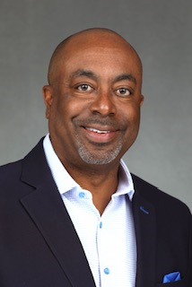
Paul Rutherford – J.P. Morgan Chase Senior Treasury Management Officer
Paul Rutherford is an executive director and senior treasury management officer that serves public sector clients in the Southeast market. With his knowledge of treasury services, he focuses on bringing solutions to his clients concerning receivables and payables issues. He has over 15 years of treasury services experience with the majority of that time focused on government sectors that include cities, counties, school districts and the State.
Paul earned his Bachelor of Science in Business Management at North Carolina State University. Paul resides in Cornelius with his wife Kat, and two daughters.
Kevin Harewood - J.P. Morgan Chase Relationship Executive
Kevin Harewood is an executive director and relationship executive with J.P. Morgan Chase’s Government Banking team. He is based in Cary, North Carolina and is responsible for managing the unique needs of J.P. Morgan Commercial Bank’s business relationships with public sector clients, including counties, municipalities, school districts, and government agencies throughout North Carolina. With more than 30 years of banking experience, Harewood has worked in various sales, lending and credit capacities for both the consumer and the commercial bank. He has spent more than 17 years of his banking career working exclusively with state and local governments and public higher education organizations across North Carolina.
Kevin earned a Bachelor of Science degree in Accounting from Hampton University and completed his Master of Business Administration degree from Elon University. Kevin resides in Durham with his wife, Lisa, and three sons.

Slide 4
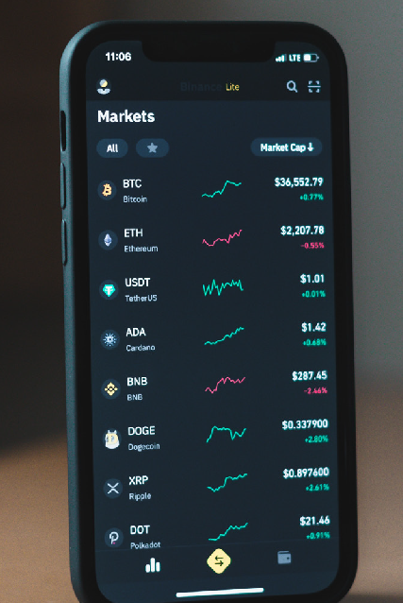





No Industry Is Immune From Today’s Cyber & Fraud Threats…
SOCIAL MEDIA/ DIGITAL CURRENCY
Mar 2022: Hackers stole nearly $600MM in cryptocurrency from a
crypto sidechain project by accessing private keys and forging fake withdrawals
Aug 2023: A widespread hijacking campaign was executed on LinkedIn accounts, locking users out or threatening deletion unless a ransom is paid
FINANCIAL SECTOR
June 2023: The European Investment Bank experienced severe website outages due to a
cyber attack carried out by Russian threat actors
May 2023: Several banks were breached due to the MOVEit vulnerability,
exposing customer and/or employee information
TECHNOLOGY SERVICES
Feb 2022: A leading Australian SaaS company halted trading after discovering unauthorized activity in their systems
May 2023: An American Telecom company disclosed a data breach that compromised the personal information of 37MM people
HEALTHCARE & PUBLICH HEALTH
Aug 2023: A California- based healthcare provider was affected by ransomware, causing emergency room shutdowns in multiple states
Oct 2022: A Ransomware attack affecting one of the largest U.S. hospital chains caused delays in surgeries and patient care at the over 140 hospitals
TRAVEL/ TRANSPORTATION
July 2023: Japan’s largest port was temporarily
shut down as a result of a ransomware attack
May 2023: A Scandinavian airline was attacked
by Anonymous Sudan, causing website and application outages for nearly an entire day
CRITICAL INFRASTRUCTURE
Feb 2022: Hackers gained access to current and former employees’ computers at nearly two dozen major natural gas suppliers and exporters
Jul 2023: Chinese state sponsored threat actors gained persistence in US military infrastructure, representing a serious threat in the event of future crises
NBC News article; Bleeping Computer article
BankInfoSecurity article; American Banker article
Reuters article; Forbes article
NBC News article; The New York Times article
Bleeping Computer article; The Record article
Bloomberg article; Dark Reading article

Slide 5




To combat these risks, employees should be reminded of the following key practices:
Enable Safe Working
Remind employees of cybersecurity best practices when working remotely, to include:
Follow Established Procedures
Ensure all staff are aware of
organizational procedures for:
Ensure Response Plan Awareness
Fully socialize plans and playbooks for how to escalate potential incidents and ensure clear channels for staff
to alert leadership of any emerging business disruptions
Test Business Resiliency
Conduct regular resiliency tests and exercises to build increased
preparedness among staff and ensure technology can effectively support contingency situations
Authenticating callers
Reporting suspicious activity
Approving changes to account details or transactions
Escalating potential privacy breaches
Securing home Wi-Fi networks
Only using company-approved communications tools
Never sending work documents to personal email accounts
Keeping personal device software up-to-date

Slide 6


“Top 10 List” of Effective Programs/Practices
Conduct an Independent Assessment
Join an Industry Forum
Deploy Mandatory Employee Training and Testing
Conduct exercises & drills
Implement controls for maximum effect
Engage Government and Law Enforcement
Simulate an Internal Attack
Know Your Third Party Vendors
Understand How Money Leaves Your Organization
Plan for and Test Payment Contingencies

Slide 7
What Is COOP?
Jinizha Johnson
Durham County/City Emergency Management
All Hazards Planner

Slide 8
Continuity of Operations Plan
Continuity is the ability to provide uninterrupted services and support before, during, and after an incident that disrupts normal operations.
A continuity of operations plan will help your organization when an event happens that disrupts normal day to day operations.

Slide 9
Teams and Responsibilities
Executive Team
Continuity Team
Planning Team
IT Team
Pandemic Team
Relocation Team

Slide 10
Communications
Your plan should have a list of all primary and alternate methods of communication systems used within your department to continue normal operations during an emergency.

Slide 11
Test, Training and Exercise Plan/Maintenance
Plans should be updated twice a year; January 31st and July 31st.
Plans should be tested once a year.
Updates include changes made to sections of your plan that have yellow and red scores.

