Slide 1
Building
Resilience
with the Resilient Operating System (ROS) & POWER Framework
A Blueprint for Leadership, Teams, and Organizations

Slide 2
TODAY’S FOCUS:
RESILIENCE AS A SYSTEM
Resilience is not just bouncing back (Resilience 1.0)
but building capacity (Resilience 2.0).
Introduction to the Resilient Operating System (ROS).
The POWER Framework as a practical tool for daily resilience.

Slide 3
THE RESILIENT OPERATING SYSTEM (ROS)
Self
Managing personal resilience.
Team
Creating a psychologically safe culture.
System
Embedding resilience into workflows and policies.

Slide 4
WHAT’S YOUR EXPERIENCE WITH STRESS & RESILIENCE?
What are the stressors you regularly face?
What is the impact of this stress on you?
What has kept you resilient over the past two years?
What have you seen keep teams together during the last two years?

Slide 5
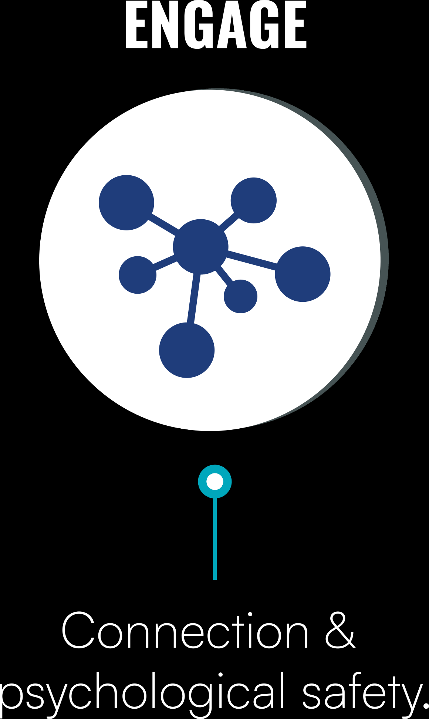
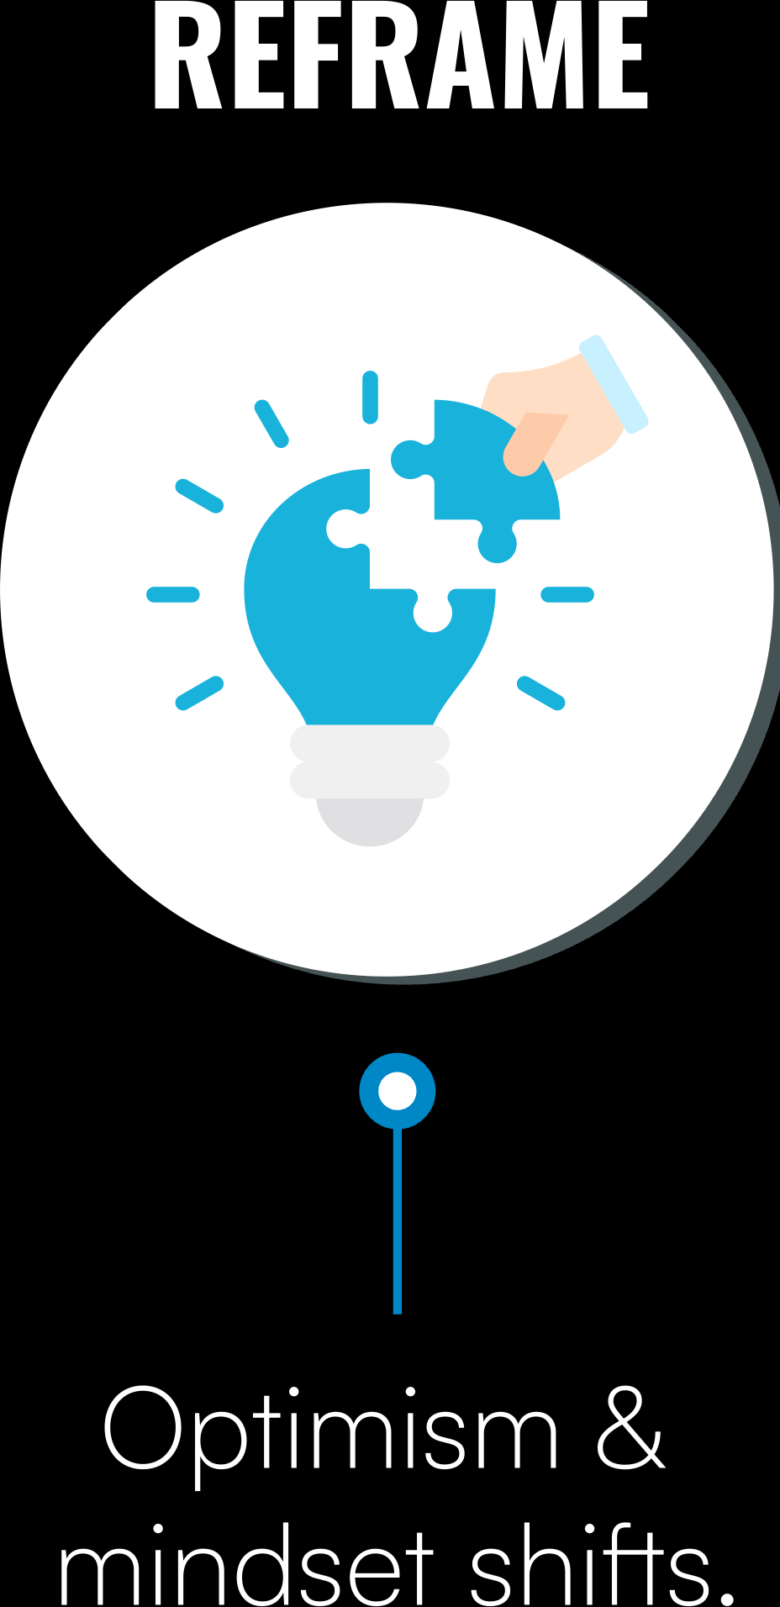
THE POWER FRAMEWORK
FIVE KEYS TO RESILIENCE

Slide 6
P – PAUSE
CREATE SPACE BEFORE REACTING
Concept
Self-awareness under stress prevents reactive decision-making.
Daily Practice
The 10-Second Reset – Before reacting, pause, breathe, and check-in.
Reflection Question
How does stress show up in your body before you even realize it?

Slide 7
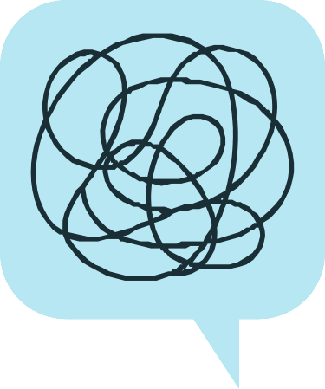
O - OWN IT
MANAGE YOUR STRESS RESPONSE
Concept
Recognize your default stress response (Fight, Flight, Freeze, Fawn).
Daily Practice
Name It to Tame It – Label emotions to reduce their impact.
Reflection Question
How do you typically respond to stress at work? What helps you shift out of it?

Slide 8
The Regulatory Process of the
Autonomic Nervous System
(Sympathetic and Parasympathetic)
Activation – Deactivation Cycles
Sympathetic
Working, Excitement, Movement
discharge
Range of Resiliency
charge
charge
Parasympathetic
Resting, Digesting, Sleeping

Slide 9
Feeling your activation and settling cycle

Slide 10
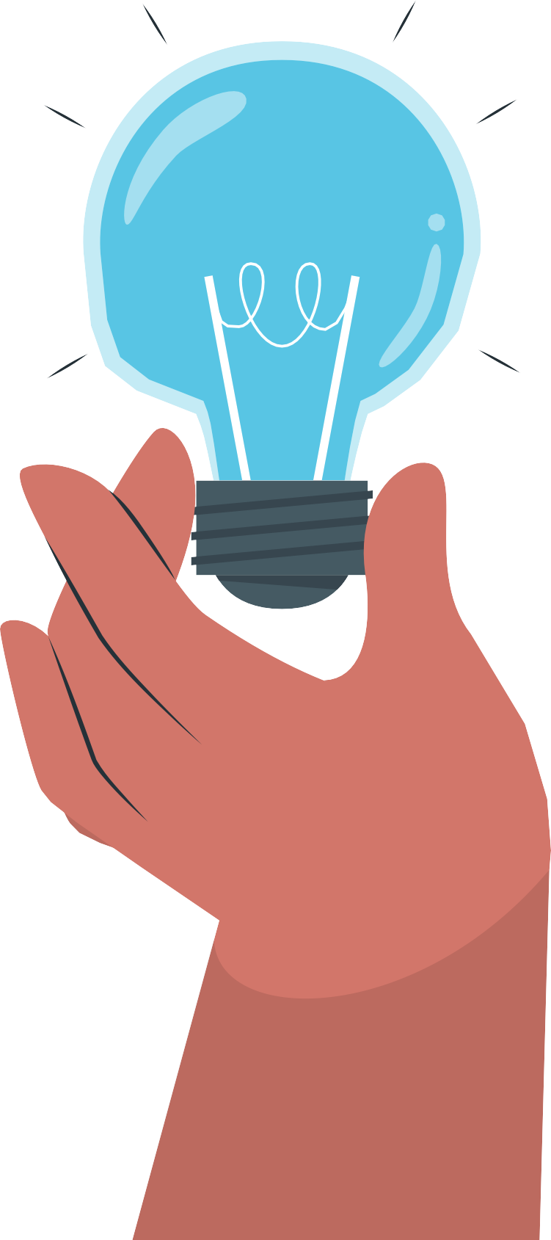
W – WORK THE CHALLENGE
Think Bold, Adapt Fast, Think Smart
Concept
Navigating complexity with curiosity , engagement, and adaptability.
Daily Practice
Always be adding something new to your routine or team.
Reflection Question
How could seeing stress as a challenge change how you approach difficulties?

Slide 11
E – ENGAGE
STRENGTHENING CONNECTION
Concept
Small moments of connection reduce stress and build resilience.
Daily Practice
Micro-Moment Check-In – Ask a teammate: “How’s your week been?”
Reflection Question
How can your team build micro-moments of connection into daily work?

Slide 12
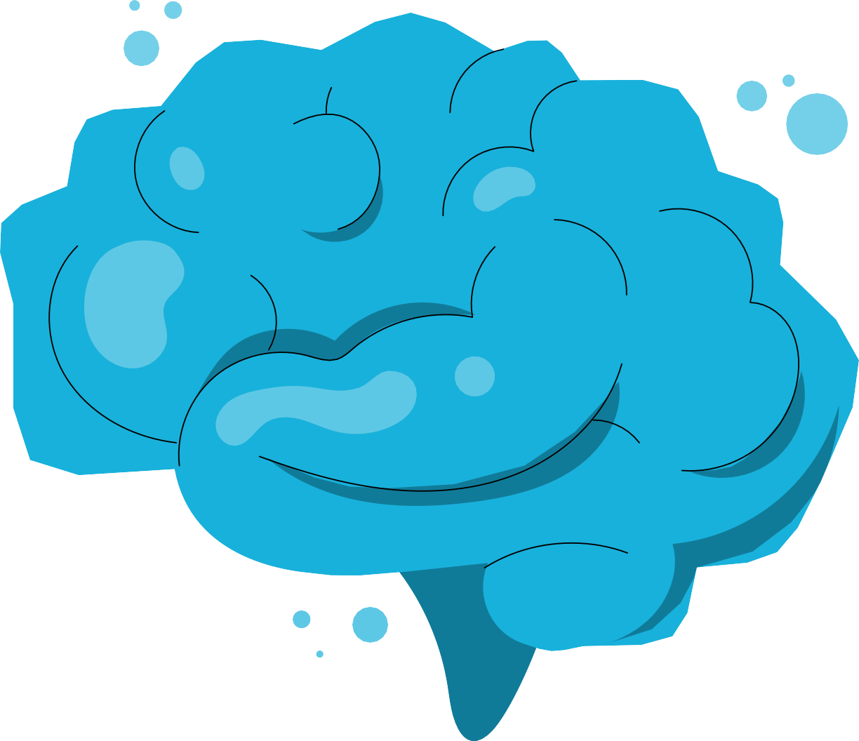
R – REFRAME
CULTIVATE OPTIMISM
Concept
Optimism is about expecting good things and being able to take in the good.
Daily Practice
End your day with “3 Good Things” exercise.
Reflection Question
How can you and your team recognize and celebrate small wins?

Slide 13
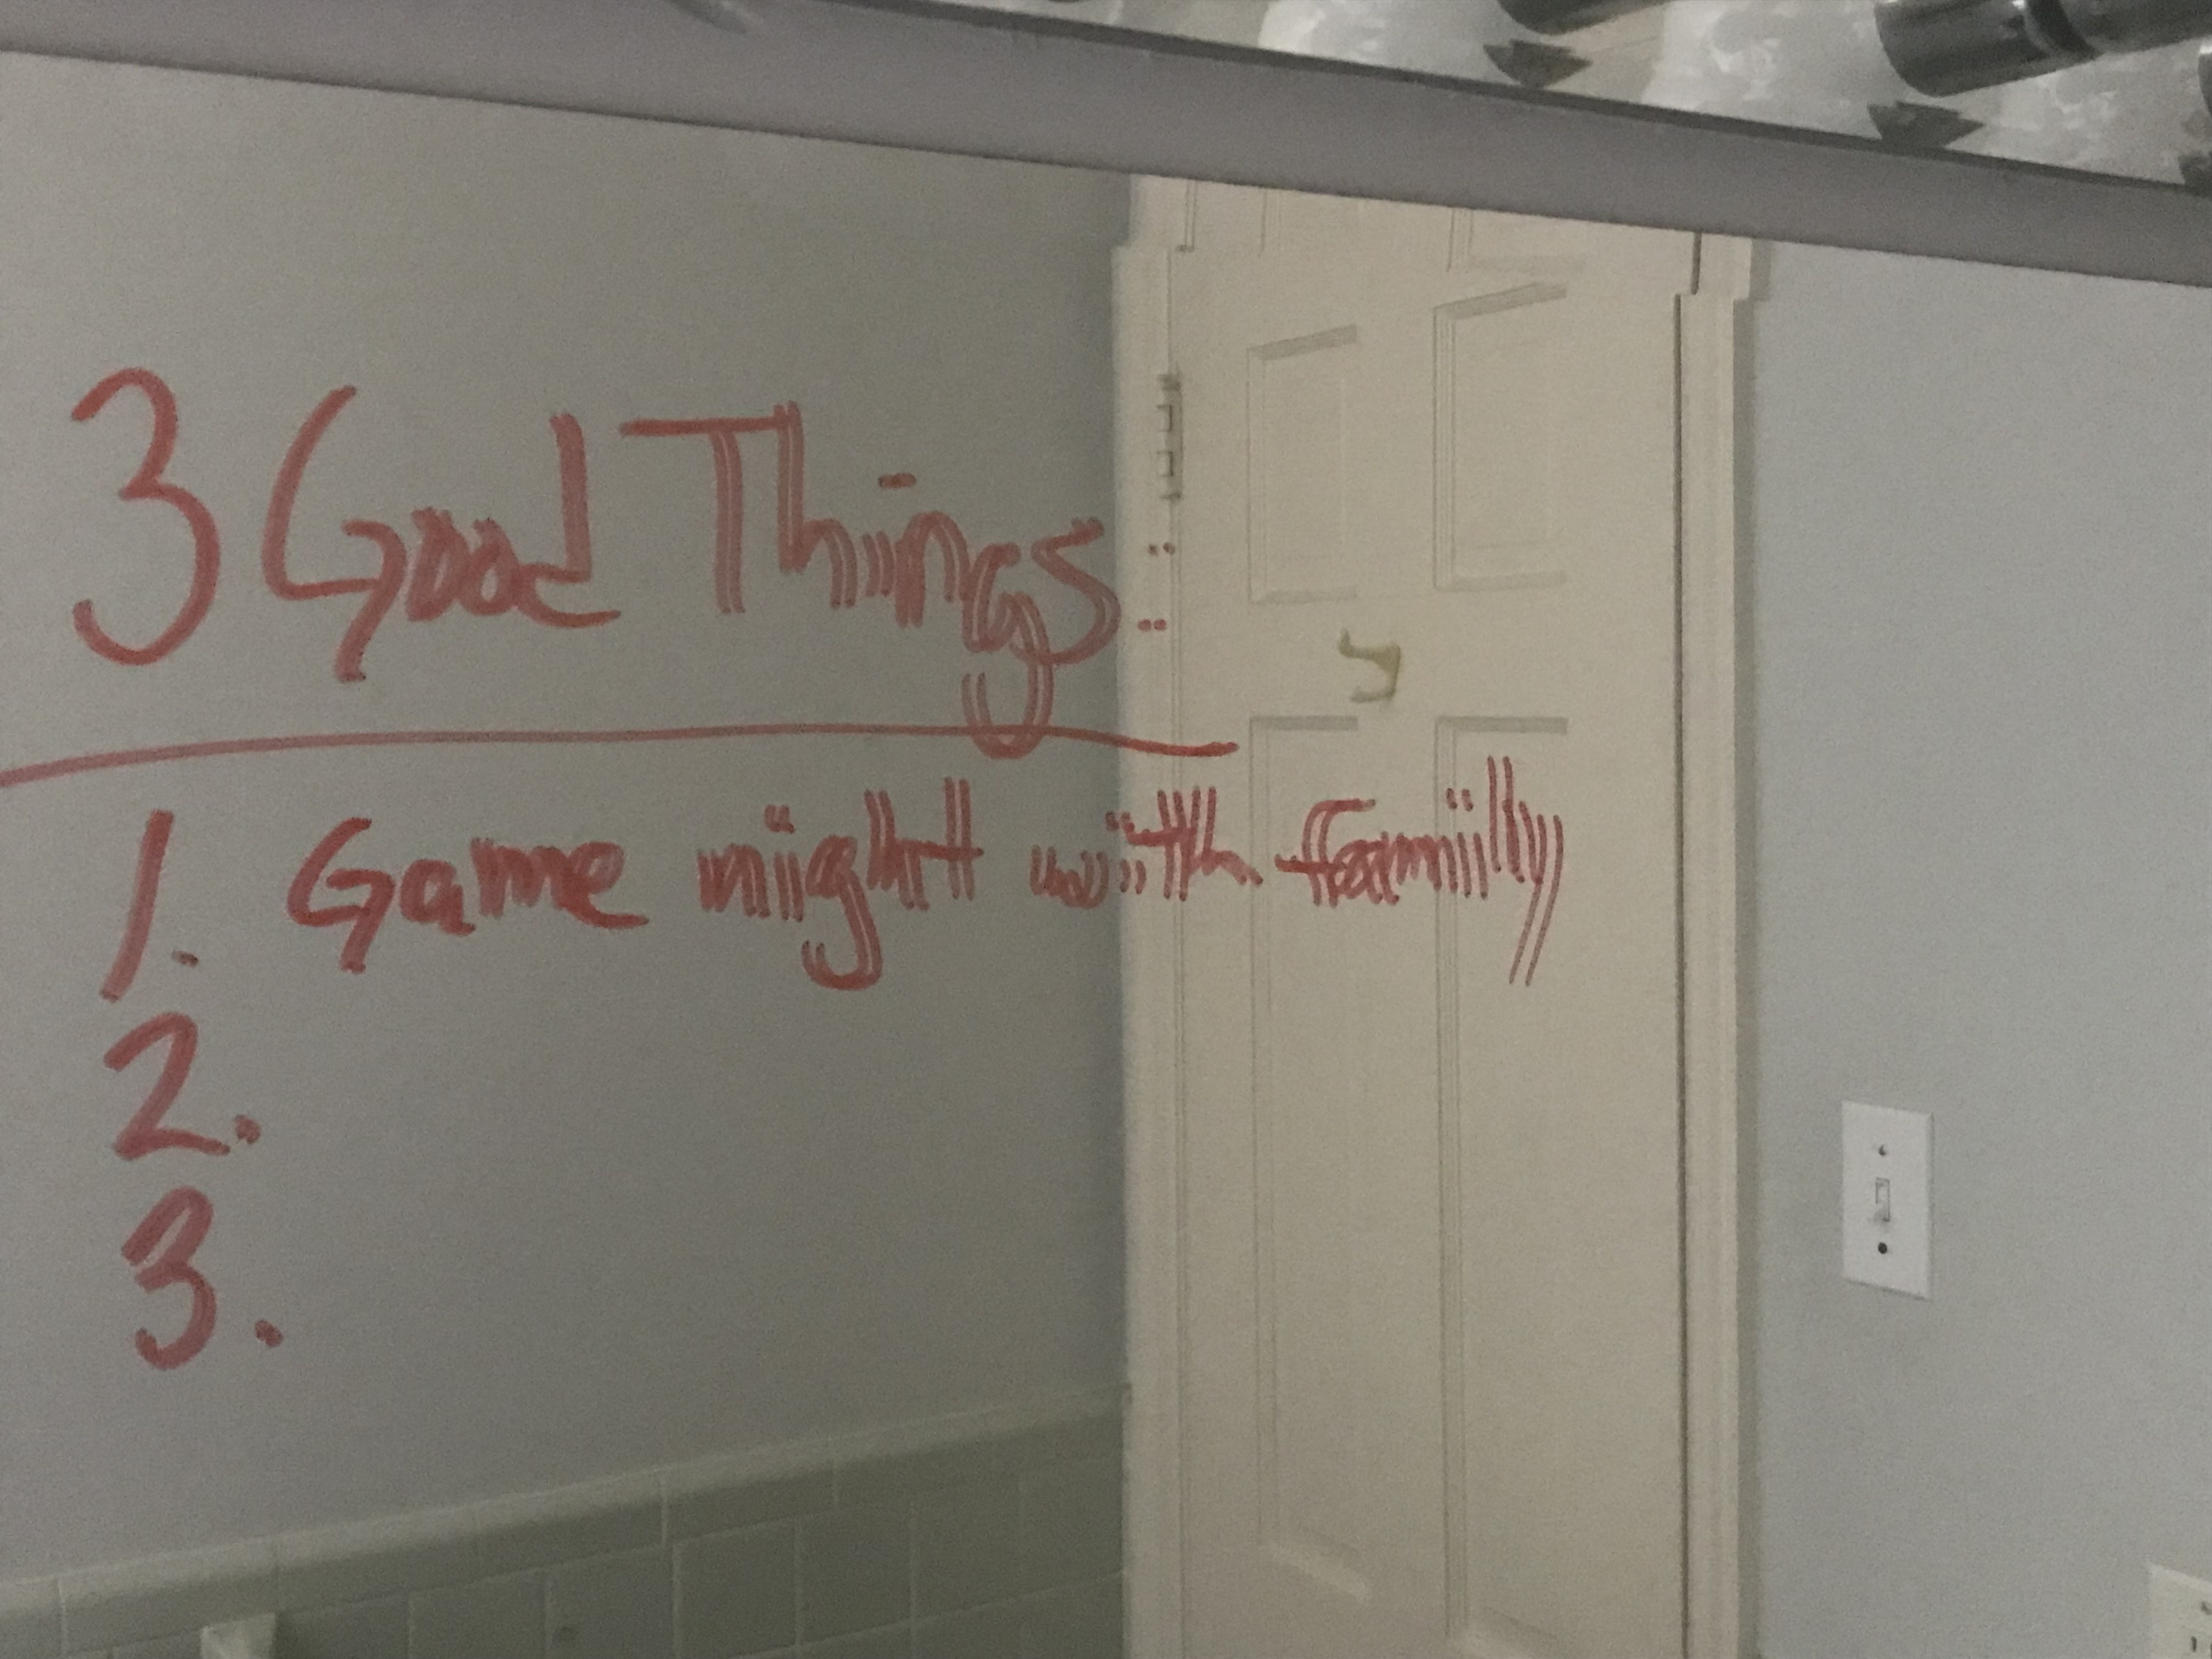
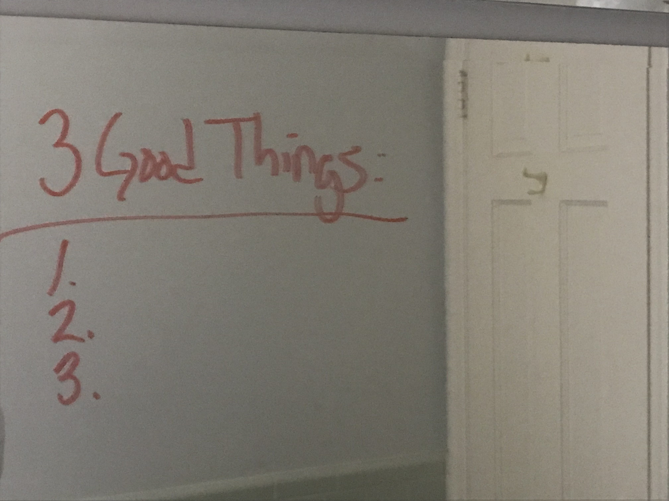
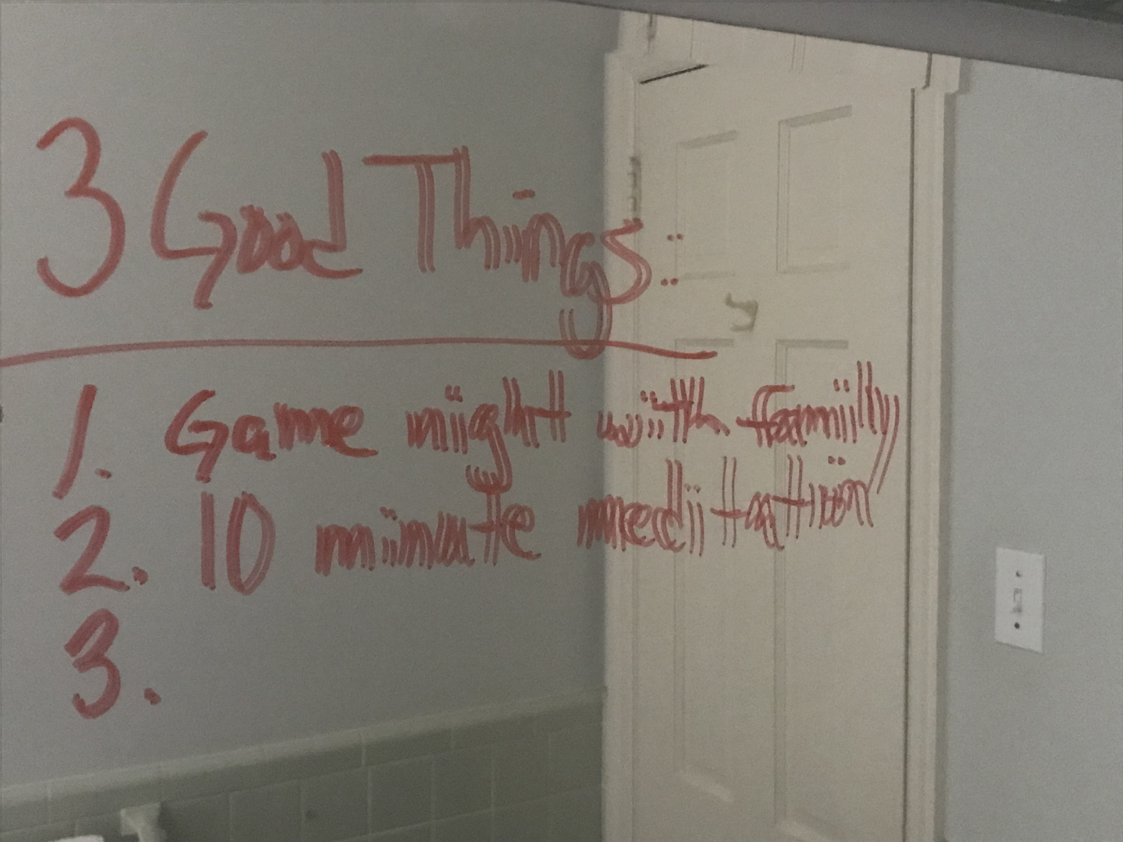
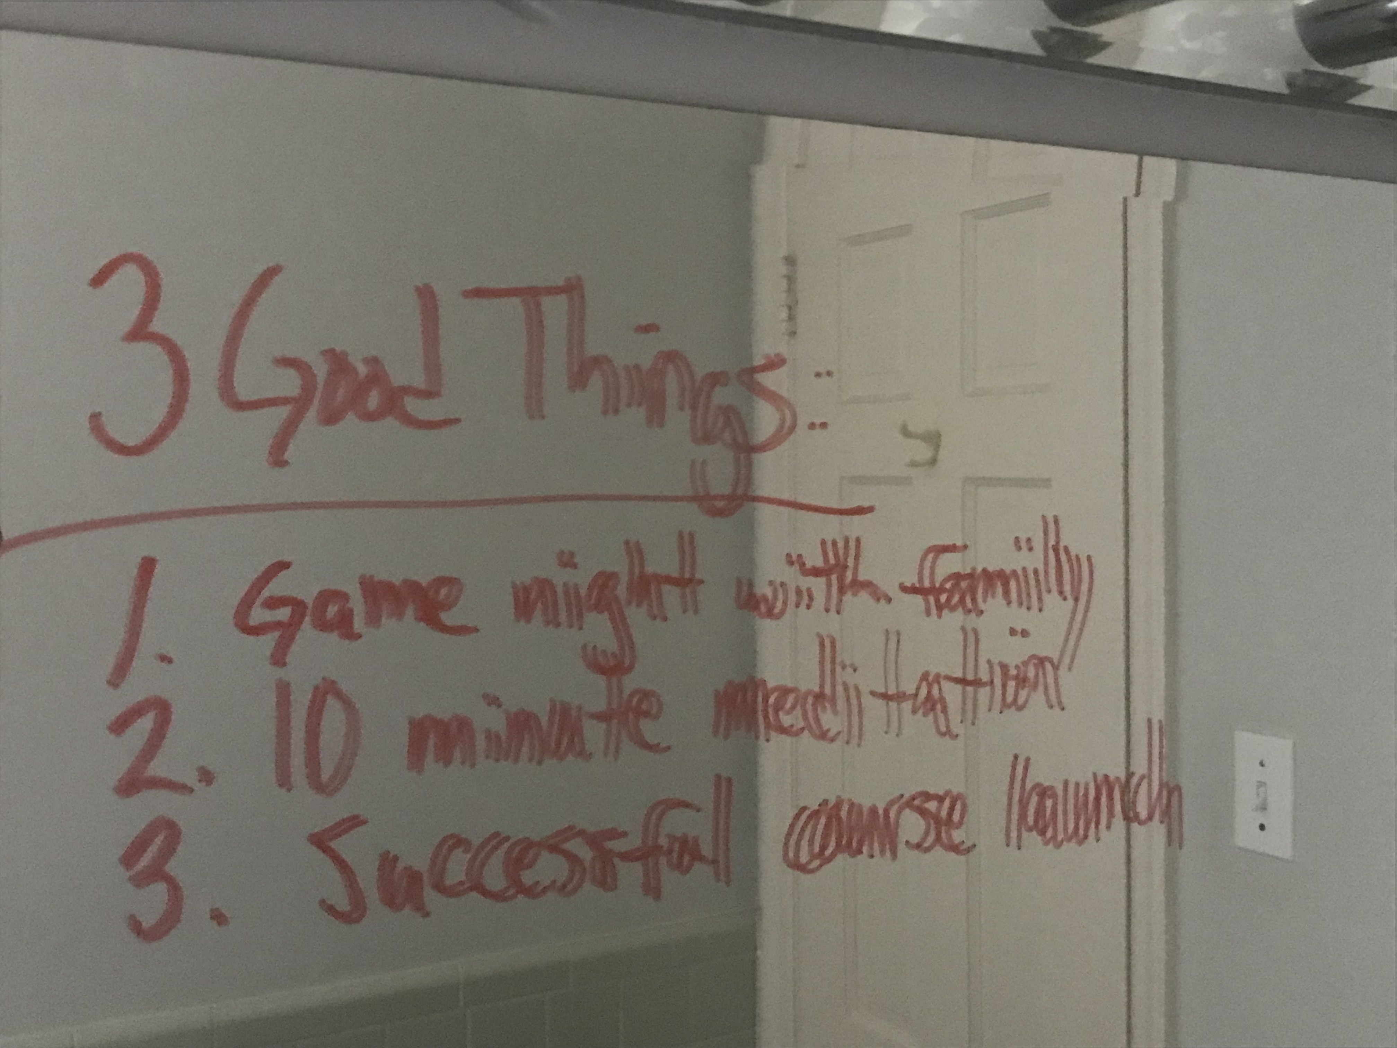
3 Good Things Exercise

Slide 14
HOW TO EMBED RESILIENCE INTO WORKFLOWS
SELF
TEAMS
SYSTEM
Create personal resilience habits around activation and settling.
Build a culture of psychological safety and excellence.
Integrate resilience into leadership, policies, and workflows

Slide 15
BRINGING POWER INTO YOUR DAILY LIFE
What is one POWER practice you will commit to daily?
Resilience is built through small, consistent actions.

