Slide 1
ECONOMIC OUTLOOK: 2025
Dr. Michael L. Walden, Reynolds Distinguished Professor Emeritus
North Carolina State University

Slide 2
REVIEW OF THE COVID RECESSION & RECOVERY
COVID HIT IN EARLY 2020 – SEVERE RECESSION
SHARP RECOVERY BEGAN IN MAY 2020
BUT THREE NEW CHALLENGES:
* LABOR SHORTAGES
* SUPPLY CHAIN DISRUPTIONS
* RISING PRICE INFLATION RATE

Slide 3
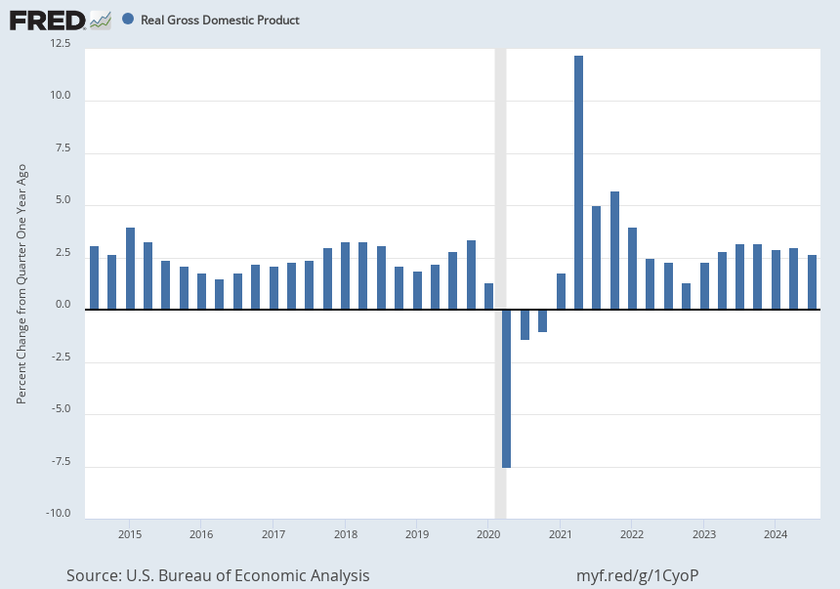
QUARTERLY REAL GDP GROWTH RATE, 2015-24

Slide 4
EMPLOYMENT TRENDS, 2019-2024

Slide 5
UNEMPLOYMENT RATE 2015-2024

Slide 6
LABOR FORCE PARTICIPATION RATE, 2020-24

Slide 7
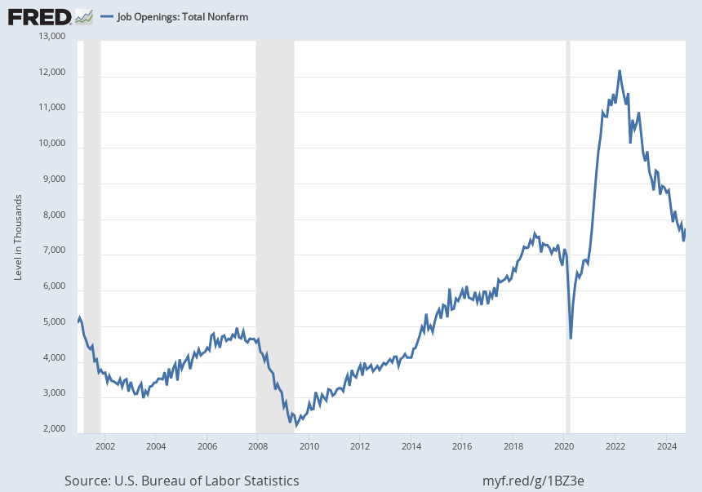
JOB OPENINGS, 2002 - 2024

Slide 8
LABOR PRODUCTIVITY GROWTH IS BACK AFTER A SLUMP DURING THE PANDEMIC

Slide 9
LINGERING ISSUE IS INFLATION ANNUAL CPI INFLATION RATE, 2020-2024

Slide 10
CAUSE OF INFLATION JUMP: TOO MUCH DEMAND AND TOO LLITTLE SUPPLY
ON DEMAND SIDE:
$6 TRILLION OF STIMULUS
ON SUPPLY SIDE:
SUPPLY CHAIN SHUTDOWNS

Slide 11
WILL PRICES FALL TO PRE-PANDEMIC LEVELS?
SOME WILL; MOST WON’T
”DEFLATION” HAPPENS IN BAD TIMES
FOR THE AVERAGE PRICE TO FALL, WAGES MUST FALL
SOLUTION IS FOR EARNINGS TO INCREASE FASTER THAN PRICES

Slide 12
WINNERS AND LOSERS IN HOUSEHOLD ECONOMICS
AVERAGE PRICES HAVE RISEN 2% MORE THAN WORKER EARNINGS
SINCE 2021
BUT STOCK MARKET (S&P 500) IS UP 48% SINCE 2021
AND “SAME-HOME” PRICES ARE UP 38% SINCE 2021

Slide 13
FED FIGHTS COVID, THEN INFLATION - RATES

Slide 14
FED FIGHTS COVID, THEN INFLATION - MONEY

Slide 15
NOW FED IS CHANGING POLICY AGAIN
SOFT LANDING APPEARS TO HAVE BEEN ACHIEVED
SIGNS OF SLOWER GROWTH, BUT NO RECESSION
FED’S RECENT BIG ANNOUNCEMENTS: 0.5% CUT
FOLLOWED BY TWO 0.25% RATE CUTS

Slide 16
“ DOT” DIAGRAM OF FEDERAL FUNDS RATE HIGH OF 5.5%; NOW AT RANGE OF 4.25% TO 4.5% END OF 2025 EXPECTED AT 3.75%

Slide 17
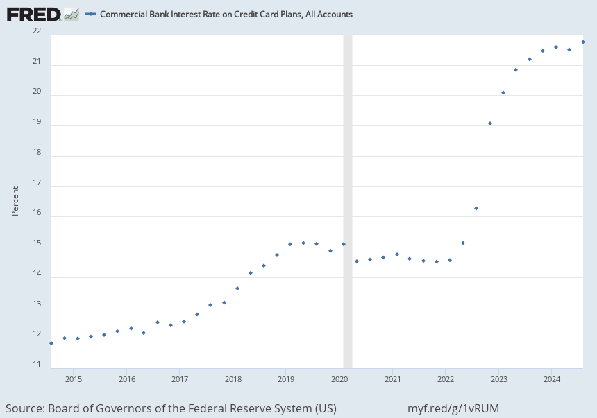
BUT NOT ALL INTEREST RATES HAVE FALLEN CREDIT CARD RATE 10-YEAR TREASURY RATE
EXAMPLE: 10 YEAR

Slide 18
FISCAL POLICY HAS BEEN MODESTLY STIMULATIVE

Slide 19
LEADING ECONOMIC INDICES NATIONAL NORTH CAROLINA

Slide 20
FORECAST
FED WILL SLOWLY LOWER THEIR KEY INEREST RATE THROUGH 2025
CONSUMER PURCHASING POWER WILL RETURN IN 2025
ECONOMY WILL GROW IN THE 1.5% TO 2.5% ANNUAL RANGE
JOBLESS RATE WILL STAY IN THE 3.5% TO 4.5% RANGE

Slide 21
FORECAST, CONTINUED
ANNUAL INFLATION RATE WILL SETTLE AT 2.5% TO 3% in 2025
SHORT TERM WORRIES: CONSUMER DEBT, COMMERCIAL REAL ESTATE
LONG TERM WORRIES: SOCIAL SECURITY, DEBT, AI AND LABOR MARKET

Slide 22
BUT NEW ADMINISTRATION’S POLICIES COULD ALTER THESE FORECASTS 1.NEW TAX CUTS
STIMULATE GROWTH OR
INCREASE DEBT?

Slide 23
2. DE-REGULATION
INCREASE BUSINESS PRODUCTIVITY
OR
MOVE AWAY FROM COLLECTIVE
GOALS?

Slide 24
3. INCREASE FOSSILL FUEL PRODUCTION
LOWER ENERGY COSTS
OR
SACRIFICE CLIMATE GOALS?

Slide 25
4. REDUCE IMMIGRATION
IMPROVE NATIONAL SECURITY
OR
REDUCE LABOR SUPPLY AND SLOW
THE ECONOMY ?

Slide 26
5. IMPOSE TARIFFS
STIMULATE DOMESTIC PRODUCTION
OR
INCREASE CONSUMER COSTS?

Slide 27
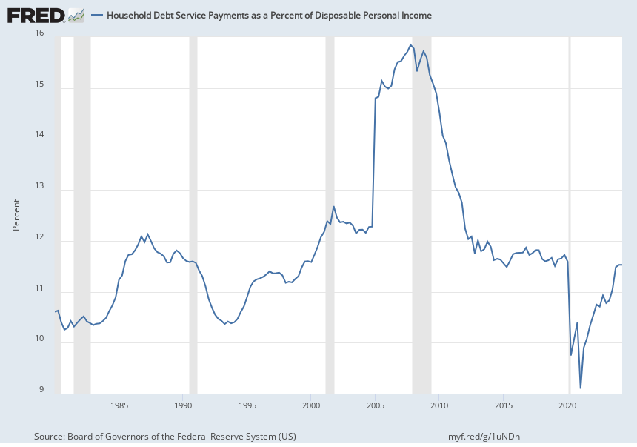
HOUSEHOLD DEBT PAYMENTS AS % OF DISPOSABLE INCOME

Slide 28
HOUSEHOLD DEBT DELINQUENIES ARE UP

Slide 29
COMMERCIAL REAL ESTATE DELINQUENCIES ARE UP

Slide 30
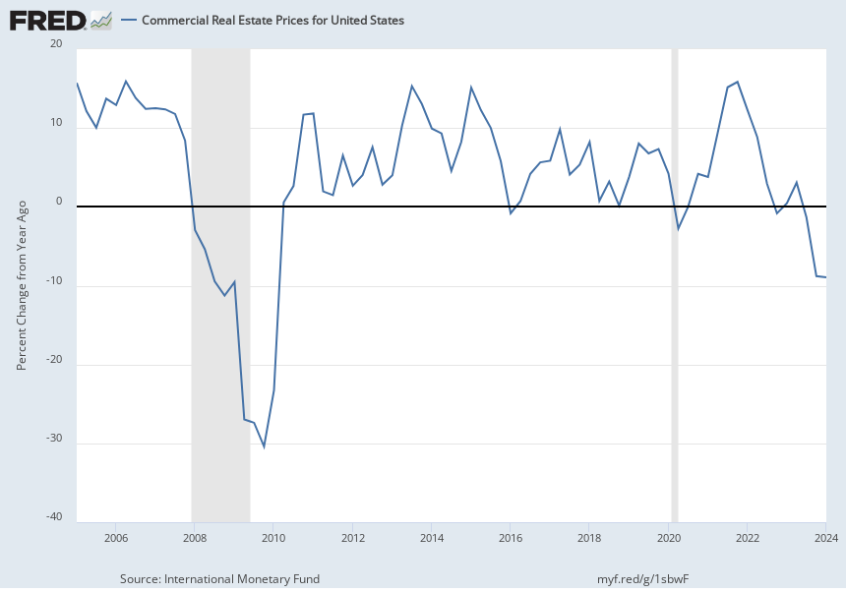
COMMERCIAL REAL ESTATE PRICES ARE DOWN

Slide 31
BIG ISSUES – SOCIAL SECURITY

Slide 32
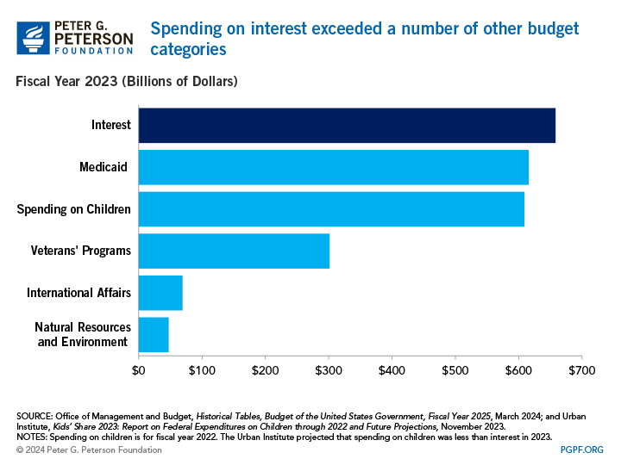
BIG ISSUE: NATIONAL DEBT

Slide 33
BIG ISSUE: A1 AND LABOR MAREKT CHANGE
DISPLACEMENT OF COGNITIVE WORK
JOBS DELETED AND CREATED
NEEDED RE-TRAINING FOR MILLIONS
OVERAL OF HIGHER EDUCATION

Slide 34
REGIONAL ANALYSIS: RISE OF THE SOUTH

Slide 35
GDP GROWTH RATE BY STATE

Slide 36
STATES’ RANKINGS ON NET IN-MIGRATION, 2020-23
NC: #3
SC: # 5

Slide 37
TOP PERFORMING CITIES (MILKIN INST)
1. AUSTIN 7. FAYETTEVILLE, ARK
2. RALEIGH 8. DALLAS
3. BOISE 9. OLYMPIA, WASH.
4. SALT LAKE 10. CHARLOTTE
5. PROVO 11. CHARLESTON, SC
6. NASHVILLE

Slide 38
NORTH CAROLINA’S BIRTH RATE IS FALLING

Slide 39
CONTRIBURTION OF MIGRATION FROM OTHER STATES IS UP

Slide 40
CONTRIBUTION OF FOREIGN IMMIGRATIONS IS STRONGLY UP

Slide 41
ECONMIC GROWTH IN NC IS SPREADING
IN LAST FOUR YEARS, MAJOR TECH AND PHARMA
ANNOUCNEMENTS FOR:
JOHNSTON CO.
CHATHAM CO.
ROCKY MOUNT-WILSON-GREENVILLE
HICKORY
POSSIBILITY OF “REMOTE WORK COMMUNITIES”?

Slide 42
CONCLUSION
ECONOMIES NEVER RUN PERFECTLY
ALWAYS CHALLENGES & OPPORTUNITIES
PUBLIC POLICY MAKERS HAVE LIMITED IMPACT ON
THE ECONOMY’S DIRECTION

Slide 43
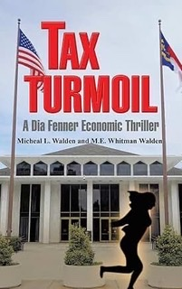
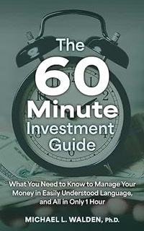
MY RECENT BOOKS – SOMETHING FOR EVERYONE !
Launch

