Slide 1
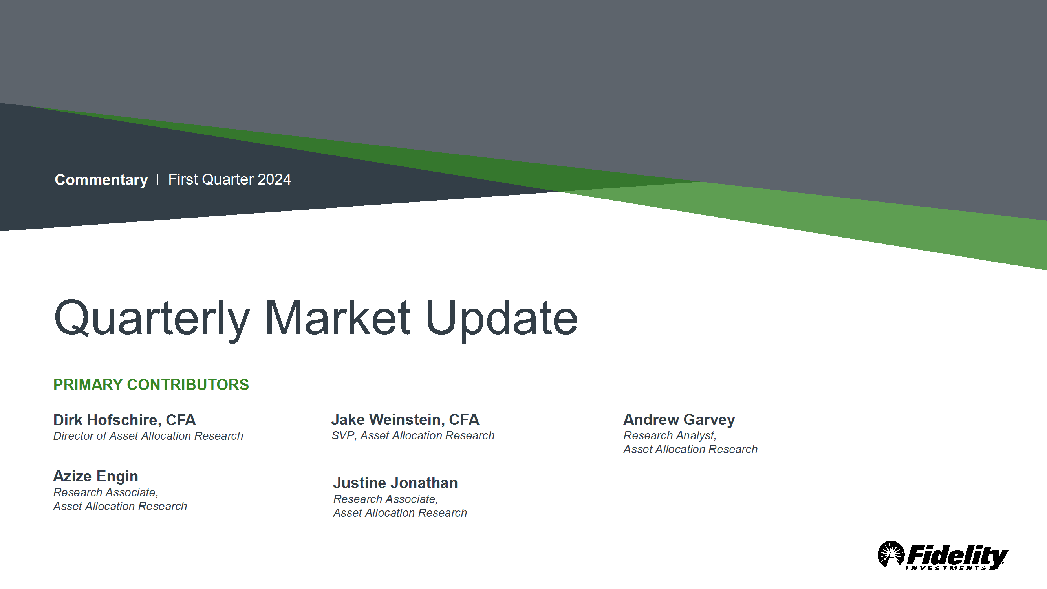
Economic Update

Slide 2

2023 RECAP

Slide 3
Lower Inflation
Higher Interest Rates
Stock Market Recovery
Middle East Conflict/War
AI Becomes Mainstream
Elusive Recession

Slide 4
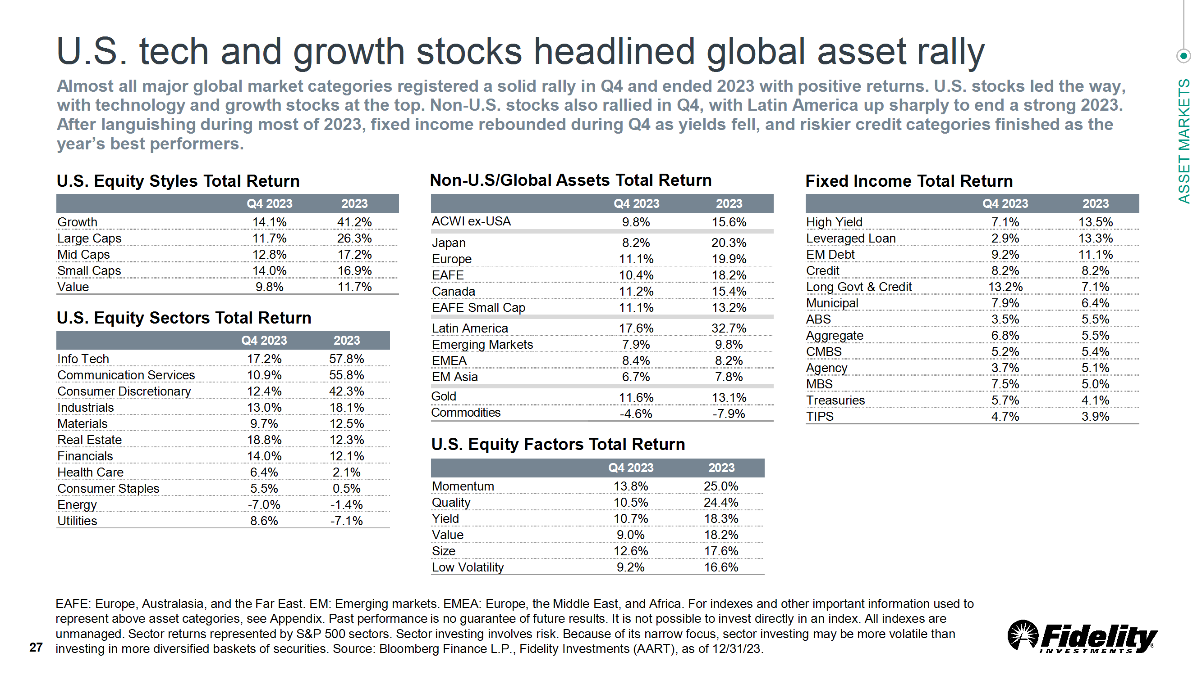

Slide 5
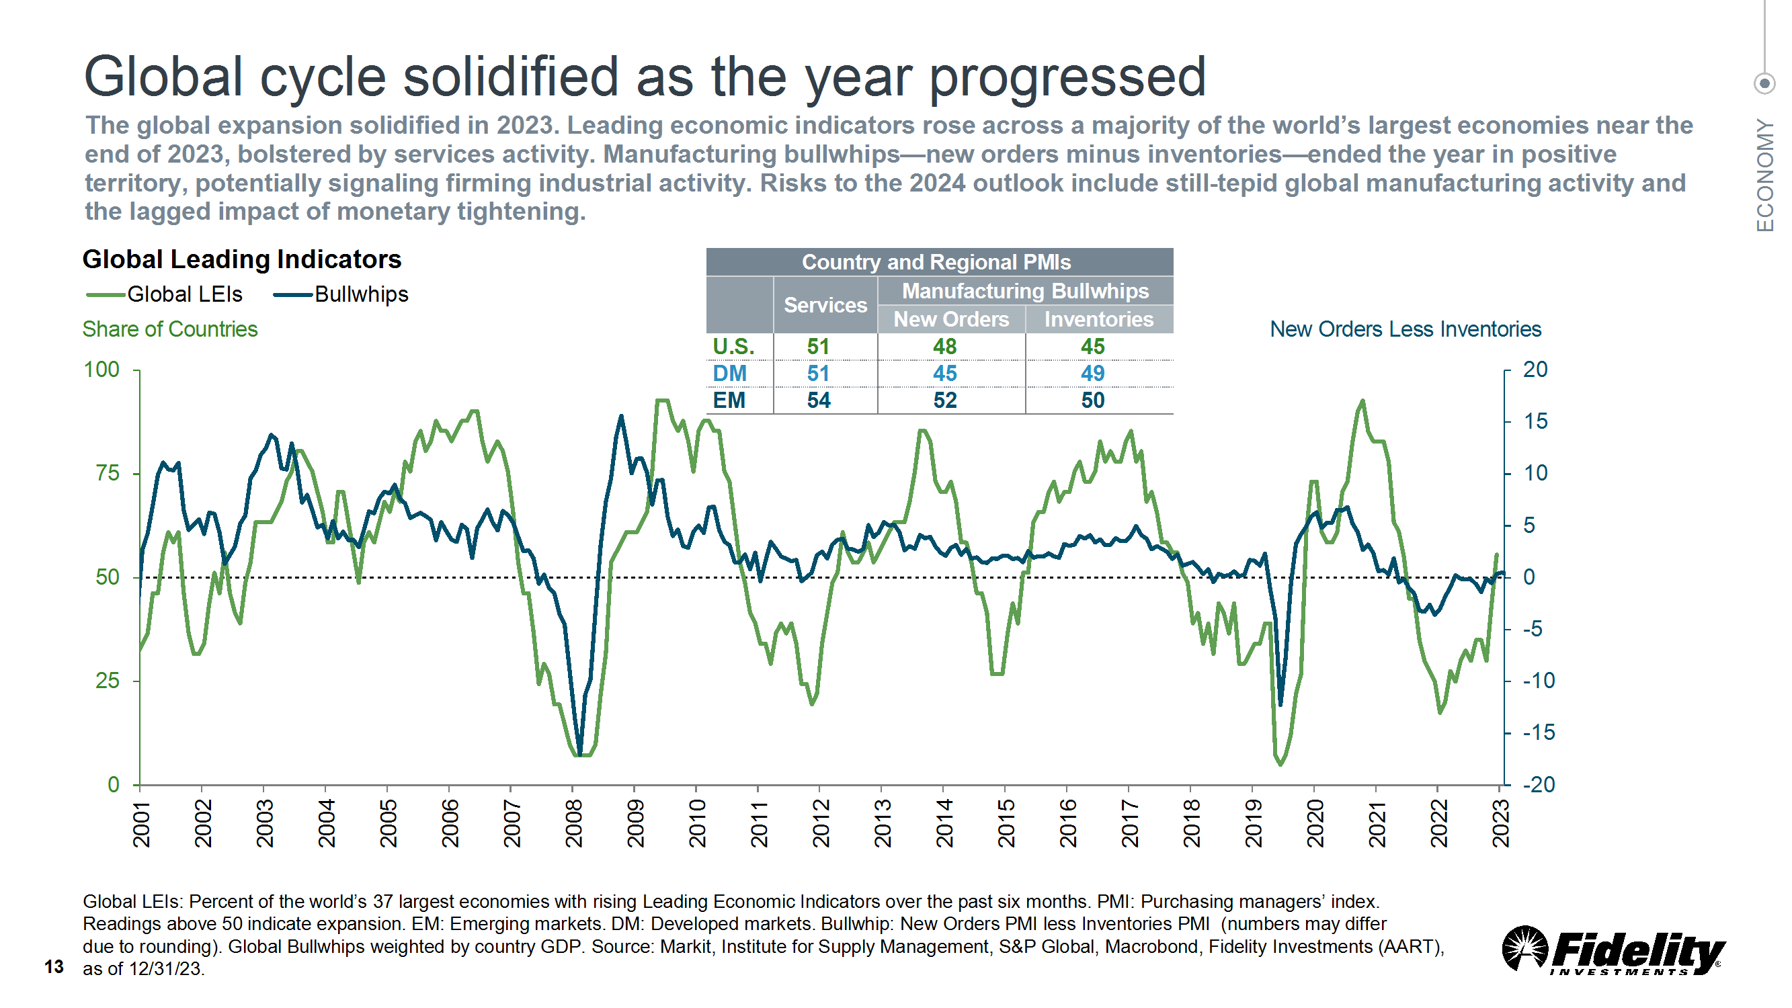

Slide 6
MACROECONOMIC UPDATE

Slide 7
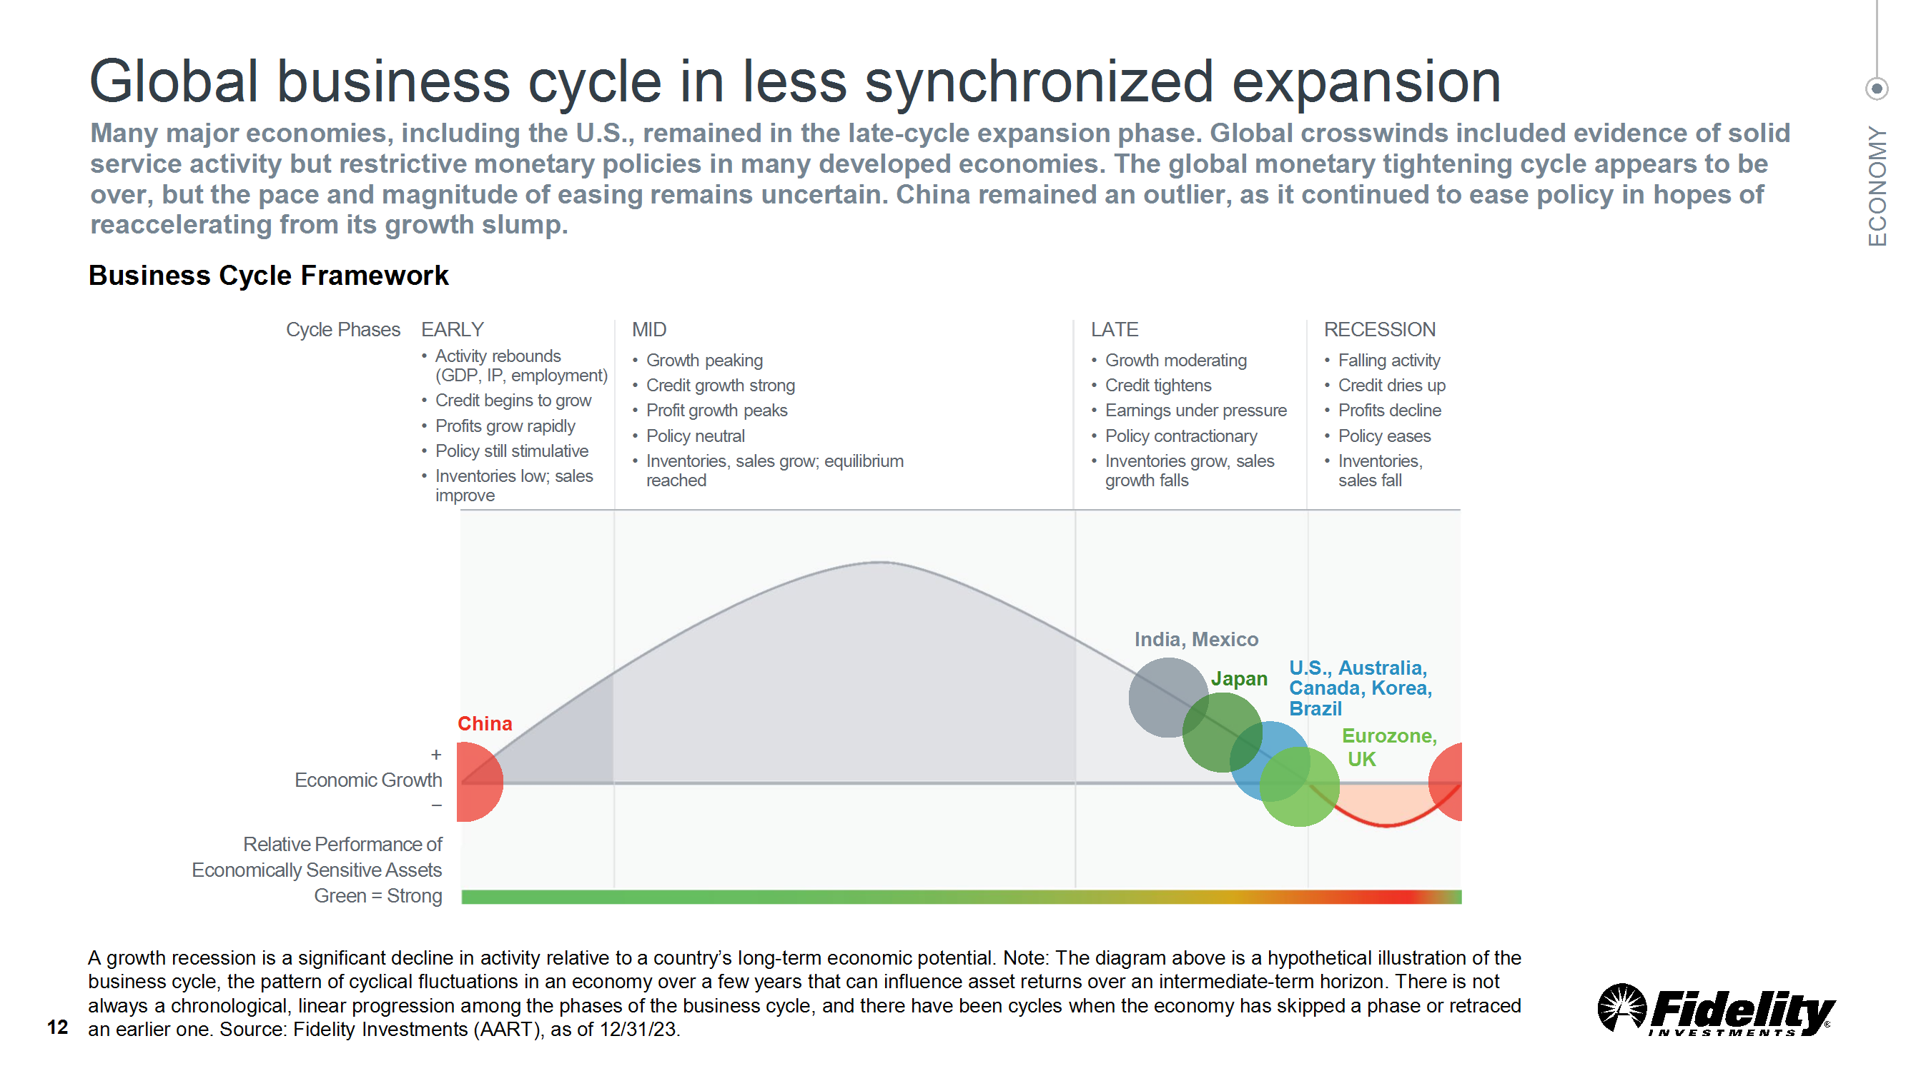

Slide 8
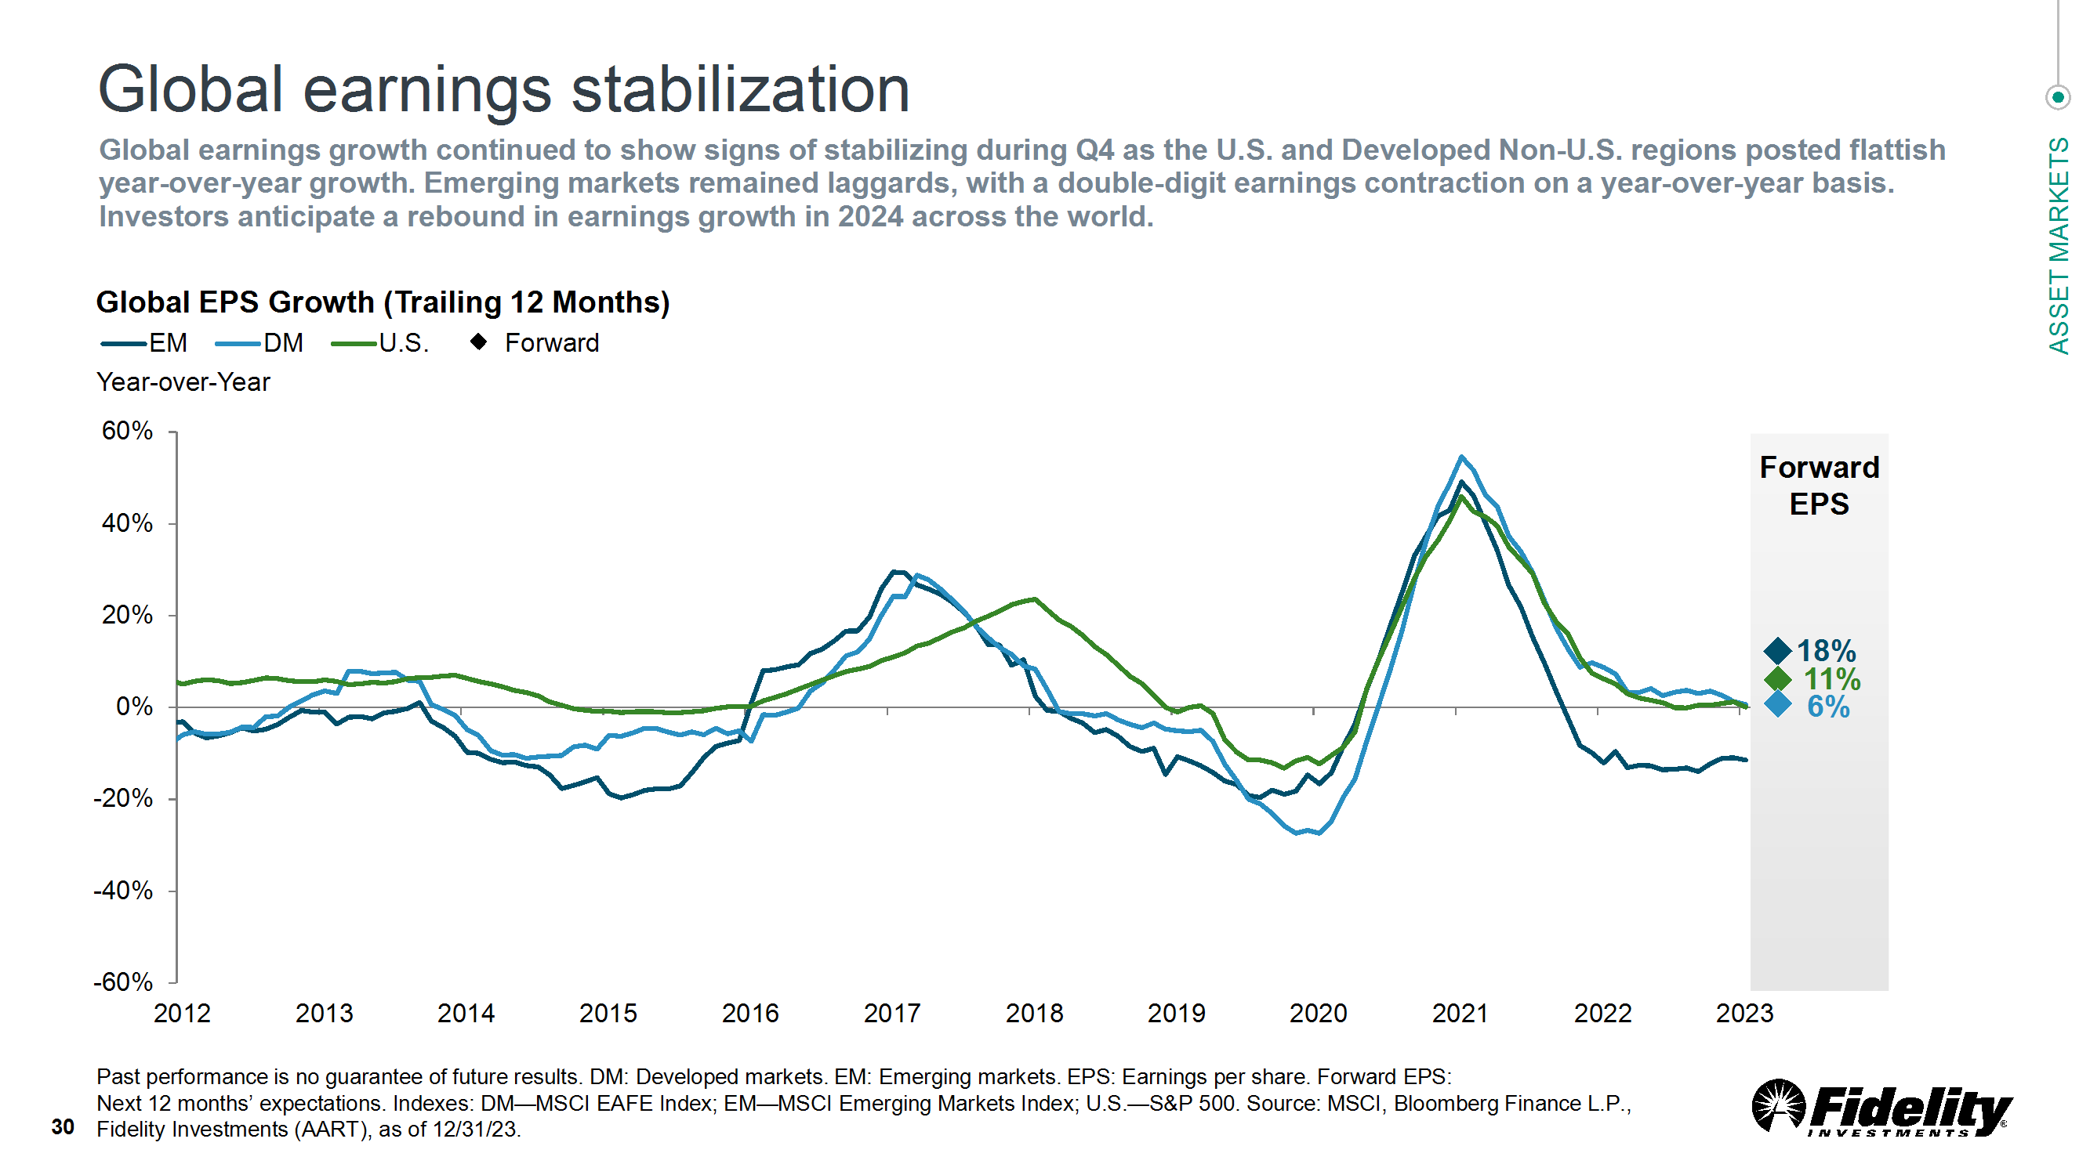

Slide 9
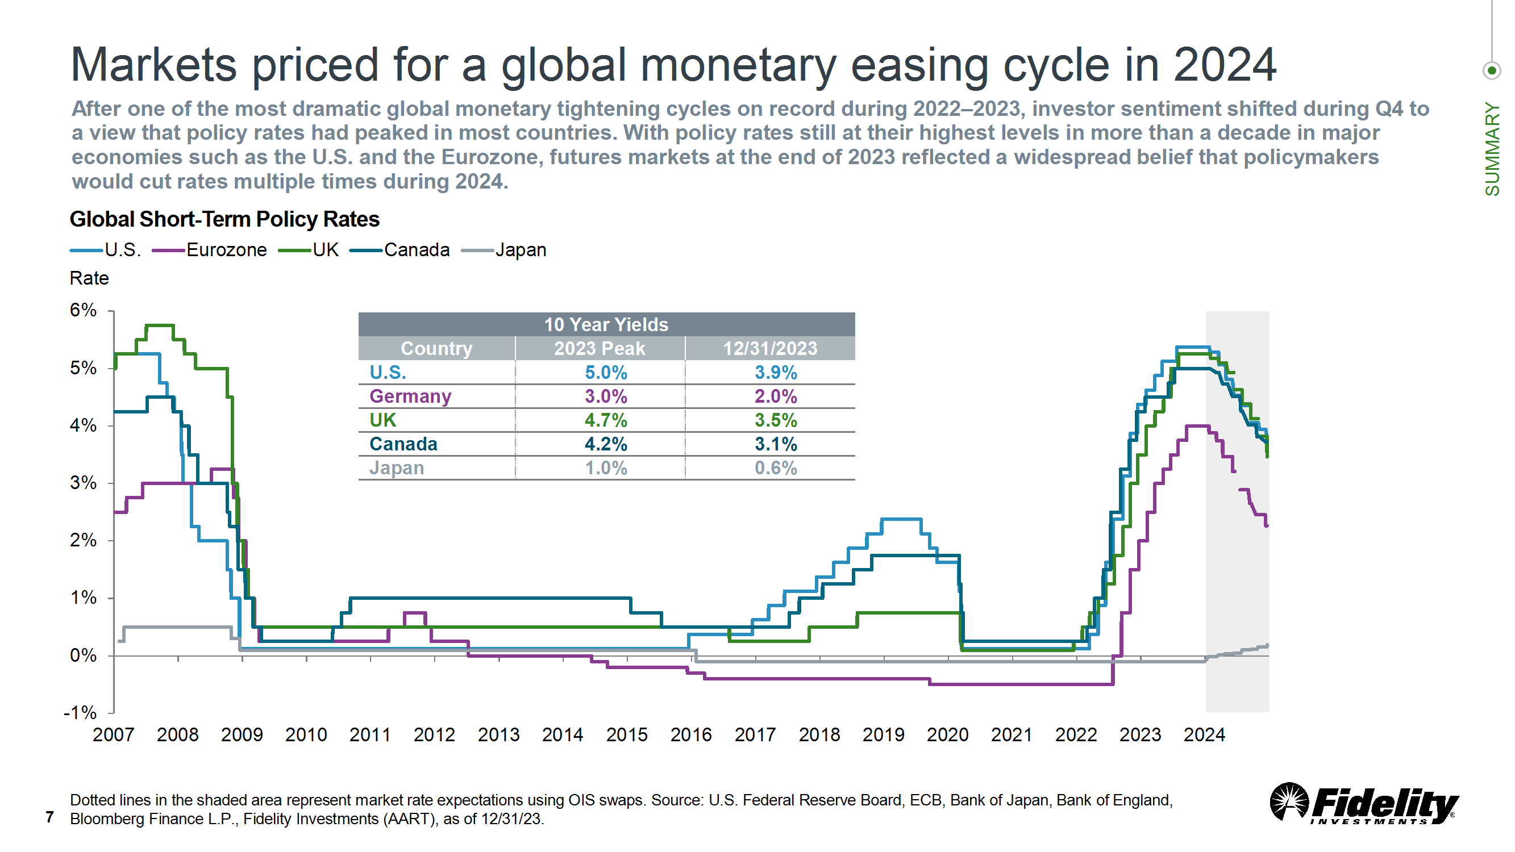

Slide 10
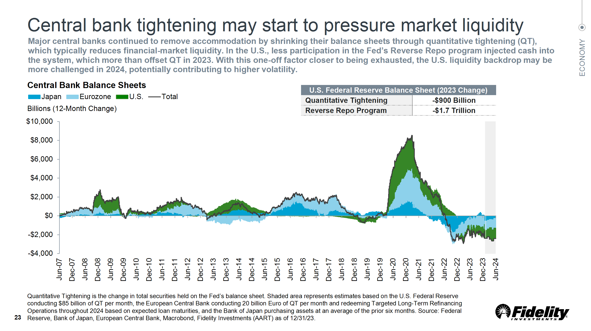

Slide 11
US ECONOMIC UPDATE

Slide 12
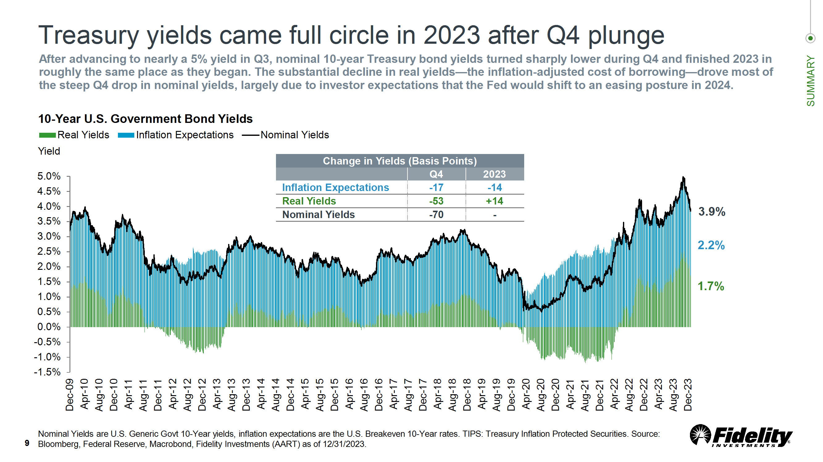

Slide 13
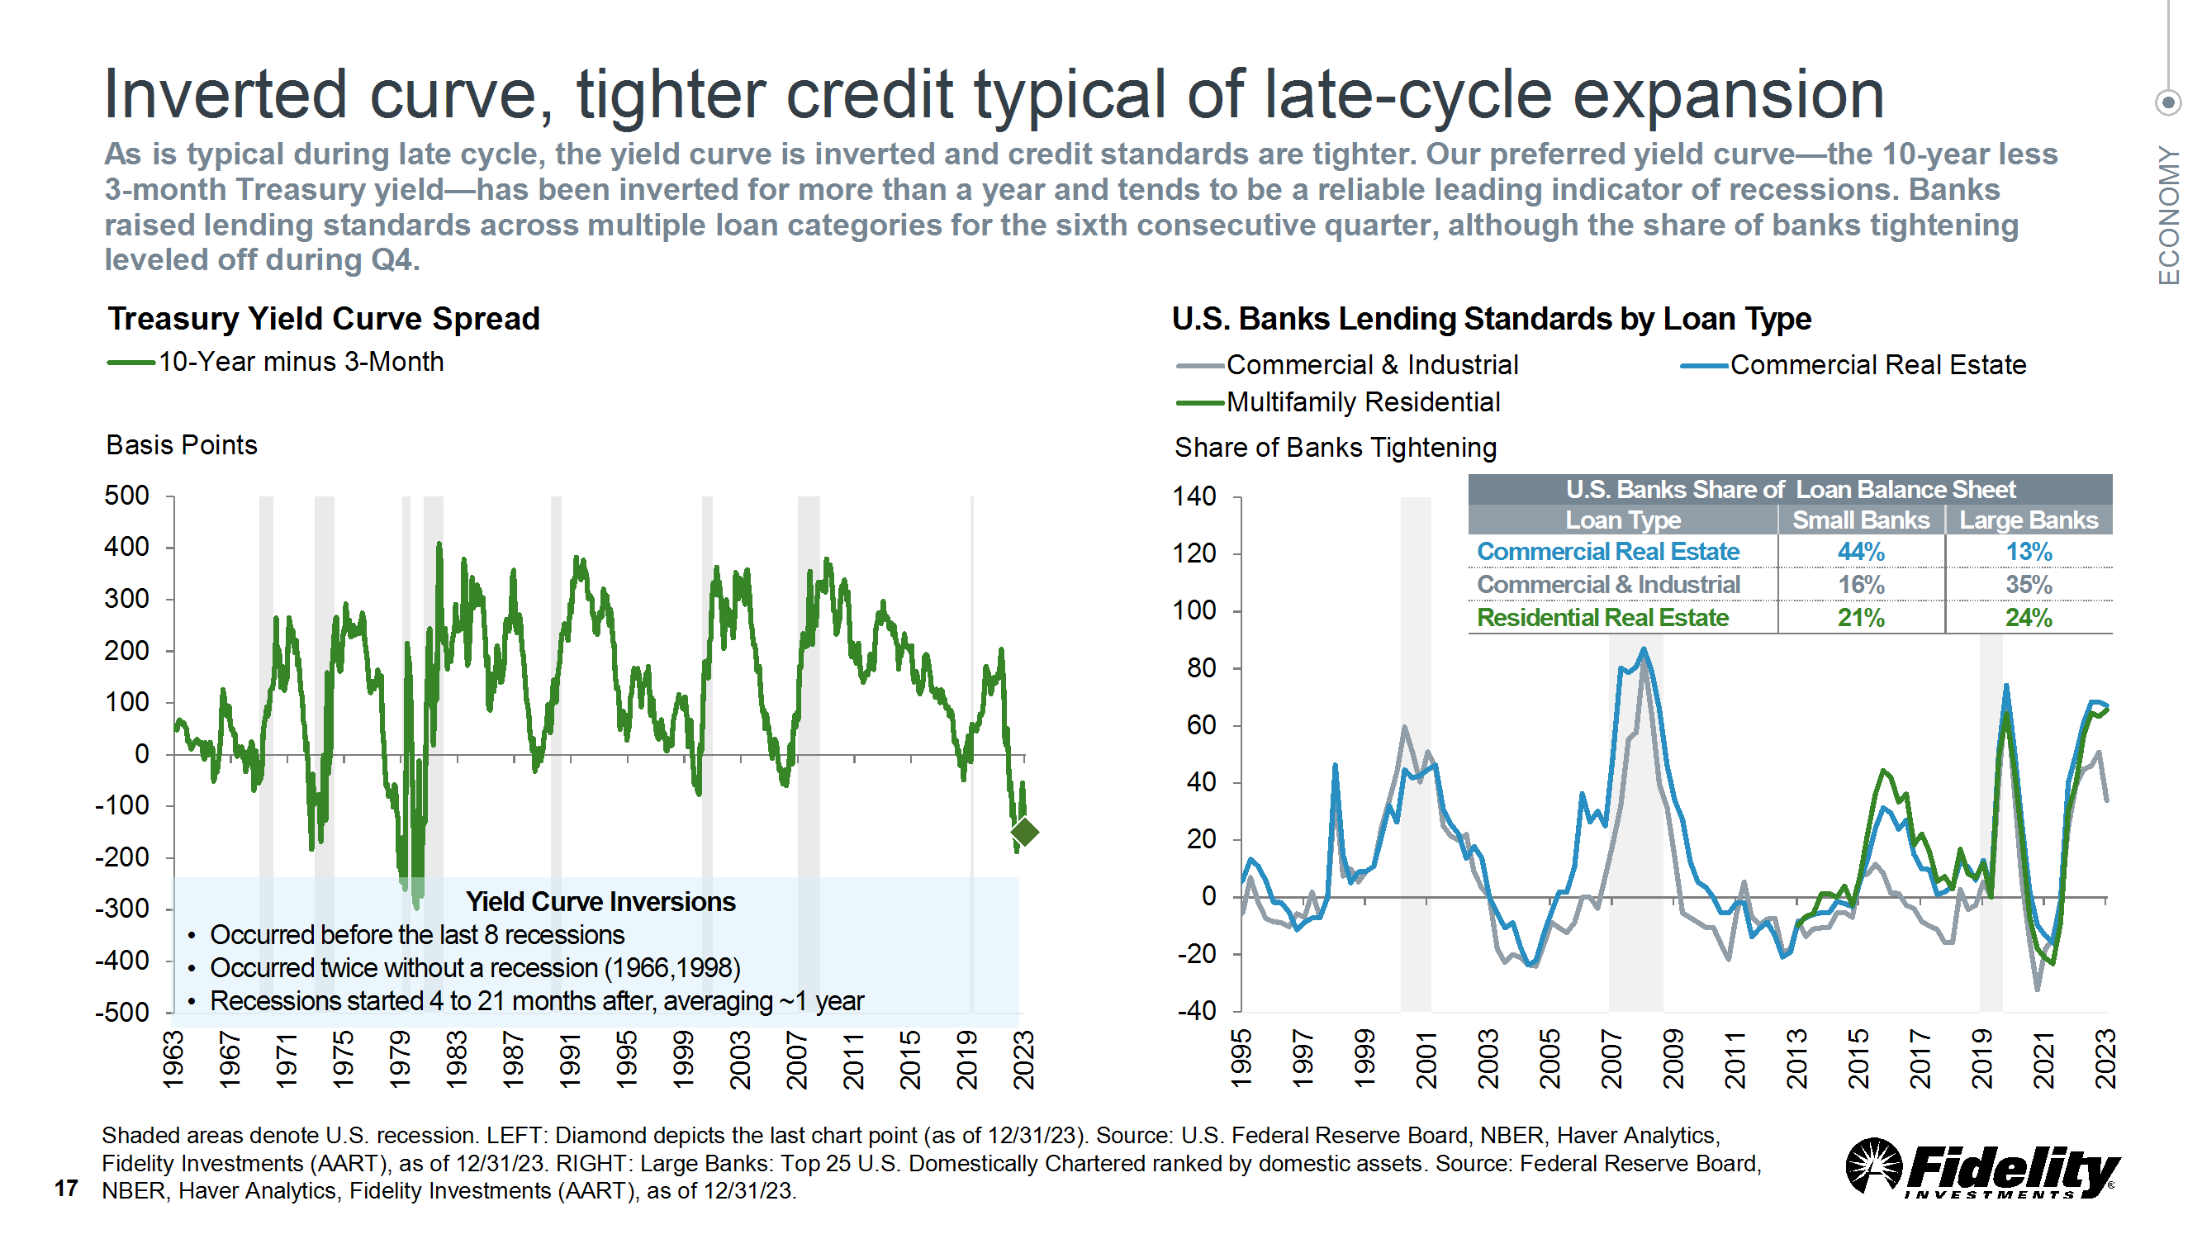

Slide 14
INFLATIONARY PRESSURES

Slide 15
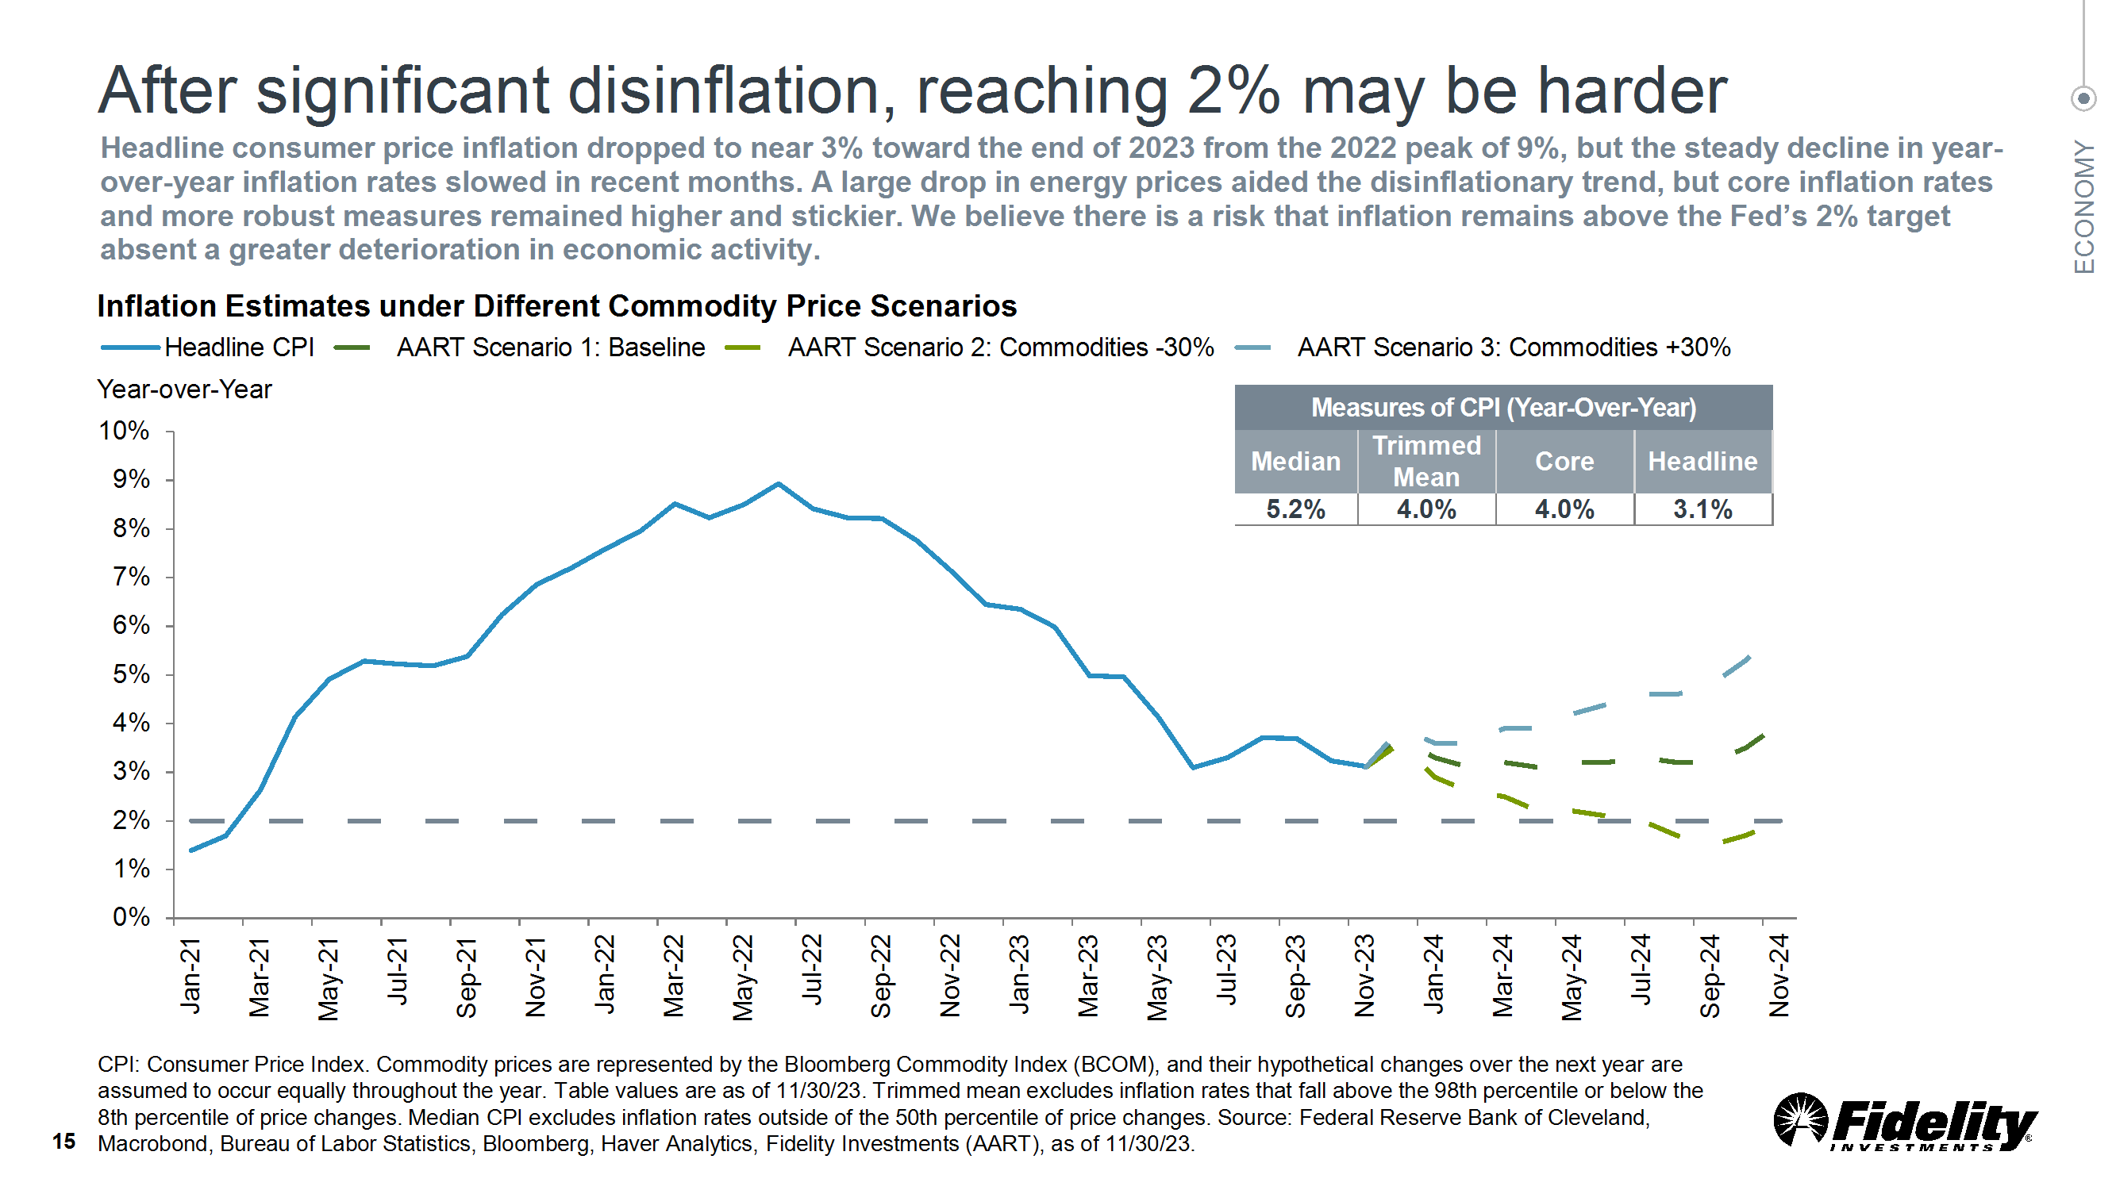

Slide 16
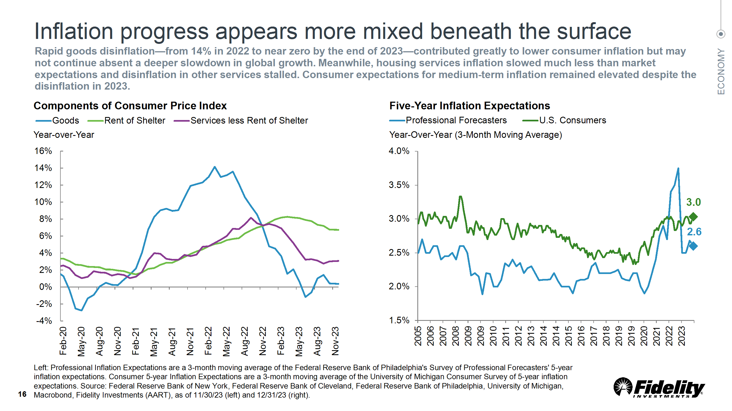

Slide 17
EMPLOYMENT OUTLOOK

Slide 18
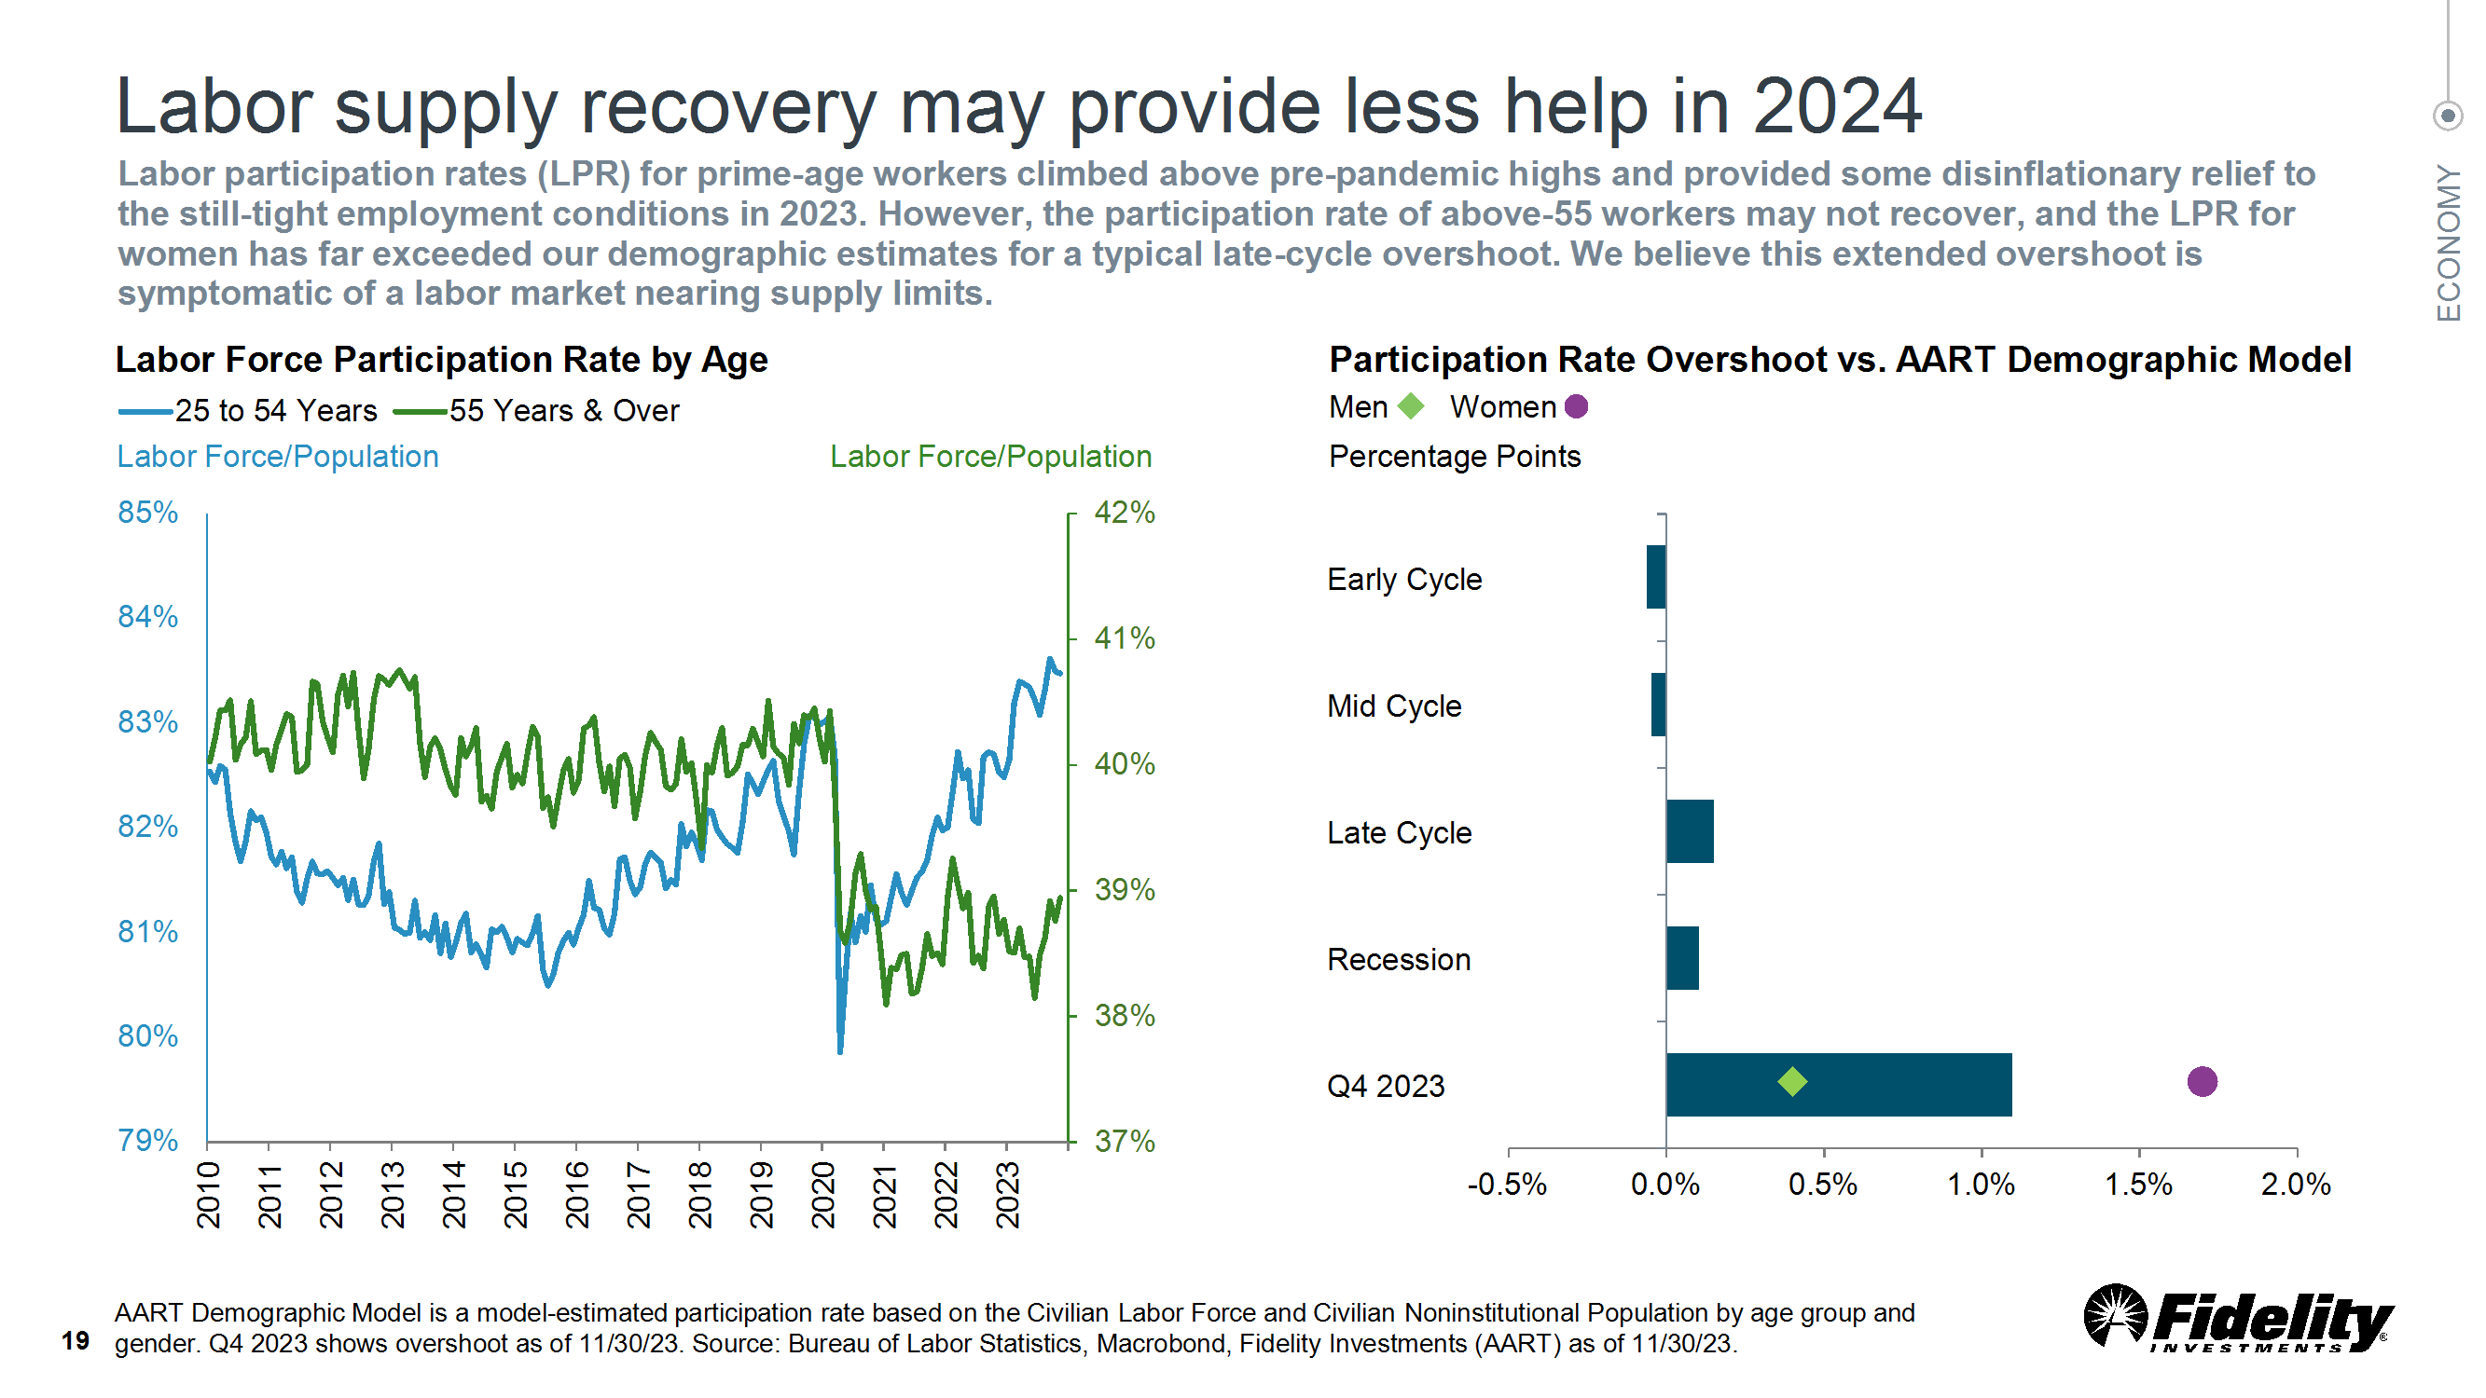

Slide 19
GDP OUTLOOK

Slide 20
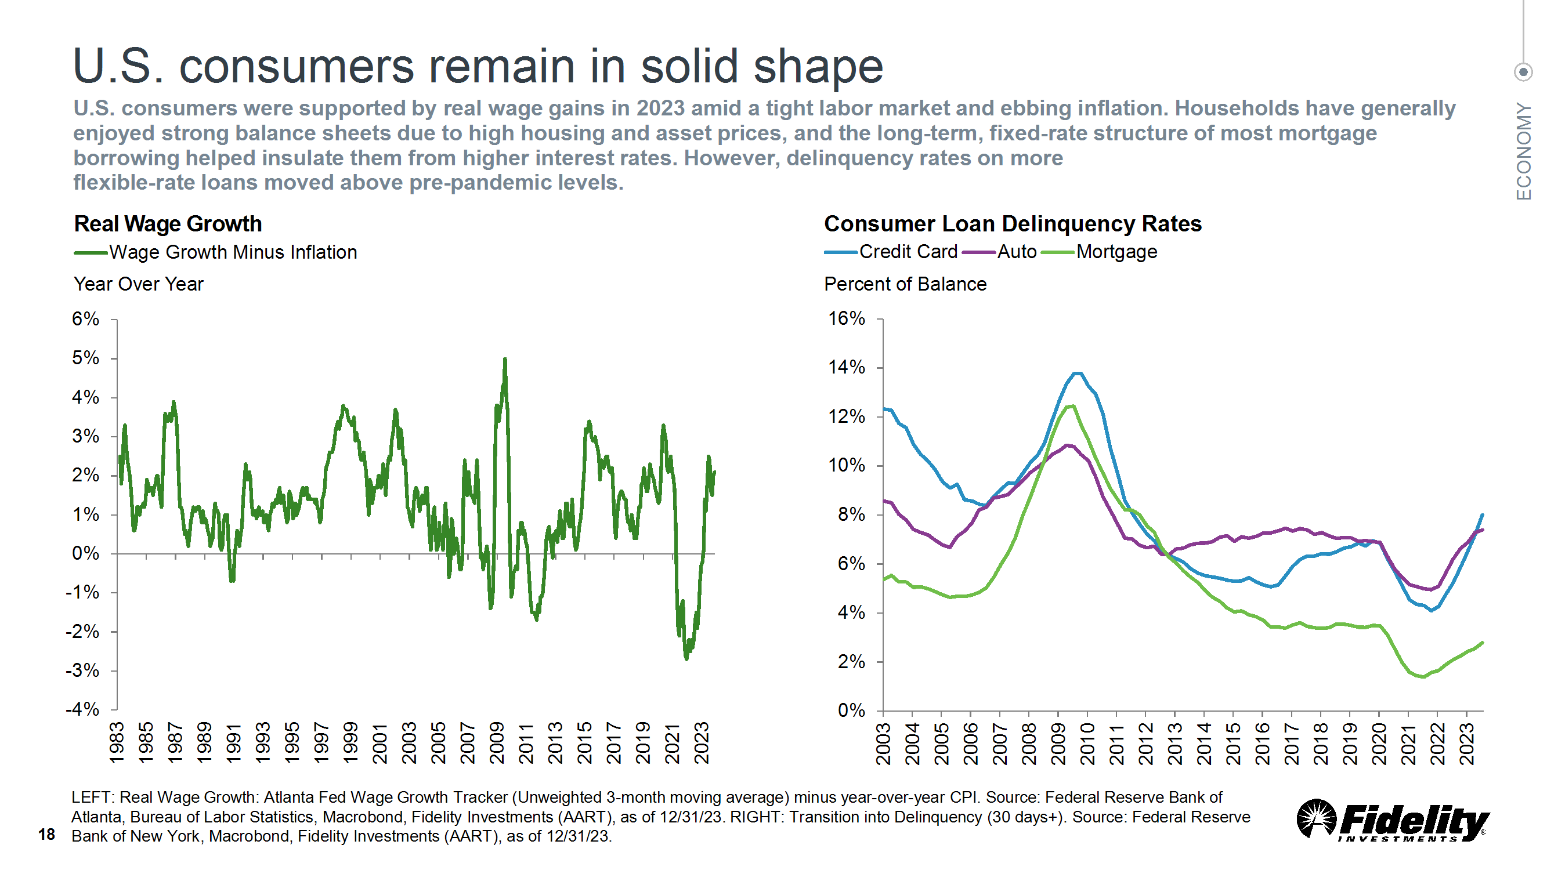

Slide 21
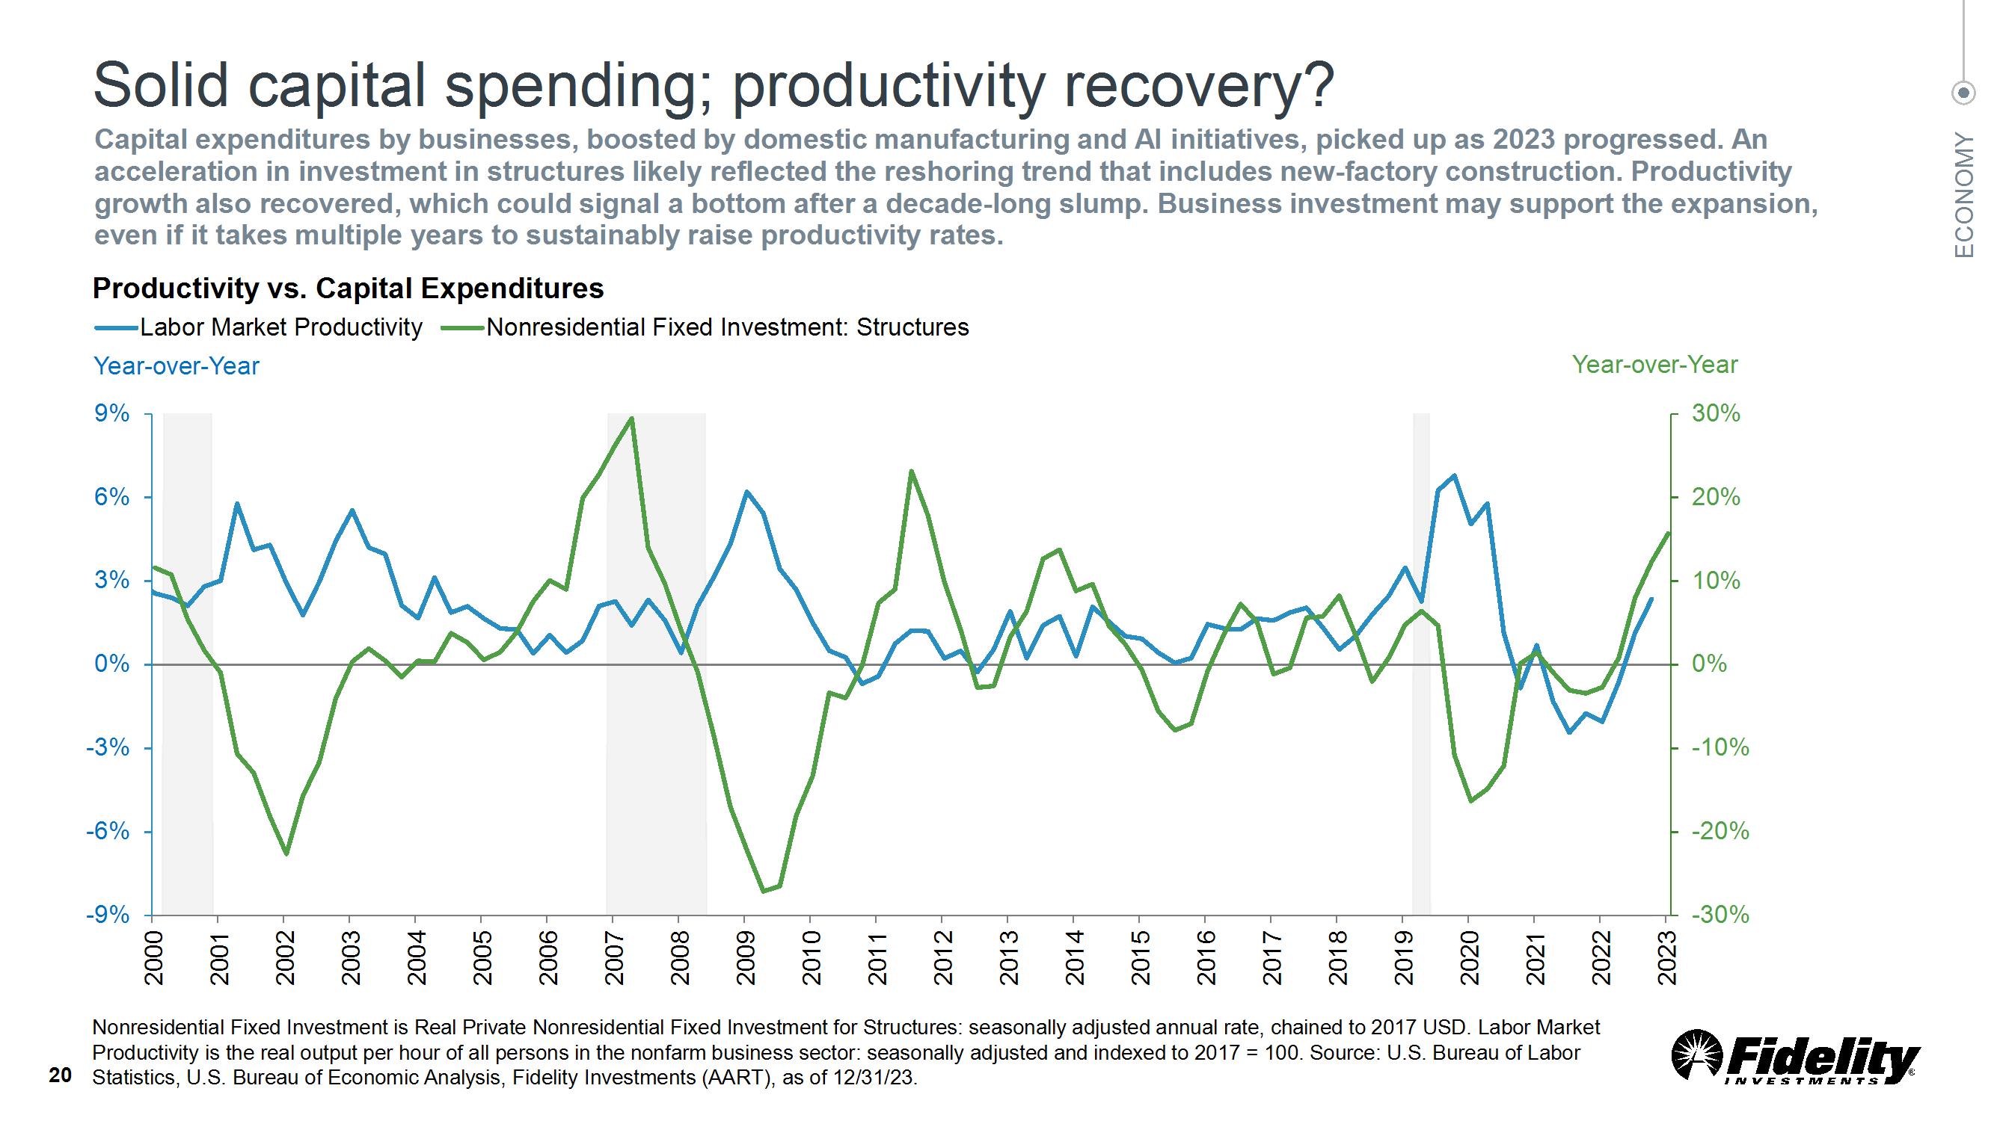

Slide 22
US MONETARY/FISCAL POLICY

Slide 23
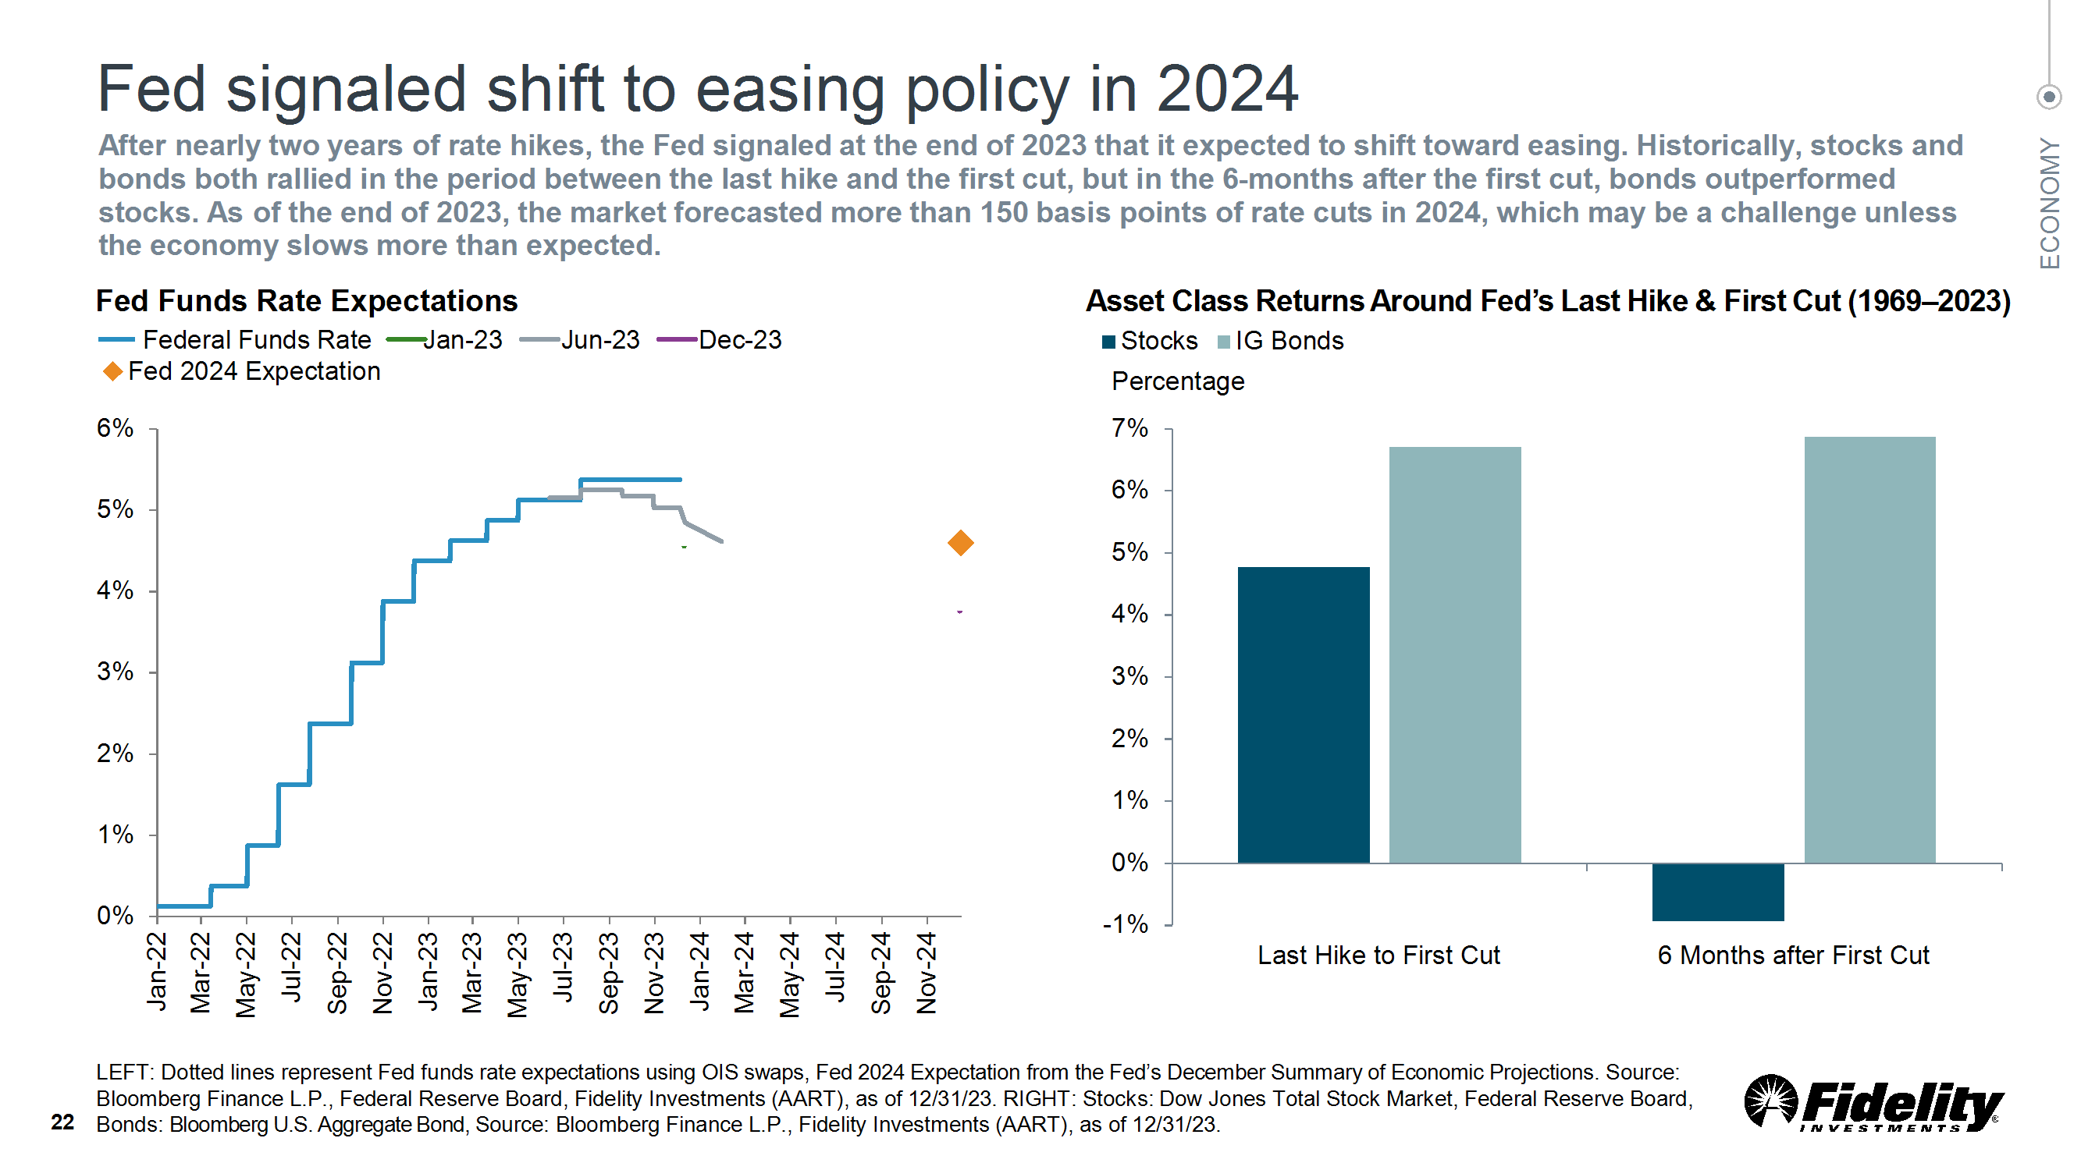

Slide 24
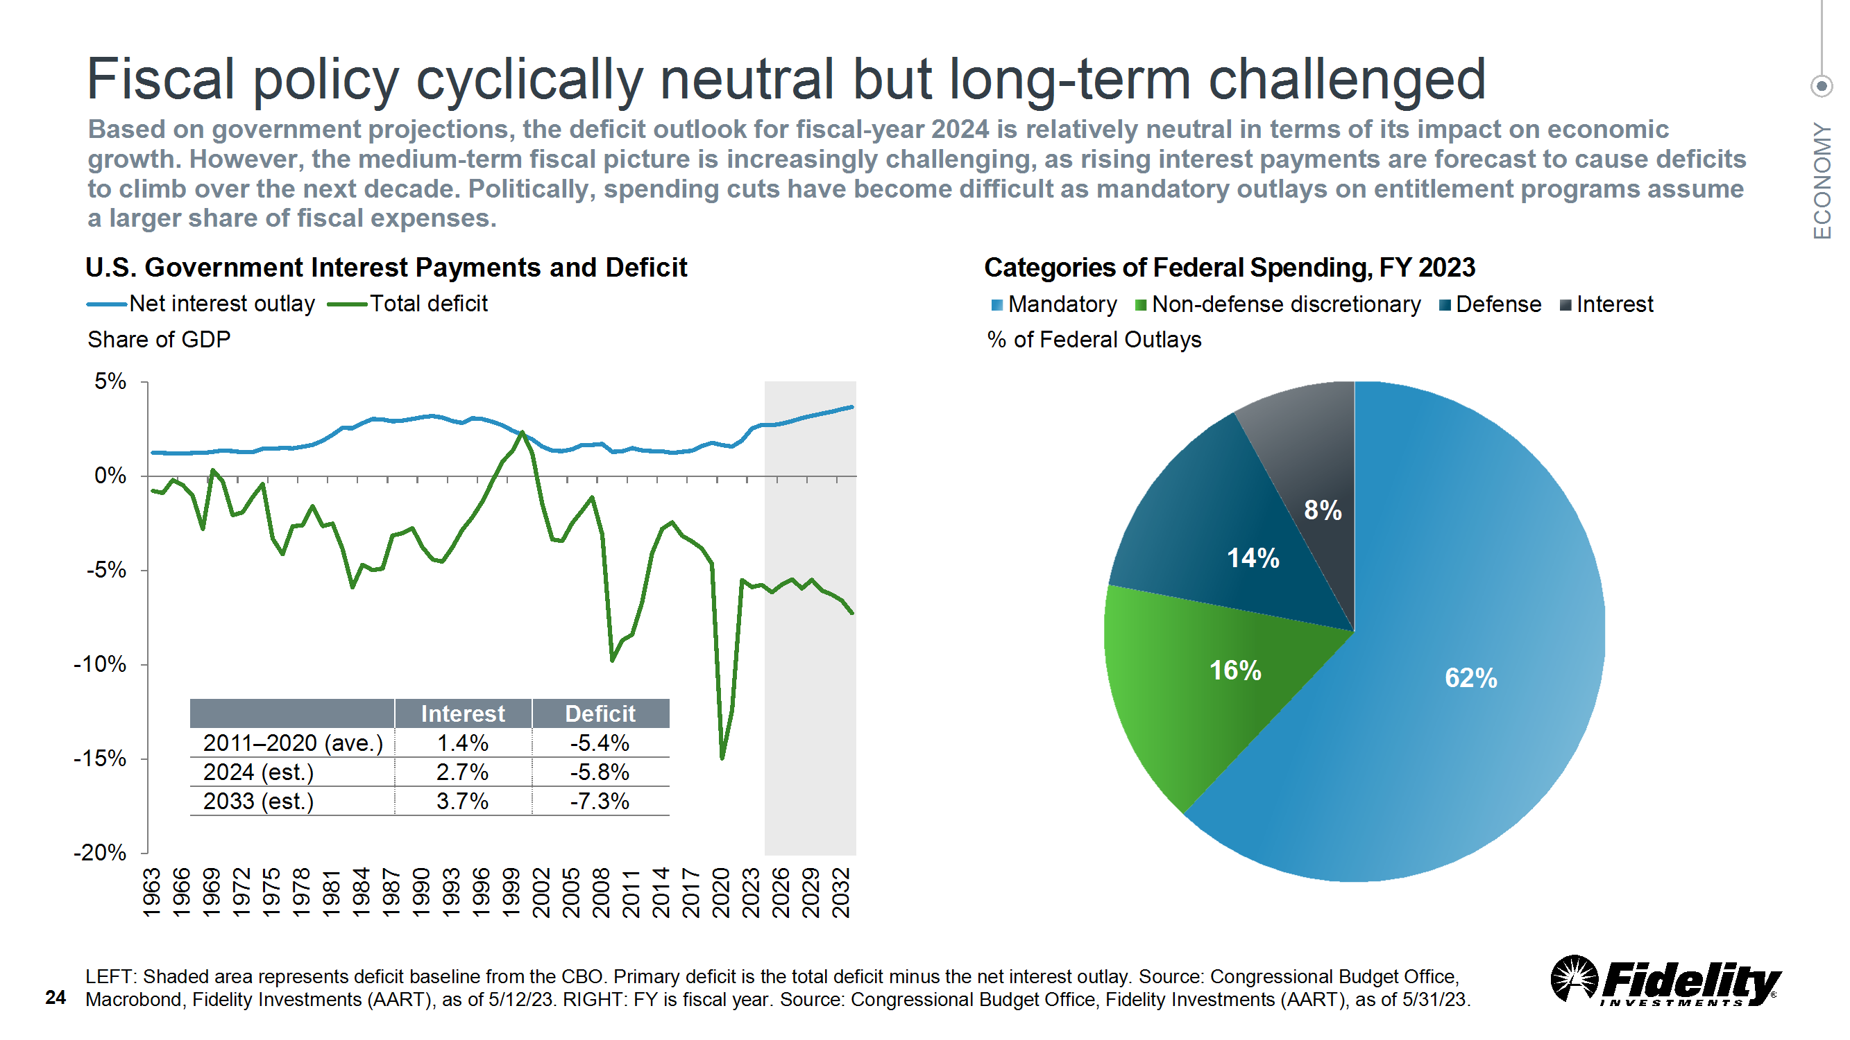

Slide 25
NC ECONOMIC UPDATE

Slide 26
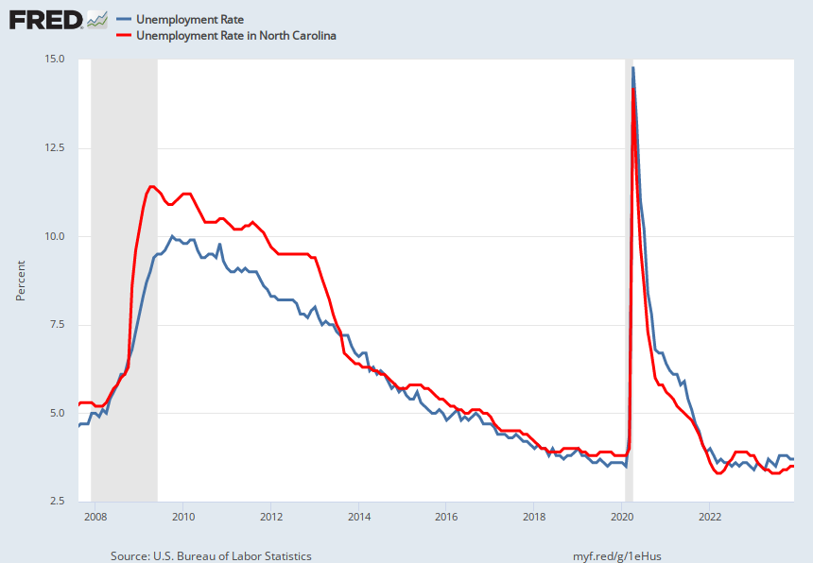
NC Unemployment Rate and the U.S. Rate
NC 3.5% - Dec ’23
US 3.7% - Dec ‘23
Notes:
Source:
U.S. Bureau of Labor Statistics
Release:
Employment Situation
Units:
Percent, Seasonally Adjusted
Frequency:
Monthly
The unemployment rate represents the number of unemployed as a percentage of the labor force. Labor force data are restricted to people 16 years of age and older, who currently reside in 1 of the 50 states or the District of Columbia, who do not reside in institutions (e.g., penal and mental facilities, homes for the aged), and who are not on active duty in the Armed Forces.
This rate is also defined as the U-3 measure of labor underutilization.
The series comes from the 'Current Population Survey (Household Survey)'
The source code is: LNS14000000
U.S. Bureau of Labor Statistics,
Unemployment Rate [UNRATE],
retrieved from FRED,
Federal Reserve Bank of St. Louis;
https://fred.stlouisfed.org/series/UNRATE,
November 3, 2023.
Source:
U.S. Bureau of Labor Statistics
Release:
State Employment and Unemployment
Units:
Percent, Seasonally Adjusted
Frequency:
Monthly
U.S. Bureau of Labor Statistics,
Unemployment Rate in North Carolina [NCUR],
retrieved from FRED,
Federal Reserve Bank of St. Louis;
https://fred.stlouisfed.org/series/NCUR,
November 3, 2023.

Slide 27
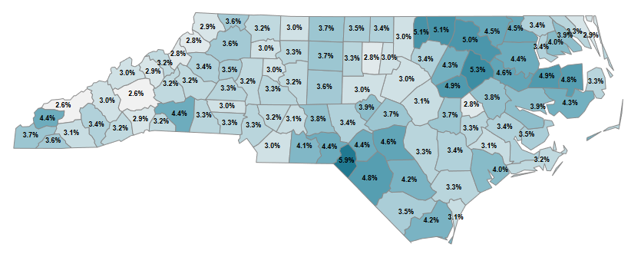
NC Unemployment Rate by County
Source: NC Dept of Commerce, November 2023 Data

Slide 28
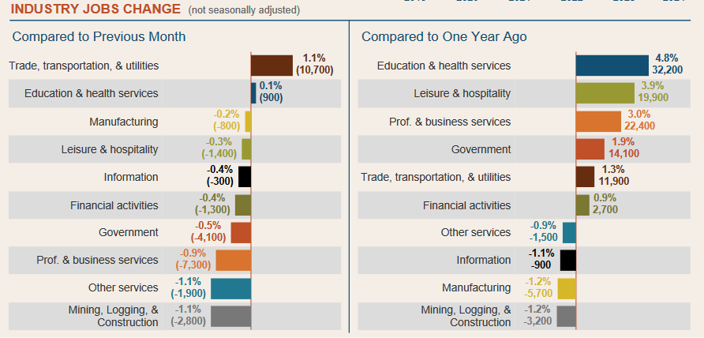
Source: NC Dept of Commerce, November 2023 Data

Slide 29
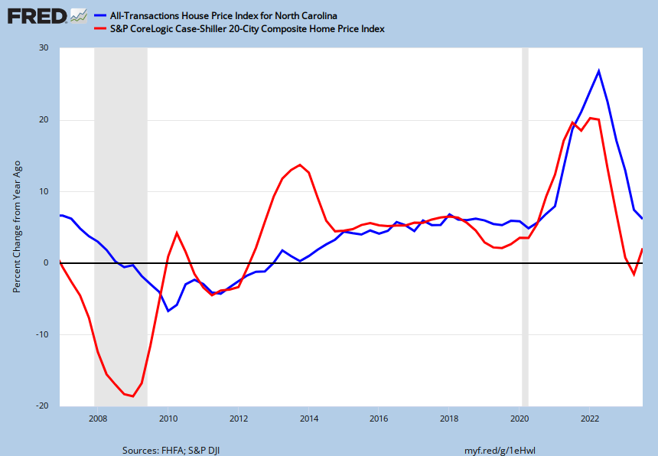
Housing Prices Up in NC and in the U.S.
NC Q3 2023 +6.2%
US Q3 2023 +2.1%
Notes:
Source:
U.S. Federal Housing Finance Agency
Release:
House Price Index
Units:
Index 1980:Q1=100, Not Seasonally Adjusted
Frequency:
Quarterly
Estimated using sales prices and appraisal data.
U.S. Federal Housing Finance Agency,
All-Transactions House Price Index for North Carolina [NCSTHPI],
retrieved from FRED,
Federal Reserve Bank of St. Louis;
https://fred.stlouisfed.org/series/NCSTHPI,
November 3, 2023.
Source:
S&P Dow Jones Indices LLC
Release:
S&P/Case-Shiller Home Price Indices
Units:
Index Jan 2000=100, Seasonally Adjusted
Frequency:
Monthly
For more information regarding the index, please visit Standard and Poor's.Copyright © 2016, S&P Dow Jones Indices LLC. All rights reserved. Reproduction of S&P Case-Shiller 20-City Home Price Index in any form is prohibited except with the prior written permission of S&P Dow Jones Indices LLC "S&P". S&P does not guarantee the accuracy, adequacy, completeness or availability of any information and is not responsible for any errors or omissions, regardless of the cause or for the results obtained from the use of such information. S&P DISCLAIMS ANY AND ALL EXPRESS OR IMPLIED WARRANTIES, INCLUDING, BUT NOT LIMITED TO, ANY WARRANTIES OF MERCHANTABILITY OR FITNESS FOR A PARTICULAR PURPOSE OR USE. In no event shall S&P be liable for any direct, indirect, special or consequential damages, costs, expenses, legal fees, or losses (including lost income or lost profit and opportunity costs) in connection with subscriber's or others' user of S&P Case-Shiller 20-City Home Price Index.Permission to reproduce this series can be requested from index_services@spdji.com. More contact details are available, including phone numbers for all regional offices.
S&P Dow Jones Indices LLC,
S&P/Case-Shiller 20-City Composite Home Price Index [SPCS20RSA],
retrieved from FRED,
Federal Reserve Bank of St. Louis;
https://fred.stlouisfed.org/series/SPCS20RSA,
November 3, 2023.

Slide 31
UNC Charlotte - NC Economic Forecast
Real NC GDP expected to increase by 2.5% (2023) over 2022 levels.
For 2024, real NC GDP is forecast to increase 1.9% over 2023 levels.
For 2024, NC expected to add 53,400 net jobs, +0.9%
Strongest Expected Growth Sectors (2023 GDP)
  Information (11.1%)
  Education and Health Services (6.7%)
  Transportation, Warehousing &Utilities (6.7%)
Strongest Expected Growth Sectors (2024 GDP)
  Information (4.8%)
  Transportation, Warehousing & Utilities (3.6%)
  Mining (3.5%)
Source: /UNC Charlotte Economic Forecast 12/14/23

Slide 32
2024 OUTLOOK

Slide 33
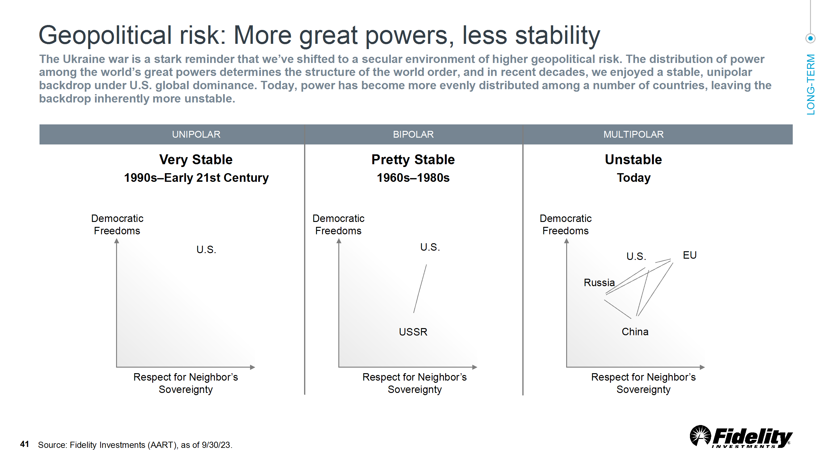

Slide 34
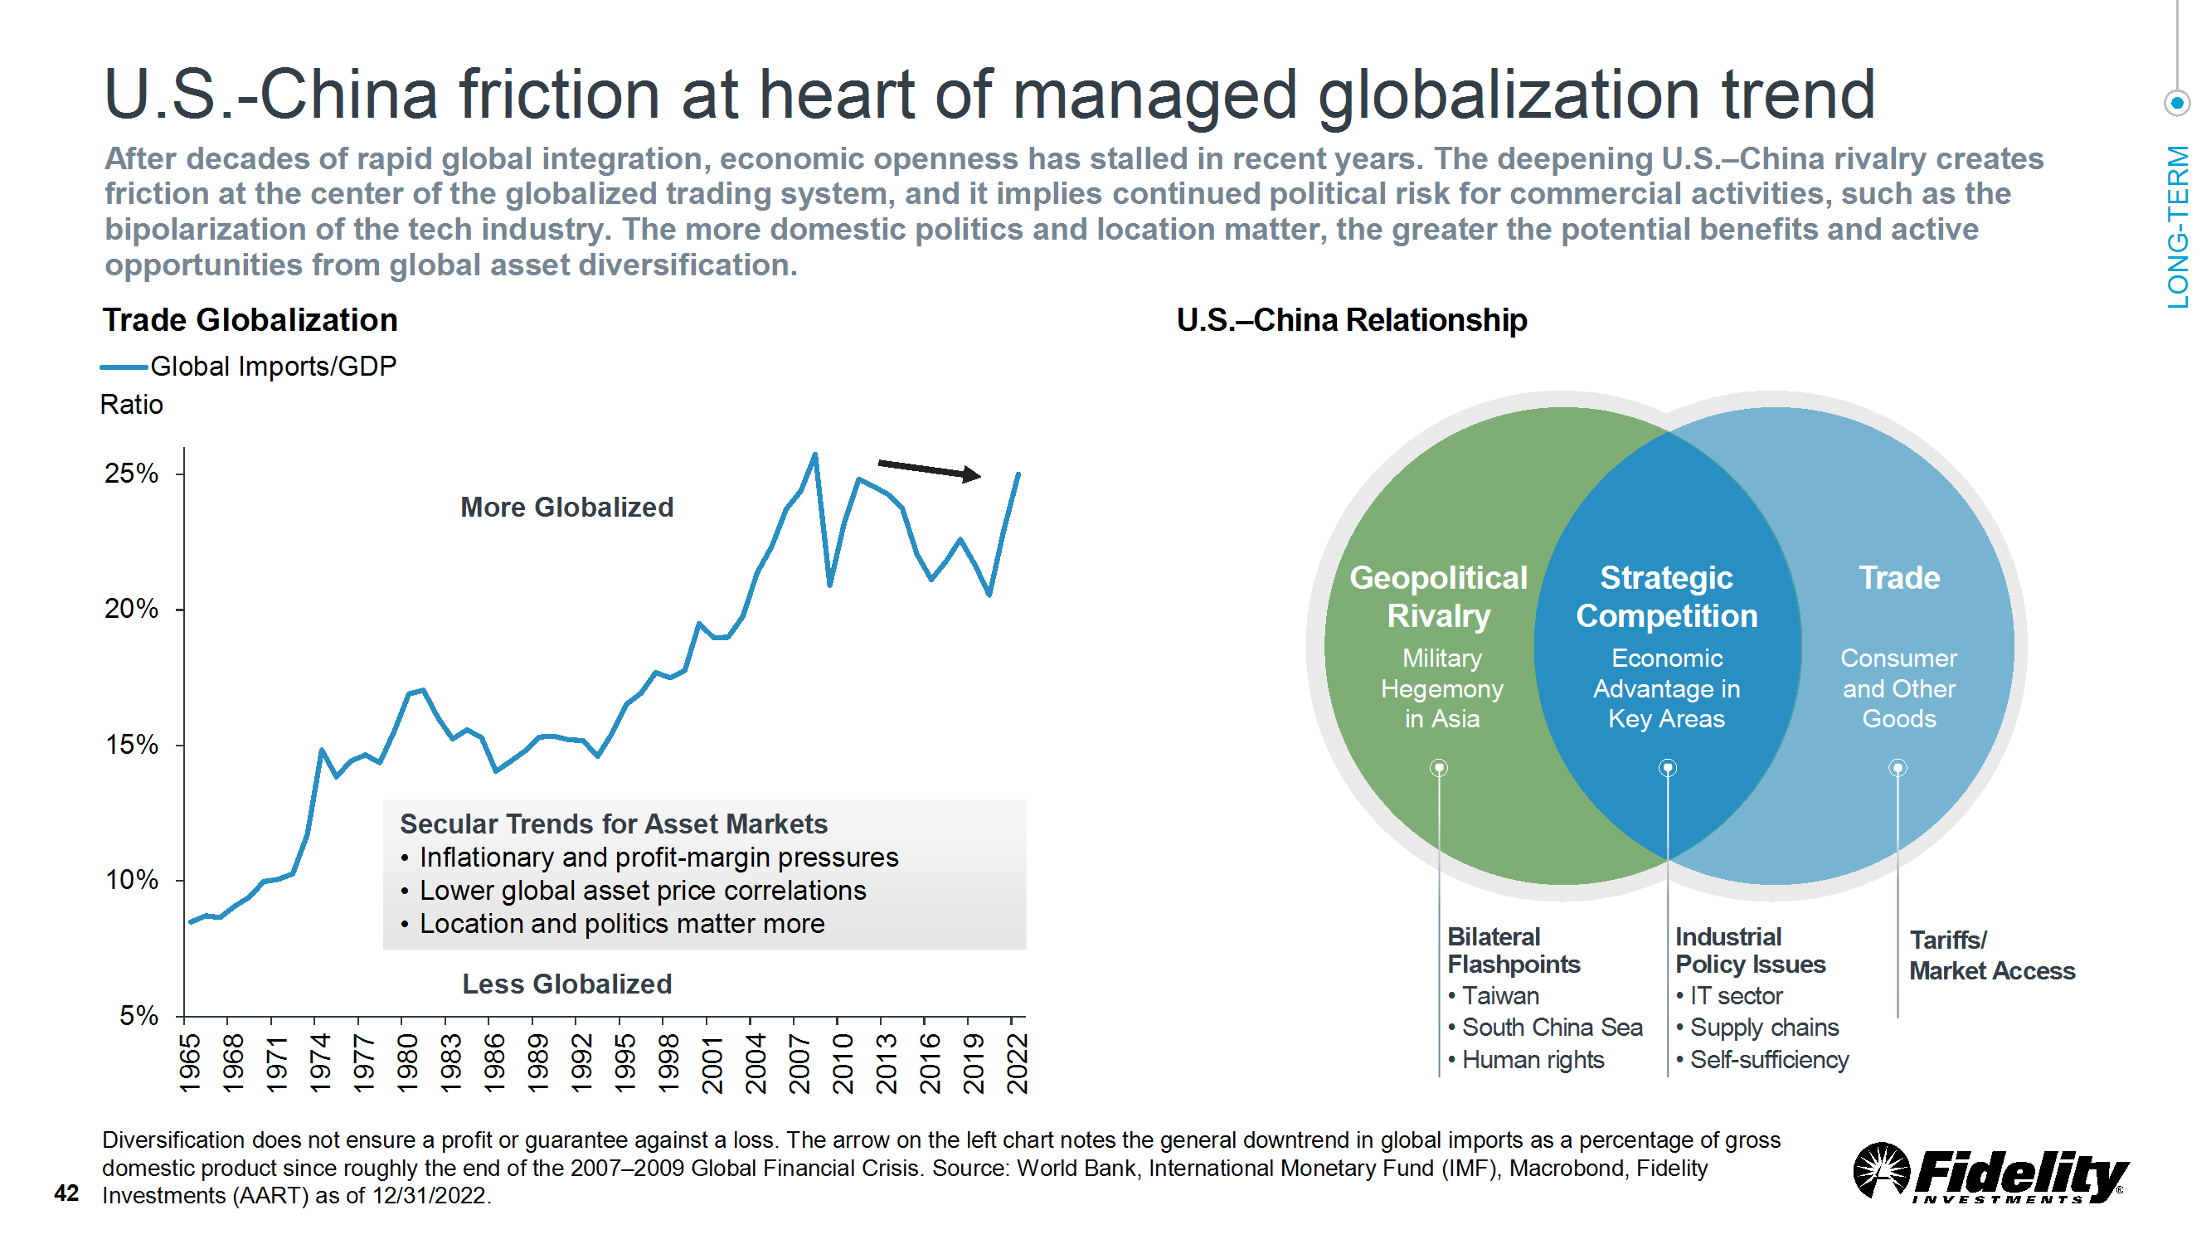

Slide 35
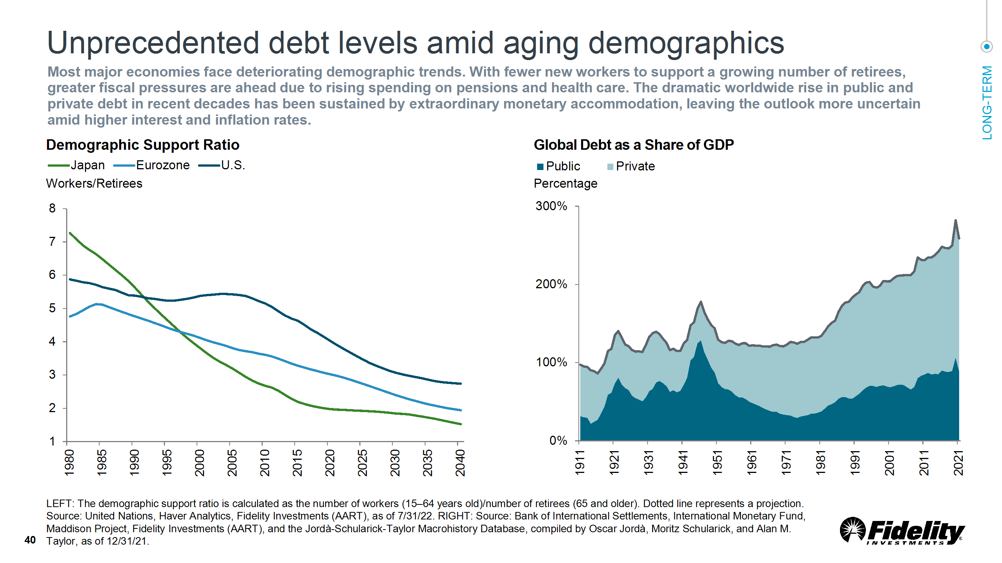

Slide 36
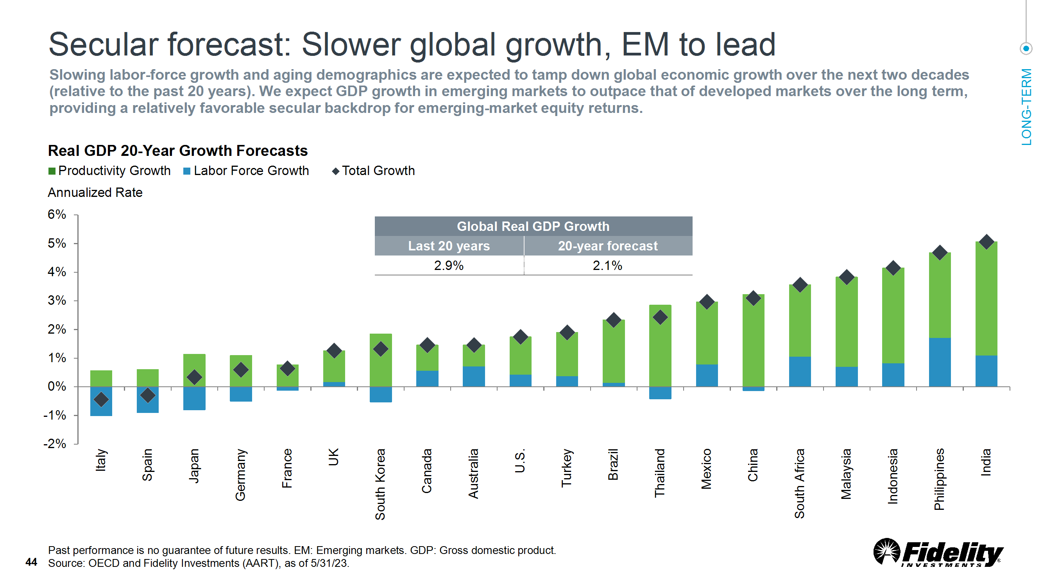

Slide 37
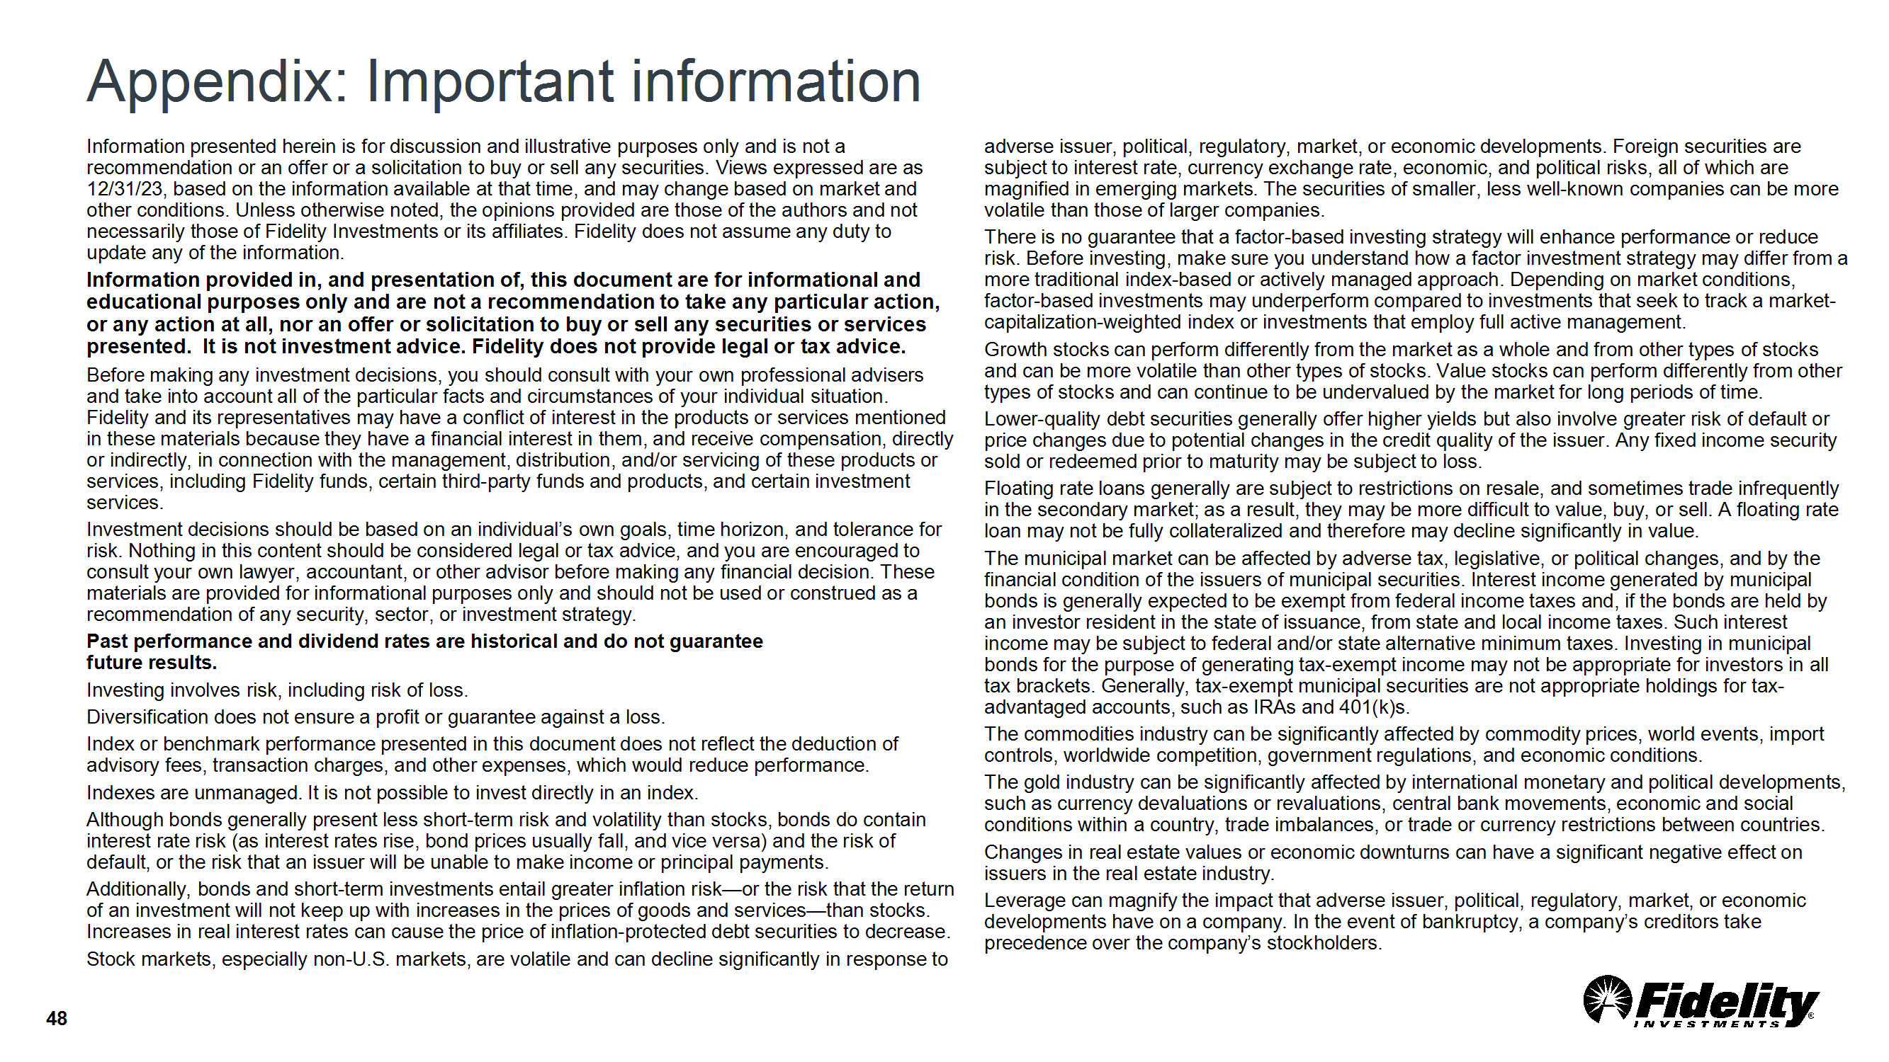

Slide 38
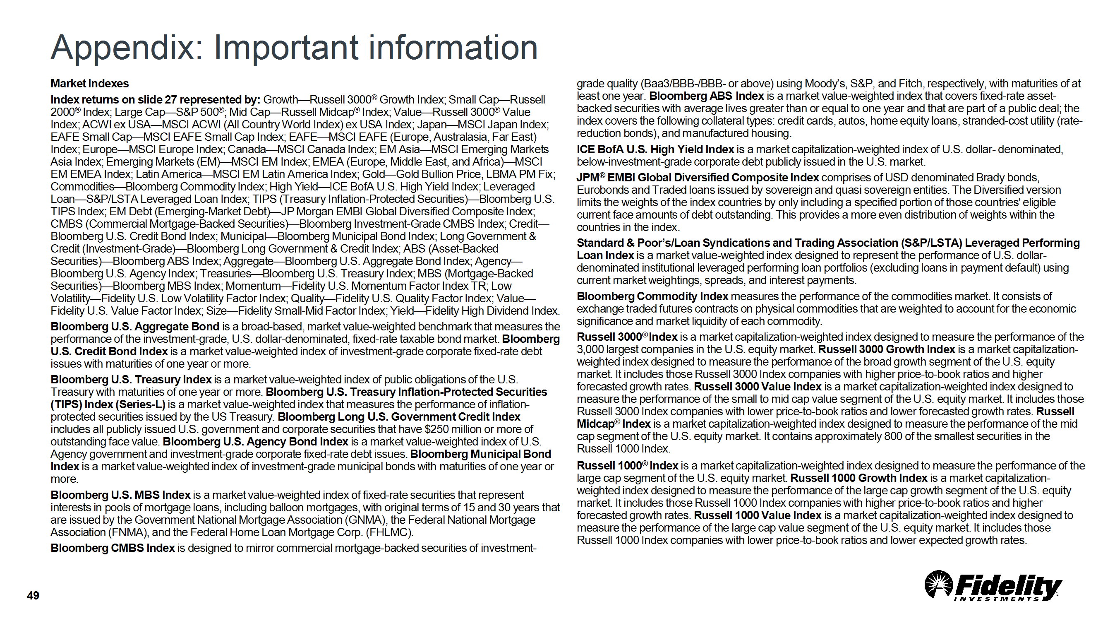

Slide 39
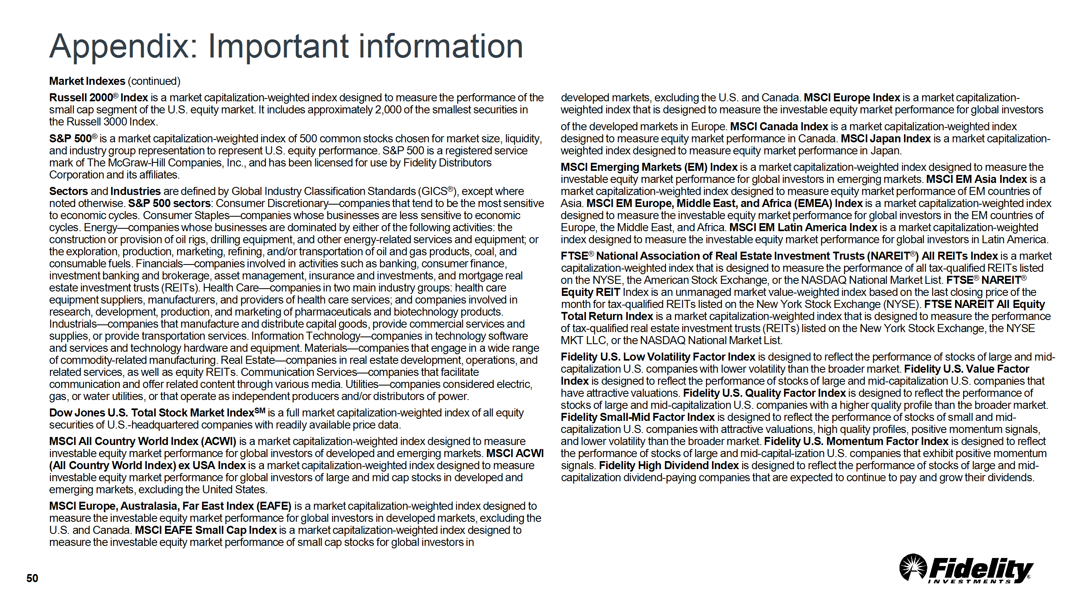

Slide 40
